Slide 1

for
Office-Based Care Online
Innovative Training Techniques to Introduce and Reinforce TeamSTEPPS Skills in the Office-Based Care Setting

Slide 2
This Webinar and Future Webinars
This webinar is part of a library to support and amplify your work on TeamSTEPPS
TeamSTEPPS for Office-Based Care Online funded by AHRQ

Slide 3
Rules of Engagement
Dial-in: 1-877-410-5657 Passcode: 165984
Questions are encouraged throughout the presentation and will be answered at the end.
  To submit a question, type it into the Chat Area and send it at any time during the presentation.
An evaluation will be emailed to you shortly after the webinar.

Slide 4
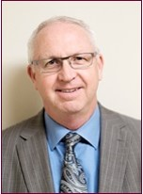
Presenter
Ross Ehrmantraut, RN
Clinical Director of Team Performance
University of Washington Medicine
WWAMI Institute for Simulation in Healthcare
rherma@uw.edu

Slide 5
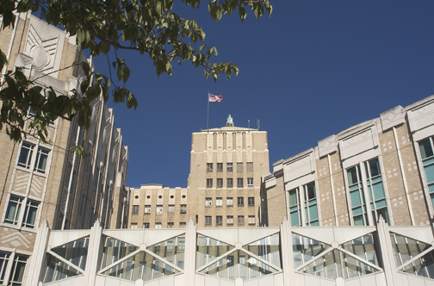
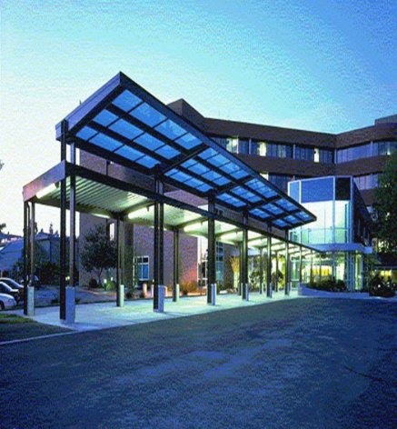
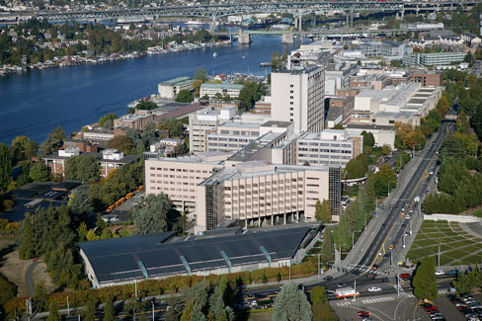
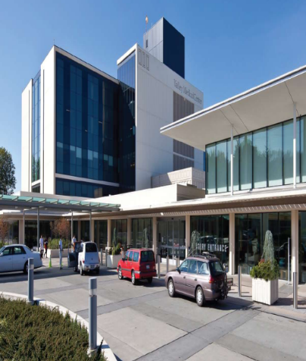
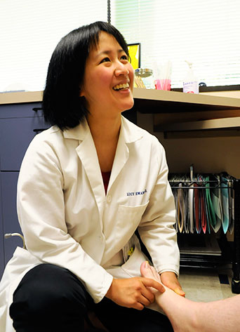
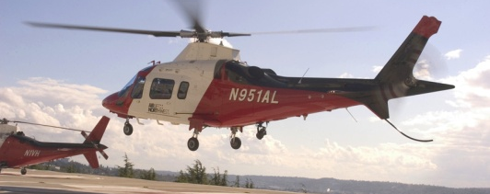
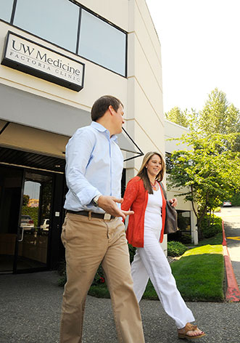
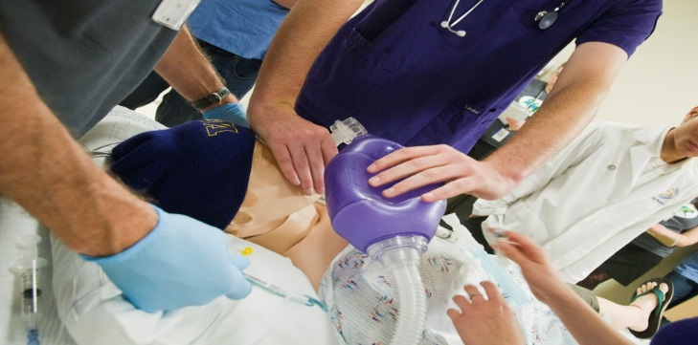
UW Medicine

Slide 6
Objectives
Demonstrate how UW has enhanced training and reinforced the use of TeamSTEPPS tools in different settings and multiple audiences through short, high impact sessions.
Identify low tech simulations/exercises that can be easily customized for training in the outpatient setting.
Discuss quick win tools such as Closed-Loop Communication, SBAR, CUS, Briefs, Huddles, and Debriefs.

Slide 7
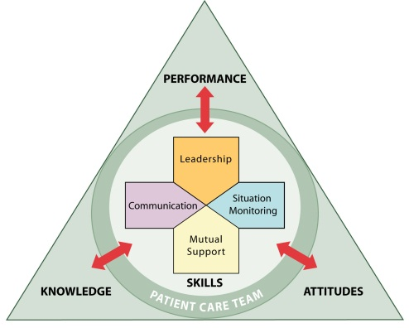
TeamSTEPPS

Slide 8
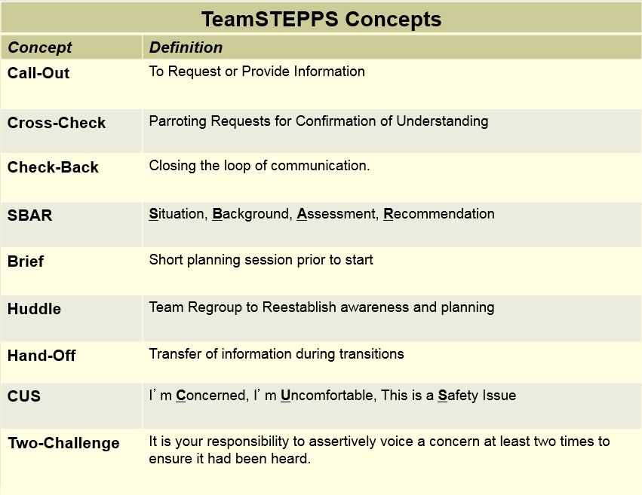

Slide 9
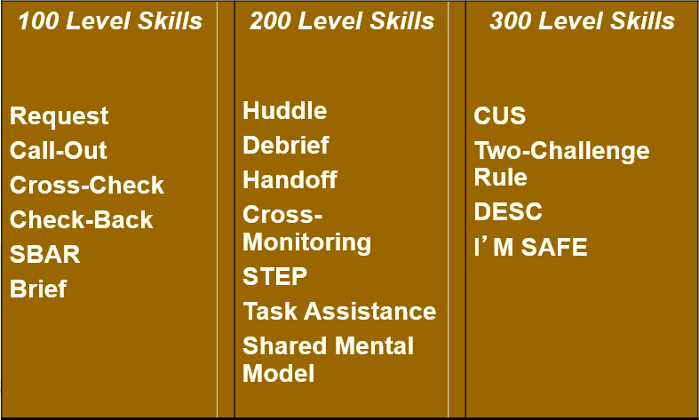
Review of Skills

Slide 10
Issues
Difficult to get anything but short training sessions without closing the clinic or conducting retreats on a weekend
Larger clinics have staggered start/end times
Others?

Slide 11
What We’ve Learned
Need leadership support – provider and administration
Work around the clinic schedule – generally 45-90 minutes
  Staff meetings
  Take advantage of any time they make available
  Early mornings before clinic, or evenings after clinic
  May need to repeat the same training multiple times to deliver message to everyone
Best Scenario
  Two to four hour retreats outside of clinic times

Slide 12
What We’ve Learned
Everyone needs to find the value in the tool/concepts being introduced
  WIFM Radio
Don’t do ice breakers – do simulations/activities that reinforce the tools/concepts of TeamSTEPPS
  Debrief with a focus on the teamwork and communication
Develop a change team
  Ownership vs. buy-in

Slide 13
Typical Short Training Session
Why are we here?
  IOM report, Journal of Patient Safety, Ambulatory care data:
    More than 1 billion ambulatory visits
    12 million ambulatory care patients experience a diagnostic error
    Paid medical liability claims (Bishop et al, 2013)
    Half arose from events in the outpatient setting
    76% due to errors in diagnosis or treatment
  If a follow up training, review previous sessions
A story related to what tool we’re reinforcing/teaching
  Afrin Story for Closed Loop Communication
TRIZ – first session only

Slide 14
Typical Short Training Session (cont.)
Introduction to the tools
Interactive exercise(s)
Debrief

Slide 15
TRIZ
Theory of Inventive Problem Solving
How can I ensure our clinic will reliably fail as a functioning team?
1-2-4-All
Liberating Structures http://www.liberatingstructures.com

Slide 16
TRIZ
Theory of Inventive Problem Solving
How can I ensure our clinic will reliably fail as a functioning team?
Am I doing any of these things?
Liberating Structures http://www.liberatingstructures.com

Slide 17
Key Tools and Concepts to Gain Short Term Wins
Communication
  Closed-Loop Communication
  SBAR
Leading Teams
  Briefs, Huddles, Debriefs
Situation Monitoring
  Shared Mental Model – one piece of information can change an outcome
Mutual Support
  CUS, Two-Challenge Rule

Slide 18
Debrief
Debriefing is where the majority of the learning occurs
  What went well?
  What could have gone better?
  One thing you will do differently next time?
ALWAYS bring the debrief back to how we worked and communicated as a team

Slide 19
Team Training Tower
Three exercises, with each exercise becoming more difficult
Reinforces all the TeamSTEPPS tools/concepts
Faculty guide available
Need at least 90 minutes to do all three exercise
  Have split into two shorter sessions

Slide 20
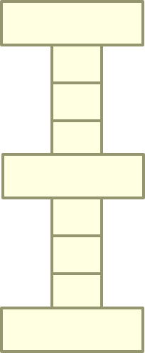
Exercise
Rules:
You have 1 MINUTE to build the tallest tower
You must follow the building pattern shown:
  1 LARGE, 3 SMALL
No two of the same color may touch
There are:
  RUNNERS – only can be runners
  BUILDERS – only can be builders
ONLY 5 items per runner
All unused materials must be returned before ‘TIME’ is called

Slide 21
Exercise
Rules:
• You have 30 SECONDS to BRIEF as a team
You have 2 MINUTES to build the tallest tower
• You must follow the building pattern outlined in the algorithm.
• There are:
RUNNERS – only can be runners
BUILDERS– only can be builders
• ONLY 5 items per runner
• All unused materials must be returned
before ‘TIME’ is called

Slide 22
Mr. Potato Head
This exercise reinforces the following tools:
  Closed loop communication
  Brief, huddles, debrief
May have to use:
  CUS, Two-Challenge

Slide 23
Mr. Potato Head
Your team has been tasked with reassembling the MVA victims
Roles include:
  Triage (will have photo IDs and group photos of patients before the crash)
  Whatever other roles the team assigns (e.g., surgeon, nurse, coordinator, etc.)
Rules:
  Only Triage can see the pictures of the patients and must relay this information to the rest of the team
  Triage cannot see what the team is doing (back is turned toward the group)
  Triage may not change roles once times starts because they will have seen the pictures
You will have 30 seconds to brief and select roles
You will have 10 minutes to put your patients back together
DO NOT START until we say GO!
DEBRIEF

Slide 24
SBAR Simulations
Short bursts of SBAR education
Reinforces the use of SBAR
Effective for:
  Telephone Encounters
  Front desk personnel communication to clinical staff/providers
  General communication throughout clinic

Slide 25
Situation: What is happening RIGHT NOW that you need to communicate
Minti, a 58 year old female with a history of A-fib and hypertension arrives to the clinic (echo lab) as a new patient. She has been living in Spokane until recently and was inconsistent, according to her daughter, with compliance with her meds and attending her appointments. So, her daughter has recently had her move in with her in West Seattle.
Minti’s daughter, who serves as her mom’s interpreter, tells the front desk person that Minti has been lethargic and has had a cough for three days. The MA finishes rooming the patient and takes admit vitals which are: Temp 37.8, HR 122 and irregular, BP 178/98, Sats 88% and RR is 28. The mom appears to be having some difficulty breathing. Her daughter is concerned because she thinks her mom is not taking her meds consistently. She also has three children, which will make it hard for her to care for her mom.
INTRODUCTION
SITUATION
BACKGROUND
ASSESSMENT
RECOMMENDATION
Situation:
A 58 year old woman has arrived hypertensive, is lethargic, has a cough and is short of breath
R

Slide 26
Background: What is the RELEVANT history for what is happening right now that you need to communicate
Minti, a 58 year old female with a history of A-fib and hypertension arrives to the clinic (echo lab) as a new patient. She has been living in Spokane until recently and was inconsistent, according to her daughter, with compliance with her meds and attending her appointments. So, her daughter has recently had her move in with her in West Seattle.
Minti’s daughter, who serves as her mom’s interpreter, tells the front desk person that Minti has been lethargic and has had a cough for three days. The MA finishes rooming the patient and takes admit vitals which are: Temp 37.8, HR 122 and irregular, BP 178/98, Sats 88% and RR is 28. The mom appears to be having some difficulty breathing. Her daughter is concerned because she thinks her mom is not taking her meds consistently. She also has three children, which will make it hard for her to care for her mom.
INTRODUCTION
SITUATION
BACKGROUND
ASSESSMENT
RECOMMENDATION
Background:
A new patient moved here from Spokane with hx of Afib and hypertension. Has been inconsistent with taking meds and attending appointments. Doesn’t speak English – daughter interpreting

Slide 27
Assessment:
What are the PERTINENT findings for what is happening right now that you need to communicate – what’s going on
Minti, a 58 year old female with a history of A-fib and hypertension arrives to the clinic (echo lab) as a new patient. She has been living in Spokane until recently and was inconsistent, according to her daughter, with compliance with her meds and attending her appointments. So, her daughter has recently had her move in with her in West Seattle.
Minti’s daughter, who serves as her mom’s interpreter, tells the front desk person that Minti has been lethargic and has had a cough for three days. The MA finishes rooming the patient and takes admit vitals which are: Temp 37.8, HR 122 and irregular, BP 178/98, Sats 88% and RR is 28. The mom appears to be having some difficulty breathing. Her daughter is concerned because she thinks her mom is not taking her meds consistently. She also has three children, which will make it hard for her to care for her mom.
INTRODUCTION
SITUATION
BACKGROUND
ASSESSMENT
RECOMMENDATION
Assessment:
  Her BP is 178/98, Sats 88%, lethargic. HR 122 and
  irregular
R

Slide 28
Recommendation:
Make a recommendation for what you think should happen next – NOT ”what do you want to do?”
Minti, a 58 year old female with a history of A-fib and hypertension arrives to the clinic (echo lab) as a new patient. She has been living in Spokane until recently and was inconsistent, according to her daughter, with compliance with her meds and attending her appointments. So, her daughter has recently had her move in with her in West Seattle.
Minti’s daughter, who serves as her mom’s interpreter, tells the front desk person that Minti has been lethargic and has had a cough for three days. The MA finishes rooming the patient and takes admit vitals which are: Temp 37.8, HR 122 and irregular, BP 178/98, Sats 88% and RR is 28. The mom appears to be having some difficulty breathing. Her daughter is concerned because she thinks her mom is not taking her meds consistently. She also has three children, which will make it hard for her to care for her mom.
INTRODUCTION
SITUATION
BACKGROUND
ASSESSMENT
RECOMMENDATION
Recommendation:
  I think she needs to be seen right away and we might want to consider sending her to the ED

Slide 29
SBAR Simulation
Mr. Smith called and he was wondering if he can get off methotrexate since he has been getting bad sinus infections that he needed antibiotics and after that he had a severe cold that took over 6 weeks to get over the really bad cold. Ever since he got off the Entyvio study at which time he was getting the Entyvio infusion every 4 weeks and now he is getting it every 8 weeks covered by his insurance which denied paying for it every 4 weeks, he was put on methotrexate to try and keep the IBD from flaring due to longer period of time between infusions. Since he started methotrexate he feels like his immune system is very compromised and every time one of his kids gets sick or a cold he really gets it back. He does feel like his GI was doing better while he was on the Entyvio every 4 weeks compared to now every 8 weeks, but the symptoms are manageable. I asked him to please continue taking the methotrexate as prescribed until he hears back from us with MD’s recommendations.
Mr. Smith saw his rheumatologist for nodules/cysts to his hands and had an X-ray done and he has stiffness to hands. The rheumatologist didn't have anything to offer in regards to what the nodule/cysts to hands were.
Scheduled him in for a f/u appt with MD on 1/17/17 since he has been seen since 6/2016.

Slide 30
Situation:
Mr. Smith called and would like his methotrexate discontinued because he’s been getting bad sinus infections, requiring abx, and colds. He feels like his immune system is “very” compromised since starting methotrexate
Background:
He was put on methortrexate to keep the IBD from flaring up in between Entyvio doses when he went from Entyvio infusions every eight weeks instead of every four weeks due to insurance coverage.
Assessment:
Pt. felt he was doing better when Entyvio was every four weeks, but he feels the symptoms are currently manageable
Recommendation/Request:
I encouraged him to continue with the methotrexate until he can have a follow up appt with you, which is now scheduled for Jan 17

Slide 31
SBAR Simulations
Provide them with a blank answer sheet
Consider using Liberating Structures activity:
  1-2-4-all
    Encourages all to participate

Slide 32
Shared Mental Model

Slide 33





Slide 34
The Emergency
Shared mental model
Assumptions that break down a shared mental model

Slide 35
The Emergency – A Story
The crying child in room 602 stopped suddenly and was silent. Immediately a man cried “help”. A nurse raced in to check the patient. A doctor was called. Two medications were delivered by a pharmacist and administered. The doctor was called again. A woman with a white coat and a stethoscope around her neck entered the room and introduced herself. The doctor checked the patient and insisted he be transferred to the intensive care unit. The pharmacist asked why the transfer was necessary. Two nurses accompanied the child in a wheelchair.

Slide 36
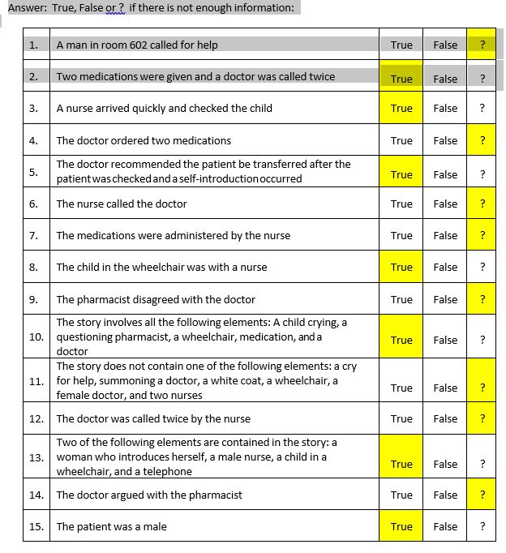

Slide 37
Staged Simulations
Disruptive Patient/Visitor
Seizure in the waiting room
Facilitates the following TeamSTEPPS concepts
  Leadership – identifying a situational leader
  Situational Awareness
Specific Tools
  Briefs, Huddles, Debriefs
  CUS, Two-Challenge Rule

Slide 38
Measurement
Start easy…
  Did the brief occur?
    Did the brief provide any information that otherwise not everyone would have known?
  Did the debrief occur?
    Were there any changes from debrief?
Behavioral measures
  AHRQ TeamSTEPPS T-TPQ survey pre/post

Slide 39
Results
Improved efficiency
  Physical environment
  Clinic flow
Improved employee satisfaction
Improved patient satisfaction
Improved T-TPQ post survey

Slide 40
Liberating Structures
Activities to enhance the training (and meetings) experience
Liberating Structures
  http://www.liberatingstructures.com

Slide 41
Presenter Information
Ross Ehrmantraut, RN
Clinical Director of Team Performance
University of Washington Medicine
WWAMI Institute for Simulation in Healthcare
rherma@uw.edu

Slide 42
Resources
TeamSTEPPS
https://www.ahrq.gov/teamstepps/index.html
Liberating Structures http://www.liberatingstructures.com
Bishop TF. Paid malpractice claims for adverse events in inpatient and outpatient settings. JAMA. 2011;305 ( 23 ): 2427 – 2431.
Institute of Medicine. To Err Is Human: Building a Safer Health Care System. Washington DC: National Academy Press; 1999.
Singh H, Meyer, A, Thomas, EJ, The frequency of diagnostic errors in outpatient care: estimations from three large observational studies involving US adult populations. BMJ. 2014 Volume 23, issue 9

Slide 43
Questions

