Slide 1
AHRQ Safety Program for Improving Antibiotic Use
The "Sometimes Antibiotics" Diagnoses: Acute Otitis Media in Children
Ambulatory Care
AHRQ Pub. No. 17(22)-0030
September 2022

Slide 2
Objectives
Describe the pathophysiology and clinical presentation of acute otitis media (AOM)
Identify criteria for the diagnosis of AOM
Use a clinical case to demonstrate evidence-based recommendations for the management of AOM

Slide 3
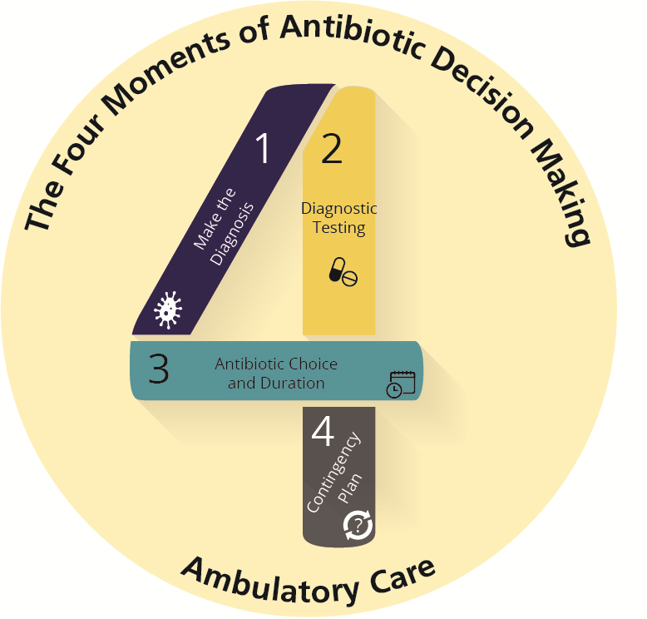
The Four Moments of Antibiotic Decision Making
Does my patient have an infection that requires antibiotics?
Do I need to order any diagnostic tests?
If antibiotics are indicated, what is the narrowest, safest, and shortest regimen I can prescribe?
Does my patient understand what to expect and the followup plan?

Slide 4
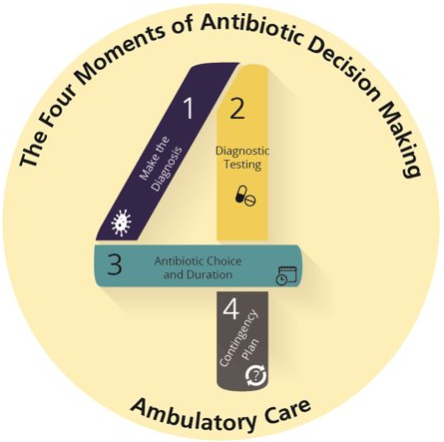
The Four Moments of Antibiotic Decision Making
Does my patient have an infection that requires antibiotics?

Slide 5
What Is AOM?^{1,2}
Moderate to severe bulging of the tympanic membrane or new onset otorrhea with signs and symptoms of middle-ear inflammation such as ear pain and fever
Most common symptom-causing bacteria:^{3,4}
Nontypeable Haemophilus influenzae, Moraxella catarrhalis, and Streptococcus pneumoniae
H. influenzae accounts for about 50–60% of cases since widespread use of pneumococcal vaccine
S. pneumoniae AOM is more likely to cause significant complications such as mastoiditis or meningitis

Slide 6
Risk Factors^{1,5}
Most common age of occurrence: 6 months to 24 months of age
Rarely occurs in school-age children or adolescents
Younger children have structural differences in their eustachian tubes
Developing immune system

Slide 7
How Does AOM Develop?¹
Viral upper respiratory tract infection (most common) – edema and inflammation of nasopharynx and eustachian tube
Obstruction of the eustachian
tube and fluid accumulation in the middle ear
Proliferation of bacteria routinely found in the nasopharynx (such as S. pneumoniae) in the middle ear; fluid accumulation
Infection of the fluid that manifests as bulging of the tympanic membrane and the classic symptoms of acute otitis media

Slide 8
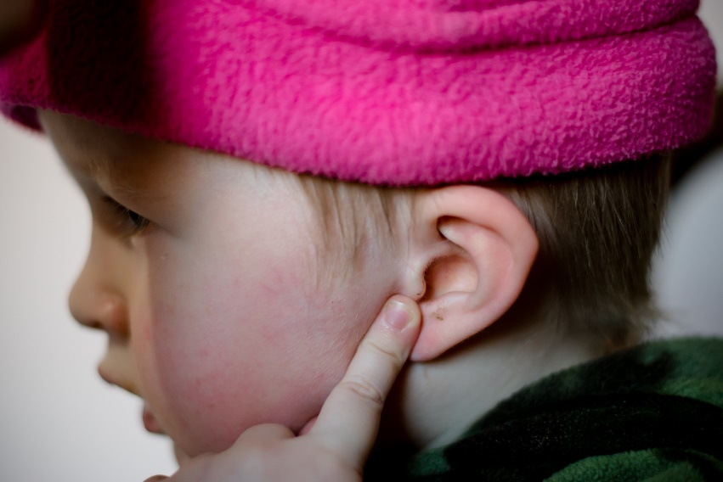
Clinical Case
One-year-old child
Two days of poor sleep
Not eating well
Holding hand over left ear
Temperature 100.4 degrees Fahrenheit

Slide 9
Moment 1⁶
About half of children with otitis media are febrile
Mild Signs and Symptoms
Severe Signs and Symptoms
Otalgia for less than 48 hours and temperature less than 102.2 degrees Fahrenheit​
Moderate to severe otalgia​ ​
Otalgia lasting at least 2 days​ ​
Temperature of 102.2 degrees Fahrenheit or greater​

Slide 10
When Antibiotics Are Indicated^{6,7}
Child Age
< 6 months
Antibiotic therapy is reasonable.^{8,9}
6 months to 2 years
Otorrhea or bilateral otitis media (with or without otorrhea): Antibiotic therapy. Unilateral otitis media without otorrhea: Either antibiotic therapy or observation if symptoms are mild. If symptoms worsen or if no improvement within 48–72 hours, start antibiotics.
6 months and older
Children 6 months and older with otorrhea have high likelihood for tympanic membrane rupture, and antibiotics are indicated at any age
> 2 years
Otorrhea with otitis media : Antibiotic therapy. Bilateral or unilateral otitis media (without otorrhea): Either antibiotic therapy or observation if symptoms are mild. If symptoms worsen or no improvement within 48–72 hours, start antibiotics.
Treat with antibiotics (any age)
Severe symptoms with ear findings (severe otalgia, otalgia lasting at least 2 days, or if no improvement, or if T ≥ 102.2°F) with unilateral OR bilateral ear findings

Slide 11
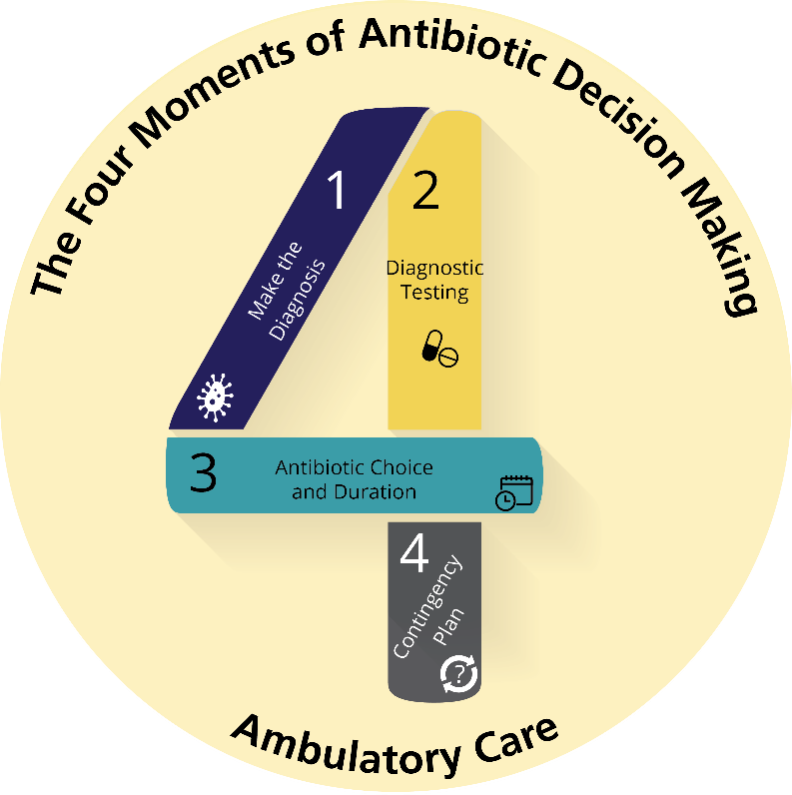
The Four Moments of Antibiotic Decision Making
Does my patient have an infection that requires antibiotics?
Do I need to order any diagnostic tests?

Slide 12
Moment 2
Empiric antibiotics prescribed based on the presumption of a bacterial infection and knowledge of the common bacteria anticipated to be recovered⁶
Consider referral to a specialist if child multiple courses of antibiotic therapy did not work or the child has had frequent ear infections where there is a concern for increasingly antibiotic-resistant organisms

Slide 13
The Four Moments of Antibiotic Decision Making
Does my patient have an infection that requires antibiotics?
Do I need to order any diagnostic tests?
If antibiotics are indicated, what is the narrowest, safest, and shortest regimen I can prescribe?

Slide 14
Moment 3⁶
Pain management should always be part of the treatment plan
First-line treatment
High-dose amoxicillin
High-dose amoxicillin-clavulanate is first line if recent amoxicillin use or concurrent conjunctivitis¹⁰⁻¹³
First-line treatment in setting of penicillin allergy
Nonsevere allergy: Second- or third-generation cephalosporins
Severe allergy: Levofloxacin

Slide 15
Duration of Antibiotic Therapy^{6,14,15}
Age | Younger than 2 years | 2–5 years with mild to moderate acute otitis media | 6 years+ with mild to moderate symptoms | Any age with severe symptoms
Course | 10-day course | 7-day course | 5- to 7-day course | 10-day course

Slide 16
The Four Moments of Antibiotic Decision Making
Does my patient have an infection that requires antibiotics?
Do I need to order any diagnostic tests?
If antibiotics are indicated, what is the narrowest, safest, and shortest regimen I can prescribe?
Does my patient understand what to expect and the followup plan?

Slide 17
Moment 4
Clinical symptoms should begin improving within 48–72 hours of treatment⁶
Counsel caregivers on signs of acute mastoiditis^{16,17}
Post-auricular tender mass or protrusion of the earlobe
Refer to emergency department
Persistent middle-ear effusion may be present in 60–70% of children two weeks after successful AOM treatment⁶

Slide 18
Moment 4, Continued^{6,18}
Children with persistent, symptoms after 48 to 72 hours of antibiotics
Consider amoxicillin/clavulanate OR intramuscular ceftriaxone for up to 3 days
Worsening, severe symptoms warrant an emergency department visit
Refer to specialist for persistence of symptoms despite antibiotic change or recurrent infections

Slide 19
Take-Home Messages
In children of any age with AOM and severe symptoms, antibiotics should be considered
Antibiotics reasonable for infants with AOM under 6 months of age
Bilateral ear findings OR otorrhea support antibiotic use in children 6 months to 2 years old
Otorrhea regardless of ear findings supports antibiotics use in children greater than 2 years of age
Antibiotic treatment duration depends on age and symptom severity
Pain control should be part of the treatment plan

Slide 20
Additional Toolkit Resources
For more resources on otitis media, please access tools listed below, available in the AHRQ Toolkit To Improve Antibiotic Use in Ambulatory Care.
Discussion Guide: Refer to the Discussion Guide to help your practice develop a standardized approach to the diagnosis and management of patients with acute otitis media.
Clinician One-Page Document: Refer to the One-Page document for a concise summary on the diagnosis and treatment of acute otitis media.
Patient Handout: The patient handout explains the symptoms and symptomatic treatment of acute otitis media. This is available in both English and Spanish.

Slide 21
Disclaimer
The findings and recommendations in this presentation are those of the authors, who are responsible for its content, and do not necessarily represent the views of AHRQ. No statement in this presentation should be construed as an official position of AHRQ or of the U.S. Department of Health and Human Services.
Any practice described in this presentation must be applied by healthcare practitioners in accordance with professional judgment and standards of care in regard to the unique circumstances that may apply in each situation they encounter. These practices are offered as helpful options for consideration by healthcare practitioners, not as guidelines.

Slide 22
References
Schilder AGM, Chonmaitree T, Cripps AW, et al. Otitis media. Nat Rev Dis Primers. 2016 Sep 8:2(1):16063. PMID: 27604644.
Pichichero ME. Otitis media. Pediatr Clin North Am. 2013 Apr;60(2):391-407. PMID: 23481107.
Cohen R, Varon E, Doit C, et al. A 13-year survey of pneumococcal nasopharyngeal carriage in children with acute otitis media following PCV7 and PCV13 implementation. Vaccine. 2015 Sep;33(39):5118-26. PMID: 26271823.
Wald ER, DeMuri GP. Antibiotic recommendations for acute otitis media and acute bacterial sinusitis: conundrum no more. Pediatr Infect Dis J. 2018 Dec;37(12):1255-57. PMID: 29570583.
Pagano AS, Wang E, Yuan D, et al. Cranial indicators identified for peak incidence of otitis media. Anat Rec (Hoboken). 2017 Oct;300(10):1721-40. PMID: 28628951.

Slide 23
References
Lieberthal AS, Carroll AE, Chonmaitree, et al. The diagnosis and management of acute otitis media. Pediatrics. 2013 Mar;131(3):e964-99. PMID: 23439909.
Randolph AG, McCulloh RJ. Pediatric sepsis: important considerations for diagnosing and managing severe infections in infants, children, and adolescents.Virulence. 2014 Jan 1;5(1):179-89. PMID: 24225404.
Ziv O, Kraus M, Holcberg R, et al. Acute otitis media in infants younger than two months of age: epidemiologic and microbiologic characteristics in the era of pneumococcal conjugate vaccines. Int J Pediatr Otorhinolaryngol. 2019 Apr;119:123-30. PMID: 30703661.
Sakran W, Makary H, Colodner R, et al. Acute otitis media in infants less than three months of age: clinical presentation, etiology and concomitant diseases. Int J Pediatric Otorhinolarygol. 2006 Apr;70(4):613-17. PMID: 16154644.
Rovers MM, Schilder AGM, Zielhuis GA, et al. Otitis media. Lancet. 2004 Feb 7;363(9407):465-73. PMID: 14962529.

Slide 24
References
Pichichero ME, Casey JR, Hoberman A, et al. Pathogens causing recurrent and difficult-to-treat acute otitis media, 2003-2006. Clin Pediatr (Phila). 2008 Nov;47(9):901-6. PMID: 18559884.
Kaur R, Morris M, Pichichero ME. Epidemiology of acute otitis media in the postpneumococcal conjugate vaccine era. Pediatrics. 2017 Sep;140(3):e20170181. PMID: 28784702.
Block SL, Hedrick J, Harrison CJ, et al. Community-wide vaccination with the heptavalent pneumococcal conjugate significantly alters the microbiology of acute otitis media. Pediatr Infect Dis J. 2004 Sep;23(9):829-33. PMID: 15361721.
Kimberlin DW, Barnett ED, Lynfield R, et al. 2021–2024 Report of the Committee on Infectious Diseases. Pediatrics. 2021.
Hoberman A, Paradise JL, Rockette HE, et al. Shortened Antimicrobial Treatment for Acute Otitis Media in Young Children. N Engl J Med. 2016 Dec 22;375(25):2446-56. PMID: 28002709.

Slide 25
References
Chesney J, Black A, Choo D. What is the best practice for acute mastoiditis in children? 2014 May;124(5):1057-8. PMID: 23852990.
Ren Y, Sethi RKV, Stankovic KM. Acute Otitis Media and Associated Complications in United States Emergency Departments. Otol Neurotol . 2018 Sep;39(8):1005-11. PMID: 30113560.
Rosenfeld RM, Schwartz SR, Pynnonen MA, et al. Clinical practice guideline: Tympanostomy tubes in children. Otolaryngol Head Neck Surg. 2013 Jul;149(1 Suppl):S1-35. PMID: 23818543.

