Slide 1

Situation Monitoring
Severe Hypertension
SPPC-II
Toolkit
Module 4 of 8
AHRQ Pub. No. 23-0046
July 2023
Notes:
SCRIPT
Welcome to Module 4 of the SPPC-II Teamwork Toolkit. In this module, we will talk about situation monitoring: what it is, how to do it, and what tools and strategies we can use to establish our shared understanding of the situation with our teammates.

Slide 2
Monitor To Establish Awareness
Monitor to identify new or changing information
Create individual awareness of what’s going on and what is likely to happen next
Discuss observations with appropriate team members to establish shared understanding
  Better decision making
  Support the patient, self, and other team members
Situation Monitoring
Individual Awareness
Shared Understanding
Notes:
SCRIPT
Situation monitoring is a way for team members to be aware of what is going on around them. Present awareness enables individuals to respond to changes more nimbly and creates opportunities to assist other team members as needed, facilitating mutual support. Situation monitoring is moderated by communication, which allows for the sharing of new and emerging information with other team members in order to develop and maintain shared understanding.
Situation monitoring is a continuous process because of the dynamic situations in which teams function. This process consists of three components:
Situation monitoring (an individual skill) is the process of actively scanning and assessing elements of the performance environment, including persons, objects, goal progress, climate, and resources, to gain information or maintain an accurate understanding of the context in which the team functions. Situation monitoring is a skill, which implies that it can be taught, developed, and improved. It enables team members to identify potential issues or minor deviations early enough to correct and handle them before they become a problem or pose harm to the patient, family members, or others.
Situation awareness (an individual outcome) is the state of knowing the conditions that affect one's work. It is a detailed picture of the situation. Note that situation awareness is not a static "thing" or concept. Because the situation and context in which the situation exists are dynamic and ever changing, team members must continually assess relevant components of the situation and update their individual situational awareness.
Shared cognitive maps (a team outcome) are the result of each team member maintaining his or her situation awareness and sharing relevant facts with the entire team. Doing so helps ensure that everyone on the team is "on the same page.“
Ask:
When have you used situation monitoring in your work?
How did the information that you obtained from the environment affect how you approached or responded to the situation?

Slide 3


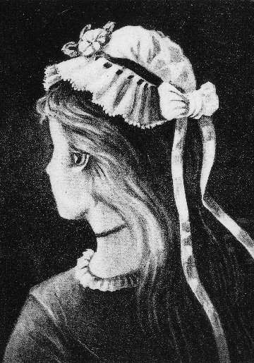
What Do You See?
Notes:
SCRIPT
Don’t ruin this exercise for others if you’re already familiar with it!
Take a look at each image. What do you see?
Instructor Tip: Allow the audience time to peruse the images.
Based on your perception, you could be seeing different things in each of the three images...and all of you could be right.
Image 1 – Who sees the Native American chief? Who sees the person in a heavy winter coat looking into the darkness?
Would someone who sees the Native American chief like to explain how they’re seeing it?
Would someone seeing the person in the winter coat like to share how they are seeing it?
Image 2 – Duck or rabbit?
Who sees the rabbit? Where is your attention that lets you see the rabbit?
Who sees the duck? What are you looking at to see the duck?
Image 3 – Old woman or young woman?
Who sees the old woman? What features do you see?
Who sees the young woman? What features are you looking at?
The purpose of this exercise is to showcase how each of us can look at the same thing and sometimes see something different, depending on whatever it is we are paying attention to at the moment. It’s possible for us to come back another time and see something different, if we are more attuned to new details.
However, did you notice how by sharing information you were (hopefully) able to see both subjects in each image? Did you notice how open you were to listening to the new information from someone else that would help you see something different? This is the attitude we want to bring to patient care. Each of us can look at a situation and, based on our personal histories, backgrounds, training, and experience, as well as our current state of mind, see something different. By sharing our different perspectives and information, we can get a fuller picture of what’s going on. It also enables all to have a shared mental model while delivering care.

Slide 4
Strategies
Individual awareness can become shared understanding through:
Briefs to establish and communicate a care plan
Huddles to provide ongoing updates or modify the care plan
  Supplement with call-outs
Debriefs to learn and improve from an experience.
Tip! Always check-back to verify information (Module 3).
Notes:
SCRIPT
Now that you have the concepts and principles you should follow when situation monitoring, you will learn about the tools and strategies you can use to be effective. In this module we teach you about briefs, huddles, and debriefs.
Remember: as we discussed in Module 3, always use check-backs to verify information.

Slide 5

What Are Briefs and Huddles?
Semi-structured conversations among team members designed to improve patient care by formulating a plan and getting all parties on the same page.
Briefs are hosted at the start of a case.
Huddles are held ad hoc at any time during care.
Notes:
SCRIPT
You have probably participated in a brief or a huddle before even if that isn’t what they have been called. Briefs are sometimes referred to in some settings as huddles, and huddles are sometimes called time-outs. Semantics aside, they serve very similar purposes. Formally defined, briefs and huddles are semi-structured interdisciplinary conversations with all team members designed to improve patient care by formulating a plan and getting all parties on the same page. The central takeaway here is that they are planning meetings during which the full team or at the very least key team members meet to discuss the patient care plan, devise a strategy for meeting the patient’s unique needs, ensure that all team members have the same understanding about the care plan, and strategize contingency plans for managing unforeseeable events should they occur.
The main distinction between what makes one of these meetings a brief or a huddle is when they take place. Briefs, ideally, take place at the start of each case, whereas huddles can be called at any time, often in response to an emergent event, to get the team back on the same page and reassess the care plan should a change become necessary.

Slide 6
Briefs
At patient admission
Mandatory attendees:
  Bedside nurse
  Physician or midwife
  Patient and/or family members
Introduce each other
  Use the patient’s proper name if she is in the room
Review the patient’s problem list and history
  Discuss potential early warning signs for severe hypertension
Discuss possible contingency plans based on problem list
Set a plan for patient care
  Establish roles and responsibilities
  Describe expectations for communication and workflow
Notes:
SCRIPT
Briefs are your opportunity to start each case with a solid plan of care and ensure that the primary care team agrees with and is prepared to adhere to the care plan. At a minimum, these meetings should take place between the bedside nurse and attending physician, although other team members such as the charge nurse, midwife, and patient should also be welcome to attend. Although it's often impossible to get everyone in the room at the same time, engaging as many team members as possible, including the patient and family, helps ensure that everyone is on the same page and has the opportunity to contribute to care decisions.
During a case briefing, the team should review the patient’s problem list and history, devise a care plan, consider potential problems that might emerge throughout her care, and talk through contingency plans in case of those events. From the teamwork perspective, briefs provide all providers a chance to introduce themselves to each other in case they aren’t already familiar with each other, describe roles and responsibilities, and set expectations for how they will work together such as when and how often they will be in contact and preferred mechanisms for communicating.
Everyone at the meeting should be in agreement with the plan and have had a chance to voice any concerns, either about the patient history or the ability for the team to care for the patient.

Slide 7
Huddles
Ad hoc response to changing circumstances
Critical attendees:
  Nurse
  Physician or midwife
Possible additional attendees:
  Charge nurse
  Anesthesiologist
  Patient and/or family members
Revise care plan to meet emerging needs
Ensure all team members understand the updated plan and their responsibilities
Reassess how the team is working together
Notes:
SCRIPT
As we’ve already learned, the purpose of the huddle is only subtly different from a brief. Not all cases will require team members to huddle. A huddle may be more of a hindrance than a help during routine textbook cases with no surprises or abnormal challenges that unfold predictably.
Unfortunately, the reality of patient care is such that sometimes surprises happen or a case is complex and requires significantly more team involvement than is typical. In these instances, huddles might be a good strategy for you to keep the team informed of changing circumstances.
Huddles may require attendance from more than just the bedside nurse and attending. Any residents, anesthesiologists, midwives, or charge nurses also assisting with the case may need to be present for a huddle. However, like a brief, the objective is to leave the meeting with a care plan that all team members understand and agree with. Huddles are also a great time to reassess how well the team is working together and make minor adjustments to their approach to teamwork.

Slide 8

Points of Discussion in Briefs & Huddles
Patient problem list and history
Teamwork considerations
Hypertension-specific planning
Notes:
SCRIPT
In order to plan and pivot well, you and your team will want to review both the patient’s problem list and personal history as a way to prepare for the clinical work involved with caring for this patient. You would also do well to think about teamwork considerations that go beyond the pure clinical aspects of patient care. We’ll go over a few of these in a moment. Finally, if your facility is addressing the AIM Severe Hypertension Clinical Bundle as part of your commitment to improving patient safety, there are a few hypertension-specific planning questions you can address in your briefs and huddles.

Slide 9
Some Teamwork Considerations for
Briefs and Huddles
Roles and responsibilities
  Are they understood by all team members? Is everyone equipped to handle their assignments? Is there a clear leader?
Communication
  Is it clear, timely, and complete? Are we using check-backs? Are the family and patient kept informed and involved?
Situation awareness
  What is everyone seeing? Is there anything that should be shared with the team?
Workload
  Is the distribution of workload fair and equitable?
Task assistance
  Are team members offering and requesting help?
Errors
  Are we making errors? How do we self-correct?
Resources
  Do we have the staff, materials (e.g., medications), and expertise needed to handle this case?
Notes:
SCRIPT
During your briefs and huddles you can think about team performance from various angles. A few items you might discuss include:
Roles and responsibilities – Does everyone know who is on the team? Does everyone know what each of their team members are responsible for? Are roles and assignments appropriate for the team members’ level of experience and expertise? Is there a clear leader?
Communication – How is it? Is it clear, timely, and complete? Is everyone getting the information they need when they need it? Are we confirming the receipt of information and clarifying uncertainties with a check-back? Are the verbal and nonverbal communication strategies the team used effective? Are we keeping the patient and her family involved and informed?
Situation awareness – What is everyone seeing? Is there anything that needs to be shared with the team? Is each member maintaining up-to-date awareness? Are team members communicating relevant insights and changes in the status of the patient to the rest of the team? Does the team have a similar understanding of what’s going on with this patient?
Workload – Is workload fair and equitable? Are there enough staff to handle the workload?
Task assistance – Are team members offering and requesting help from each other? Are offers of help genuine? Are requests for help honored?
Errors – Are we making any errors? How do we self-correct?
Resources – Do we have the staff, materials, and expertise needed to handle this case? For instance, was there enough medication to manage a severe hypertension event?
You may find you don’t need to cross-walk through each of these points at every huddle or brief, especially if you’re familiar with your teammates and already have an established system and expectations in place for working together. However, it doesn’t hurt to touch base with each other on these points from time to time or use this list as a gentle reminder about how and what team dynamics may be affecting care beyond the clinical context. Even textbook clinical cases can sometimes go awry when teamwork is weak, so it’s important to consider these elements, too.

Slide 10
Hypertension-Specific Planning
Tip! Convene a huddle at the first signs of severe hypertension and
every 15 minutes until BP is below the severe range.
Is the patient at risk for hypertension?​
What are her early warning signs, if any?​
What should we watch out for to make sure she doesn’t worsen?​
What does the facilitywide standard protocol suggest we do?​
Do we have a contingency plan?​
  What will we do if the medication does not reduce the blood pressure? ​
How is the patient doing? ​
  Is she distressed? What fears or anxiety has she communicated?​
Are the family and patient aware of the plan?
Notes:
SCRIPT
Whether you are briefing or huddling, you might find the following questions to be useful discussion points if you are concerned about hypertension.
Begin by asking if the patient is at risk for hypertension? What are her early-warning signs, if any? How do we make sure she doesn't worsen?
Consider what the facility's standard protocol for hypertension suggests you do.
Do you have a contingency plan? What will you do if medication does not reduce blood pressure?
Have you asked the patient how she is doing? Is she distressed? What fears or anxiety has she communicated?
Finally, are the family and patient aware of what is unfolding and the plan for managing her condition?

Slide 11
Application to 4 Rs: Briefs & Huddles
4 Rs
Readiness Every Unit | Recognition Every Patient | Response Every Case | Reporting Every Unit
N/A | Brief upon patient intake Discuss problem list Assess HT early-warning signs Review facility protocol for measuring and assessing blood pressure and urine protein Include at-risk patients to provide education on signs and symptoms Huddle at earliest warning signs E.g., when systolic BP ≥ 160 or diastolic BP ≥ 110 | Huddle at earliest warning signs Review protocol and escalation policies Revise care plan in response Huddle when patient does not respond to treatment or symptoms worsen Review protocol and escalation policies Revise care plan in response | N/A
Notes:
SCRIPT
Briefs and Huddles are primarily applicable to the Recognition and Prevention and Response stages in the AIM 4 Rs framework.
Recognition and Prevention
Conduct a team brief upon patient intake to review the patient problem list, subsequent care plan for preventing and managing hypertension, expectations for the case, and any anticipated points of diversion from plan
Discuss the standard protocol for measuring and assessing blood pressure and urine protein for all pregnant and postpartum women
Consider during the intake briefing and any huddles what early-warning signs may already be present
Include patients who are at risk for hypertension/preeclampsia in team briefs; discuss these signs and the care plan that follows to educate prenatal and postpartum women on signs and symptoms of hypertension and preeclampsia.
Response
Make clear your facility’s expectations for when to huddle as part of the facility-wide standard protocols and policies for managing and escalating treatment
Huddle as hypertension risk or other aspects of patient care change and merit modifications to the care plan
Huddle as soon as early-warning signs are noticed, e.g., when systolic BP =/> 160 or diastolic BP =/> 110
Huddle again when patient does not respond to treatment or if symptoms worsen.

Slide 12
Huddle/Brief Practice
Instructions
Key Tips
Partner with three to five other participants
Think about the case scenario you read and all the events that unfolded
Conduct a 5-minute huddle
Focus on
  Patient problem list and history
Teamwork considerations
Hypertension-specific planning
Notes:
SCRIPT
Get into groups of three to five people. Recall the case scenario from the introduction module and all the events that unfolded. Conduct a 5-minute huddle about this case or any particular aspect of it.
As you go through this exercise, think about the patient’s problem list and history, any teamwork considerations that arose, and what specifics you might want to address about the hemorrhage event.

Slide 13
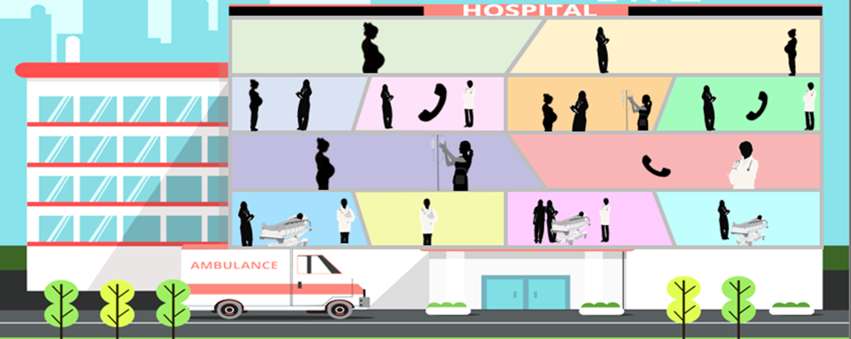

Severe Hypertension
Huddle
Observe how a huddle can be used to quickly and efficiently convey pertinent and timely clinical information.
Notes:
SCRIPT
We will now revisit a scene from the severe hypertension master scenario presented in Module 1. In this scene, we will demonstrate how a huddle can be used to quickly and efficiently convey pertinent and timely clinical information to appropriately inform the team and advance patient care.

Slide 14



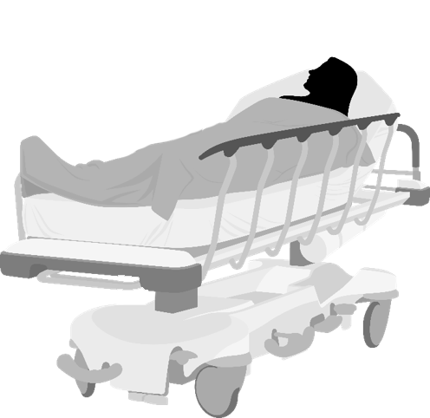
Severe Hypertension
Huddle
Dr. Johnson reviews Ms. Smith’s vital signs and laboratory values and calls a huddle with the L&D treatment team to discuss the plan for care.
Dr. Larsen, anesthesiologist
Alice Smith, the patient
Beth, L&D Nurse
Dr. Johnson, obstetrician
Notes:
SCRIPT
As you recall from our master scenario, the patient first presented with severe-range blood pressure to triage. Ms. Smith’s lab results return shortly after her arrival on L&D and demonstrate a protein/creatinine ratio of 0.46 with 3+ protein on a catheterized urine sample, elevated transaminases with AST of 107 U/L and ALT of 98 U/L, a Hgb of 10 g/dl, and a normal platelet count. Labs were collected and sent. Our current scene picks up with those labs returning and Dr. Johnson wanting to inform the team about the care plan moving forward.

Slide 15
Severe Hypertension
Huddle
Good afternoon, Ms. Smith.
I called a huddle of your clinical team to give us an opportunity to review your clinical course, and make sure everyone is on the same page moving forward!
I hope it is OK that I will be talking about your situation for a few moments...
Dr. Larsen, anesthesiologist
Of course, Dr. Johnson.
Alice Smith, the patient
Beth, L&D Nurse
Dr. Johnson, obstetrician
Notes:
SCRIPT
Dr. Johnson convenes a huddle with the team in the patient's room. When appropriate, it is a great opportunity to involve the patient in her own care.

Slide 16
Severe Hypertension
Huddle
Great! Beth, can you start us off?
Certainly, Dr. Johnson.
Ms. Smith is a 31-year-old primip at 36 weeks and 2 days with overall uncomplicated prenatal care who presented to L&D triage with a headache.
Dr. Larsen, anesthesiologist
Alice Smith, the patient
Beth, L&D Nurse
Dr. Johnson, obstetrician
Notes:
SCRIPT
Dr. Johnson asks Beth, the L&D bedside nurse, to start off the huddle. Beth begins with a summary of the patient’s situation: “Ms. Smith is a 31-year-old primip at 36 weeks and 2 days with overall uncomplicated prenatal care who presented to L&D triage with a headache.”

Slide 17
Severe Hypertension
Huddle
On arrival to L&D triage, Ms. Smith was noted to have multiple severe-range blood pressure readings, reaching as high as 202/120.
Due to initial issues obtaining an IV, she was given 10 mg immediate-release oral nifedipine.
Her blood pressure is now improved after receiving the IR nifedipine and currently remain in the mild range.
Dr. Larsen, anesthesiologist
Alice Smith, the patient
Beth, L&D Nurse
Dr. Johnson, obstetrician
Notes:
SCRIPT
Beth continues with some background about Ms. Smith: “On arrival to L&D triage, Ms. Smith was noted to have multiple severe-range blood pressure readings, reaching as high as 202/120. Due to initial issues obtaining an IV, she was given 10 mg immediate-release oral nifedipine. Her blood pressure is now improved after receiving the IR nifedipine and currently remain in the mild range.”

Slide 18
Severe Hypertension
Huddle
Excellent. Thank you, Beth.
Ms. Smith, your labs just returned and are notable for an elevated protein/creatinine ratio and elevated liver enzymes but normal platelets, creatinine, and hemoglobin.
Dr. Larsen, anesthesiologist
What does that mean?
Alice Smith, the patient
Beth, L&D Nurse
Dr. Johnson, obstetrician
Notes:
SCRIPT
Dr. Johnson now pivots to inform not only the patient but the team about the new lab results and the patient's diagnosis of severe preeclampsia.

Slide 19
Severe Hypertension
Huddle
Well, these results indicate that you have severe preeclampsia. If we don’t treat it, it can lead to seizures and become life threatening.
I think our best course of action will be to induce labor and deliver your baby today.
Team, can we please initiate magnesium sulfate for seizure prophylaxis with a 6-gram bolus followed by a 2 g/hr continuous rate?
We will also proceed with induction of labor.
Dr. Larsen, anesthesiologist
Alice Smith, the patient
Beth, L&D Nurse
Dr. Johnson, obstetrician
Notes:
SCRIPT
In answer to Ms. Smith’s question, Dr. Johnson lays out the plan moving forward: “Well, these results mean that you have severe preeclampsia. If we don’t treat it, it can lead to seizures and become life threatening. I think our best course of action will be to induce labor and deliver your baby today. Team, can we please initiate magnesium sulfate for seizure prophylaxis with a 6-gram bolus followed by a 2 g/hr continuous rate? We will also proceed with induction of labor.”

Slide 20
Severe Hypertension
Huddle
Understood, Dr. Johnson.
Ms. Smith, I’ll be back to do your anesthesia evaluation and discuss pain control.
Thank you, all.
Ms. Smith, would you like to call anyone to come be with you?
I’ll administer the bolus.
Dr. Larsen, anesthesiologist
Alice Smith, the patient
Beth, L&D Nurse
Dr. Johnson, obstetrician
Notes:
Script:
The anesthesiologist and the nurse both agree to the plan and explicitly acknowledge their respective responsibilities. Dr. Johnson thanks them and turns her attention to Ms. Smith, concerning herself with her comfort and emotional needs by asking if she’d like to make any phone calls to friends or family.

Slide 21
Debrief aka, After-Action Review
Semi-structured conversation among team members designed to improve care by reviewing the team’s performance.
Central to Patient Safety and Quality Improvement:
  Learn from unit-based drills (Readiness)
  Immediate review of real cases (Response)
    Successful cases, too!
  Assess weaknesses in the system (Reporting & Systems Learning)
    E.g., inefficient work processes; technology failures; poorly organized environments
Notes:
SCRIPT
Also known in some facilities as “after-action reviews,” debriefs are semi-structured, interdisciplinary conversations with all team members to review the team’s performance during a recent case or clinical event. The purpose is to learn from the event with the intention of applying those lessons to future team performance under similar circumstances. As such, debriefs are a critical tool for improving patient safety and quality improvement within your facility.
They may be used in training practice scenarios, like unit-based drills, as opportunities for personal and team performance feedback. In these situations, the focus will be on practicing teamwork and clinical skills so that the team is prepared to respond to a real event. Debriefs may also be used in regular clinical practice in two ways. First, as an after-action review of a patient case, especially one involving an adverse event like severe hypertension. These after-action reviews provide an opportunity for the team to reflect on their performance and discuss ways to either perform better or sustain good performance in the future. Debriefing each case, whether the case went smoothly or there were adverse events associated with the patient’s care, is good practice. You can learn much from reflecting on what helped a case succeed as much as you can learn from figuring out what the team could have done to prevent unwanted events, particularly when the causes of some events were beyond the control of the team and had nothing to do with the team’s ability to perform well.
Finally, debriefs can be used on a larger scale to assess system weaknesses. Generally, these types of debriefs will be held in the Reporting and Systems Learning stage in response to an adverse event and involve unit representatives who were not initially involved with a particular case. The purpose of these types of debriefs will be to conduct a root-cause analysis of an event to look for ways that the system (and not the team) itself can be improved. Examples of system issues include technology failures, such as alarms that are easily turned off; environmental concerns, such as poorly organized environments that contribute to human errors or work inefficiencies; and processes that create delays in patient care.
The remainder of this module focuses on that second type of debrief: after-actions reviews, because these are the ones that you can leverage most consistently in your everyday practice. Learning how to debrief cases and making it a habit to do so regularly will help you to provide consistent high-quality care as you begin to recognize patterns of good teamwork and can correct behaviors that deviate from these patterns.

Slide 22
Debriefing at a Minimum
What went well?
  What should we replicate or do similarly during the next event?
What did not go well?
  What do we need to do differently to improve our performance next time?
What were our major lessons learned from this case?
How do we prepare now so that we are ready to handle the next event in the way we have just discussed?
Who will accept responsibility for any outstanding tasks and how will they communicate back to the team?
Notes:
SCRIPT
Because debriefs are real-life learning opportunities, it’s important to conduct the debrief in a way that maximizes learning and leaves team members feeling like they know exactly what to do differently (or the same!) next time.
There are many questions you can ask during a debrief to help you understand.
At a minimum, the high-level questions your team should discuss during a debrief include:
What went well? Sometimes, things that went well might not have been a direct result of anything the team did; however, it’s useful to explore what the team can do to repeat good performance and outcomes during the next event.
What did not go well? Similarly, you will want to explore aspects of the case that might have hit some snags along the way and, importantly, discuss what it is your team can do differently to avoid or better manage those difficulties in the future.
Summarize your major takeaways by asking what the team’s lessons learned were from this case.
Finally, your team will want to thoughtfully think about what you can do now so that you are ready in the future to implement the strategies you’ve discussed. Sometimes follow-through might be needed. In these cases, be clear about who is responsible for the task.

Slide 23
Some Teamwork Considerations for Debriefs
Roles and responsibilities
  Were they understood by all team members? Was everyone equipped to handle their assignments? Was there a clear leader?
Communication
  Was it clear, timely, and complete? Did team members check-back on communications? Was the family and patient kept informed and involved?
Situation awareness
  Did the team maintain up-to-date awareness? Were relevant changes communicated to the team?
Workload
  Was the distribution of workload fair and equitable?
Task assistance
  Did team members offer and request help?
Errors
  Were errors made? Avoided? Can they be prevented?
Resources
  Did we have the staff, materials (e.g., medication), and expertise needed to handle this case?
Notes:
SCRIPT
During your debriefs, you can think about team performance from various angles. A few items you might discuss include:
Roles and responsibilities – Did everyone know who was on the team? Did everyone know what each of their team members were responsible for? Were roles and assignments appropriate for the team members’ level of experience and expertise? Was there a clear leader?
Communication – How was it? Was it clear, timely, and complete? Did everyone get the information they needed when they needed it? Did everyone check-back or close-the-loop to confirm messages were correctly understood? Were the verbal and nonverbal communication strategies the team used effective? Was the family and patient kept informed and involved?
Situation awareness – Did each member maintain up-to-date awareness? Did they communicate relevant insights and changes in the status of the patient to the rest of the team? Did everyone maintain a similar understanding about the patient’s situation?
Workload – Was workload fair and equitable? Were there enough staff to handle the workload?
Task assistance – Did team members offer and request help from each other? Were offers of help genuine? Were requests for help honored?
Errors – Were mistakes made? Were there any near misses? How could mistakes and near misses be prevented?
Resources – Did the team have the staff, materials, and expertise needed to handle this case? For instance, was there enough medication to manage a severe hypertension event?
Please note the topics presented here are not exhaustive. There are lots of questions you can ask and explore regarding your team’s performance.

Slide 24
Debriefing Questions for Hypertension
Was everyone aware of this patient’s potential for hypertension?
How could we have identified the risk sooner? Early warning signs?
How well did the team adhere to the clinical protocol elements?
  How could we have better managed this case?
  What did we do well in our treatment?
What system issues contributed to our handling of the event?
What teamwork behaviors contributed to our handling of the event?
Did we keep the patient and family informed and involved?
Notes:
SCRIPT
As you debrief cases of patients who suffered severe hypertension, you might consider exploring additional hypertension-specific questions with your team. These could include, but certainly aren’t limited to:
Was everyone aware of this patient’s potential for hypertension?
How could we have identified the risk sooner? Early-warning signs?
How well did the team adhere to the clinical protocol elements?
How could we have better managed this case?
What did we do well in our treatment?
What system issues contributed to our handling of the event?
What teamwork behaviors contributed to our handling of the event?
Did we keep the patient and family informed and involved?
A few points to highlight in these questions are the thoughtful ruminations about how to better involve patients and family members and to focus on both those desirable behaviors you’d like to replicate in the future in addition to changing any behaviors that did not serve you well in the present case.

Slide 25

Debrief Ground Rules
Host the debrief as soon as possible following a case or event
  Anyone can request and lead a debrief
Keep it short (5–10 minutes) but pertinent
All-inclusive
  Acknowledge good contributions
  Solicit thoughts from silent team members
Communication is open, transparent, and interactive
Maintain respect
No finger-pointing
Notes:
SCRIPT
Debriefs do not have to be long conversations. It’s amazing what you can accomplish in 5–10 minutes if you follow a format. It’s better to have a short meeting that doesn’t address every checklist item than to not have one at all.
Time will be an important factor in the success of a debrief. It’s better to hold debriefs immediately following a case or event, while the details are still fresh in everyone’s memory. Don’t wait for a perfectly scheduled time for a lengthy debrief because by then team members won’t recall as well what improvements the team could make.
That said, debriefs are best when they are all-inclusive and each team member has an opportunity to listen as well as share their own insights. A good debrief facilitator will both acknowledge contributions and solicit input from team members who aren’t speaking up. Importantly, any team member and request and lead a debrief. It is not only the responsibility of the physician to ensure a debrief is completed.
The only time some of these rules may not apply is when you are conducting a debrief of a serious event with the larger staff. In these cases, individuals who weren’t involved in the original case might be convened to learn from the event and/or help solve larger systems-based problems that limited team effectiveness. Even if that is the case, during all debriefs, communication should be open, honest, transparent, and interactive.
Importantly, respect should be maintained at all times and all finger-pointing should be avoided. Debriefs are not opportunities for venting personal grievances or blaming individual team members for failures. A good debrief session is focused on looking for ways the team can perform well in the future.

Slide 26

Debrief Discussion Tips
Focus on positives as well as negatives
Share feelings about recent events, like a patient with severe hypertension
  Find ways to extend support to struggling team members
Discuss how to apply lessons in practice
Take de-identified notes about the outcomes of your discussion
  Store these separate from any identifying patient information
Assign responsibility to team members for follow-through
Notes:
SCRIPT
During the team debrief, you should focus on positives (that is, what went well) just as much as negatives (or what didn’t go so well). Sometimes it might be helpful to start the discussion with positives, especially if you have reticent team mates who are hesitant to speak up. Of course, use your judgement. In cases with poor patient outcomes it might feel unpalatable to discuss positives. It’s critical in such cases especially to let the debrief be a forum for staff to share their feelings about recent events and find way to extend support to struggling team members.
Given that debriefs are learning opportunities, your team will want to give some consideration to how the lessons they’ve discussed can be applied. It’s not always enough to simply agree to do better next time. Sometimes the team needs to have follow-up conversations with each other or outsiders to actualize their plan. In these cases, the team should consider being clear about who will shoulder the responsibility for managing the follow-through. Having a designated note taker will help you to manage and log any decisions made during your debrief. Any notes should be de-identified and kept separate from patient information.

Slide 27
Application to 4 Rs: Debriefs
4 Rs
Readiness Every Unit | Recognition Every Patient | Response Every Case | Reporting Every Unit
Debrief after unit education on protocols and unit-based drills to improve and/or sustain performance | N/A | Debrief after events to support patients, families, and staff Debrief regularly to establish a culture of continuous learning from successes and failures When debriefing, specifically discuss how well the team adhered to the clinical protocol | Host unitwide debriefs to facilitate multidisciplinary review of serious events to address systems issues and enable others to learn
Notes:
SCRIPT
Debriefs may be applicable at the Readiness, Response, and Reporting stages described by AIM’s 4 Rs framework. In the Readiness stage, you might debrief with your team members after unit education on protocols and unit-based drills. During these sessions, you can talk about what went well, what didn't go so well, and what you would change during a live event or the next drill.
During the Response stage, you might debrief after caring for a hypertensive patient. Regular debrief sessions after such events help to establish and sustain a culture of continuous learning. Relatedly, unit-wide “debriefs” might be used at the Reporting stage to facilitate multidisciplinary review of serious events, address systems issues, and enable staff uninvolved with the actual event to learn from the case.

Slide 28
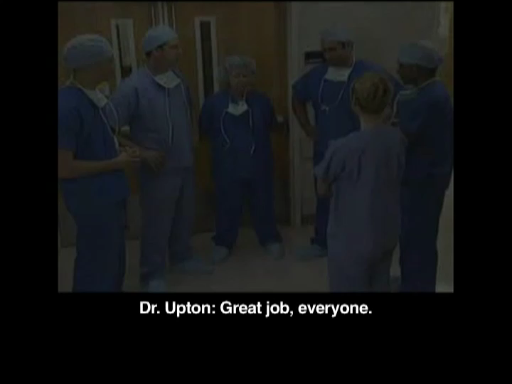
Debrief video
What went well?
What did not go well?
How can they prepare to
handle future similar events?
Who will be responsible for
any outstanding tasks?
How will those tasks be communicated?
Click video to watch
Notes:
SCRIPT
Click the video to see an example of a debrief. Please note that the scenario does not relate to a severe hypertension event. We encourage you to focus on the technique, rather than the context. While you are watching, think about what they are discussing in regard to what went well, what did not go well, how they can prepare to handle future similar events, who will be responsible for any outstanding tasks, and how those tasks will be communicated back to the team.

Slide 29

Discussing the Debrief Video:
Pros
Convened the debrief before everyone could leave
Facilitator set a positive tone
Solicited opinions from multiple team members
  Did not input his opinion
Pointed out examples of good teamwork (i.e., task assistance)
Specifically asked to discuss communication (i.e., teamwork)
  Was not solely focused on the clinical scenario
Notes:
SCRIPT
What did you think about the video you just saw? What did you think the team did well?
This team demonstrated a number of good debrief habits. First, the facilitator got everyone together before they could go off to their various responsibilities. This enabled the team to keep the debrief shorter and speak with more saliency. He also set a positive tone for the debrief. It seemed clear that this was an opportunity and not a punishment. He solicited opinions from multiple team members about what went well and pointed out examples of good teamwork when they were brought up. He also began to address teamwork elements about how the team performed when he asked how their communication went, not simply focusing on the clinical aspects of the case. It’s also important to note that he himself withheld his opinion, instead asking the team members to share their perspective. This is notable because had the facilitator, who seemed to have some formal power in the group, led with his opinions, the team members may have been less likely to share theirs. Instead, it was made clear that their input was wanted and valued.
What other things did you like about this debrief?

Slide 30
Discussing the Debrief Video:
Limitations
Uncertain how long they debriefed
  Probably no more than 5–10 minutes
Not everyone spoke up
Could have had more discussion
Did not explicitly talk about how to replicate good performance
Did not discuss weaknesses or how to improve
  “What would you like to do differently next time?”
Notes:
SCRIPT
The biggest limitation from this debrief example is that we weren’t able to see the entire session, so we don’t know how long the debrief carried on. However, the pacing of the video seems to indicate that they probably did not spend more than 5–10 minutes together, which hopefully reinforces to you that debriefs do not have to be arduous meetings. They can be very effective even when kept short.
A few other aspects that seemed missing from the debrief included the fact that not everyone spoke up. There definitely could also have been more discussion at times and opportunity given to members to respond to points made by other team members. Even simple “I agrees” to demonstrate that the team are all on the same page about what the others mentioned could have been helpful in ensuring that everyone was, indeed, on the same page.
They also did not explicitly talk about how to replicate good performance. For example, when the anesthesiologist said it was good for him to be brought in early, there wasn’t discussion about how they can make sure he’s brought in early again on the next case or what contributed to him being able to come in early. That is the sort of discussion that helps team members know exactly what to do in the next case.
While it’s really good that the team discussed what they did well, it is actually important to also be honest about places where they could improve. It actually makes an interesting point—while we often tend to focus a lot on deficiencies, sometimes it’s easier to gloss over our weaknesses and focus explicitly on strengths in a team setting. Trust, vulnerability, and moral courage are key players in being able to admit to weaknesses, so sometimes it may take the facilitator asking the question, “What would you like for us to do differently next time?” to encourage this sort of honest discussion.
Of course, since the debrief video was cut short, it’s entirely possible this team did eventually address all of these points. I simply bring them up to encourage you to remember them when you debrief!

Slide 31
Debrief Practice
Instructions:
Key Tips:
Partner with three to five other participants
Think about the case scenario you read and all the events that unfolded
Conduct a 5-minute debrief
Focus on positives as well as negatives
All-inclusive
Share feelings about recent events, like a hemorrhage
Communication is open, transparent, and interactive
No finger-pointing
Discuss how to apply lessons in practice
Notes:
SCRIPT
Get into groups of three to five people. Recall the case scenario from the introduction module and all the events that unfolded. Conduct a 5-minute debrief.
As you go through this exercise, remember to consider positive behaviors or events in addition to the negatives. Try to be all-inclusive—get everyone talking. Remember, it’s okay to share feelings about the events. Don’t finger-point; instead, make sure that communication is open, transparent, and interactive.
Make sure to spend some time talking about how to apply any lessons learned into practice for future patient care.

Slide 32
Severe Hypertension
Debrief
Ms. Smith presented with severe blood pressure.
There was trouble obtaining IV access; she was treated with IR nifedipine.
IV access eventually obtained; Ms. Smith was admitted to L&D and started on magnesium sulfate.
Observe the care team debrief this case.
Notes:
SCRIPT
Let’s revisit our maternal severe hypertension scenario presented in the introduction module (Module 1) and explore what a short debrief of that case might look like.
To recap the scenario, Ms. Smith was a 31-year-old primip at 36 weeks and 2 days who presented to L&D triage with complaints of a headache. While in L&D triage, she was noted to have multiple severe-range blood pressure readings, reaching as high as 202/120. IV antihypertensives were ordered, as well as labs; however, there was initial difficulty obtaining IV access so her severe-range blood pressure was appropriately treated with IR nifedipine. IV access was eventually obtained and Ms. Smith had a good response of her blood pressure profile. She was admitted to L&D and started on magnesium sulfate for seizure prophylaxis.

Slide 33
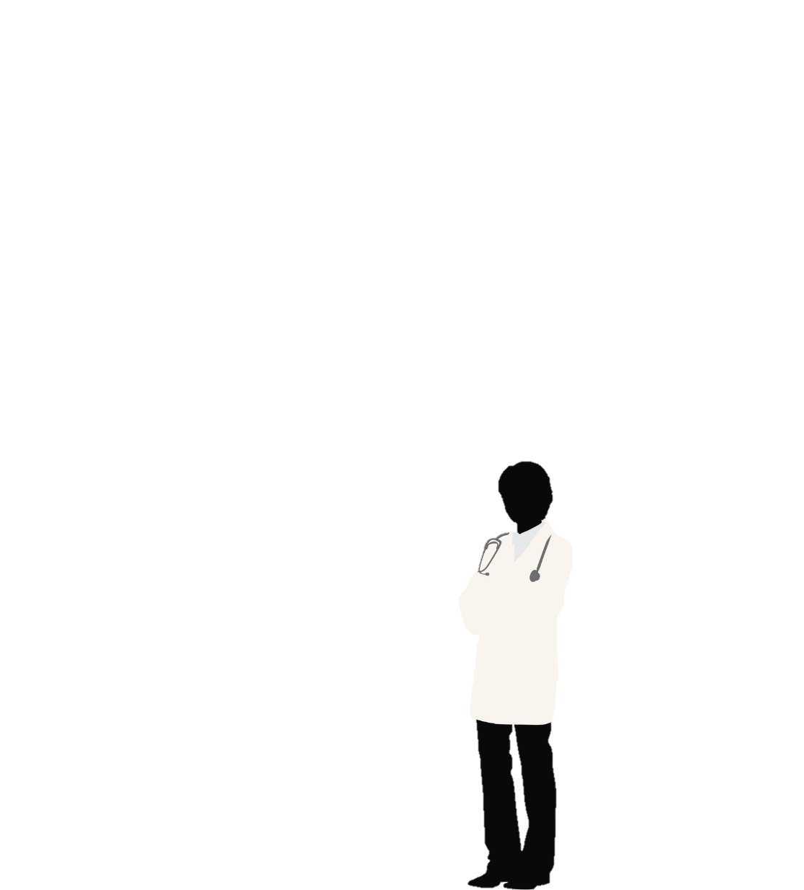
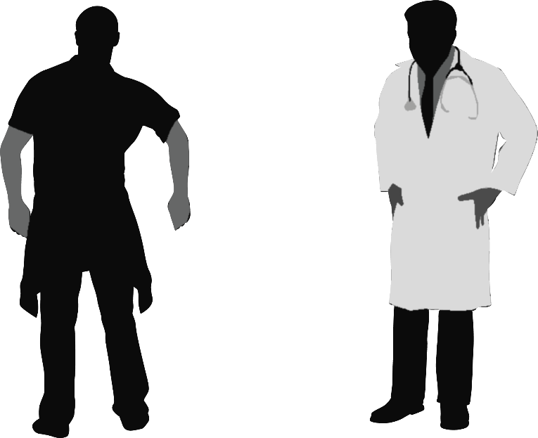
Severe Hypertension
Debrief
If we could, I’d like to take about 5 minutes to share our observations about how we handled Ms. Smith’s case.
What do you think we did well?
Dr. Johnson, obstetrician
Dr. Larsen, anesthesiologist
Beth, L&D Nurse
Notes:
SCRIPT
To begin, the obstetrician, Dr. Johnson, says: “If we could, I’d like to take about 5 minutes to share our observations about how we handled Ms. Smith’s case."
Dr. Johnson invites the team members to provide their thoughts about the event and specifically asks for examples of what the team did well to get the conversation started.

Slide 34
Severe Hypertension
Debrief
In review of Ms. Smith’s initial presentation to L&D triage, I thought Beth did well by identifying her severe-range blood pressure quickly and notifying you immediately.
Dr. Johnson, obstetrician
Dr. Larsen, anesthesiologist
Beth, L&D Nurse
Notes:
SCRIPT
Dr. Larsen, the anesthesiologist on the team, commends the L&D bedside nurse, Beth, for identifying Ms. Smith’s severe-range blood pressure early and immediately notifying Dr. Johnson.
Consciously crowd sourcing team members encourages them to share. All team members should be encouraged to participate and contribute their thoughts and feelings about their experiences. Each team member has a unique perspective, and everyone can learn from one another.

Slide 35
Severe Hypertension
Debrief
That’s a great assessment, Dr. Larsen. Kim, anything to add?
Well, I do have some ideas about what we could have done better in terms of treating Ms. Smith, but I thought everyone did a great job and Ms. Smith received overall excellent care.
Dr. Johnson, obstetrician
Dr. Larsen, anesthesiologist
Beth, L&D Nurse
Notes:
SCRIPT
Dr. Johnson welcomes and encourages the input of each team member. She actively invites thoughts from Ms. Smith’s bedside nurse, Beth, a quieter teammate, who hasn’t yet contributed her thoughts. Beth indicates that, while everyone did a great job and Ms. Smith received excellent care overall, she did observe some opportunities for improvement.

Slide 36
Severe Hypertension
Debrief
Thanks for the kudos. What do you see as our best opportunity for improvement?
Although we upheld the standard of care by treating Ms. Smith’s severe-range blood pressure within 1 hour using IR nifedipine, I still think there was an opportunity for improvement by recognizing our difficulty in obtaining IV access.
Dr. Johnson, obstetrician
Dr. Larsen, anesthesiologist
Beth, L&D Nurse
Notes:
SCRIPT
Noting Beth’s hesitancy to share her thoughts more fully, Dr. Johnson encourages her to talk about what she sees as their best opportunity for improvement.
Beth explains, “Although we upheld the standard of care by treating Ms. Smith’s severe-range blood pressure within 1 hour using IR nifedipine, I still think there was an opportunity for improvement by recognizing our difficulty in obtaining IV access.”

Slide 37
Severe Hypertension
Debrief
I agree. Any ideas on what we can do differently moving forward?
The treatment team can consider other options for obtaining IV access in difficult patients.
I like those ideas and think we should add them to our huddle topics cheat sheet so that it becomes consistent practice.
Dr. Johnson, obstetrician
Dr. Larsen, anesthesiologist
Beth, L&D Nurse
Notes:
SCRIPT
Dr. Johnson agrees and asks the team for ideas about how they can do things differently next time.
Dr. Larsen suggests that moving forward treatment teams can consider other options for obtaining IV access in difficult patients. Beth seconds those ideas and provides additional suggestions for adding them to the huddles topics cheat-sheet in an effort to make it consistent practice.
Notice how the team lead adopted the role of debrief facilitator rather than sole expert. The conversation was a dialogue among colleagues, not one person’s diatribe. Importantly, Dr. Johnson encouraged independent thought, inclusion, and prompted discussion of both opportunities for improvement and viable methods for making those improvements in addition to observations about the behaviors they would like to reinforce during future cases.
The team members served as good listeners to feedback and ideas for improvement. This is important as once this opportunity is lost, there may be very little learning that gets applied for future improvement due to reduced recall as time passes.

Slide 38
Severe Hypertension
Debrief
I’d like to make sure we also get Ms. Smith’s impressions. While we managed her case in a way that makes clinical sense, I imagine she may have a very different impression of her care and I’d like to hear her concerns and observations. I’m on my way to talk with her now, if either of you have time to join me.
Thank you for your great work and honest, constructive comments.
Dr. Johnson, obstetrician
Dr. Larsen, anesthesiologist
Beth, L&D Nurse
Notes:
SCRIPT
Debriefs should occur following all clinical events. It enables a full-circle communication and provides an opportunity for feedback from the team for future improvement.
To wrap up the debrief, Dr. Johnson thanks her teammates for their good work and honest, constructive comments. She offers her own insights last, suggesting that next time they might try to include the patient or family members in the debrief, reinforcing the idea of the patient as a team member. She acknowledges Ms. Smith may have a different impression of her care. Although it may not be entirely appropriate to include the patient in formal team debriefs so that staff can feel that they can speak freely, it is wise to talk with your patients about how they perceived their care. They may provide novel insights or at least a different but important perspective.
Related, though beyond the scope of this module and toolkit, is the important issue of providing support and resources to patients and clinicians after a traumatic event. Additional information about partnering with patients and families can be found on the resources page at the end of this module.

Slide 39
Summary
Situation Monitoring is critical to establishing individual and shared awareness of the patient, clinical environment, and other teammates
Three tools for sharing independent situational awareness:
  Briefs
  Huddles
  Debriefs
Notes:
SCRIPT
Situation monitoring is critical to establishing individual and shared awareness about the patient, other teammates and colleagues, and the clinical environment at large.
Three tools for helping teams share independently held information in service to establishing a shared awareness of the situation and creating a common understanding of expectations include briefs, huddles, and debriefs. Each of these team meetings are respectively held before, during, and after events. They allow teams to prepare for care, pivot as the situation changes, and learn from the experience to improve performance for the next case.

Slide 40
Resources
Institute of Medicine. Partnering with patients to drive shared decisions, better value, and care improvement. 2013. https://nap.nationalacademies.org/read/18397/chapter/1. Accessed July 8, 2019.
Agency for Healthcare Research and Quality. Engaging Patients and Families in Their Health Care. Agency for Healthcare Research and Quality, Rockville, MD. https://www.ahrq.gov/patient-safety/patients-families/index.html. Accessed July 8, 2019.
Agency for Healthcare Research and Quality. Patient and Family Engagement in Primary Care. Agency for Healthcare Research and Quality, Rockville, MD. https://www.ahrq.gov/patient-safety/reports/engage/casestudies.html. Accessed July 8, 2019.
Notes:
SCRIPT
For additional information about partnering with patients and families you might reference the following resources:
Institute of Medicine. Partnering with patients to drive shared decisions, better value, and care improvement. 2013. https://nap.nationalacademies.org/read/18397/chapter/1. Accessed July 8, 2019.
Agency for Healthcare Research and Quality. Engaging Patients and Families in Their Health Care. Content last reviewed April 2018. Agency for Healthcare Research and Quality, Rockville, MD. https://www.ahrq.gov/patient-safety/patients-families/index.html. Accessed July 8, 2019.
Agency for Healthcare Research and Quality. Patient and Family Engagement in Primary Care. Content last reviewed December 2017. Agency for Healthcare Research and Quality, Rockville, MD. https://www.ahrq.gov/patient-safety/reports/engage/casestudies.html. Accessed July 8, 2019.

Slide 41
Acknowledgments
This project is funded and implemented by the Agency for Healthcare Research and Quality and the Johns Hopkins University Contract Number HHSP233201500020I in collaboration with the Health Resources and Services Administration and the Alliance for Innovation on Maternal Health.

