Slide 1
Hospital admission rates through the emergency department: An important, expensive source of variation
Jesse M. Pines, MD, MBA, MSCE
Mark Zocchi
George Washington University AHRQ Annual Meeting

Slide 2
Disclosures / Funding
AHRQ
Robert Wood Johnson Foundation
National Priorities Partnership on Aging
Department of Homeland Security
Kingdom of Saudi Arabia

Slide 3
Study team
Ryan Mutter (AHRQ)
Mark Zocchi (GWU)
Andriana Hohlbauch (Thomson-Reuters)
David Ross (Thomson-Reuters)
Rachel Henke (Thomson-Reuters)

Slide 4
Introduction
HCUP Data: 125 million ED visits in 2008
  15.5% admission rate
  19.4 million hospitalizations
  ED visit growth outpacing population growth
Why are EDs so popular?
  Variable outpatient primary care availability
  High-technology care has become the standard
  Patient preferences / convenience

Slide 5
Introduction
EDs are becoming the hospital’s front door
2008 v. 1997
  43% of U.S. hospital admissions originated in the ED v. 37%
  Mean charge per hospital stay - $29,046 v. $11,281.

Slide 6
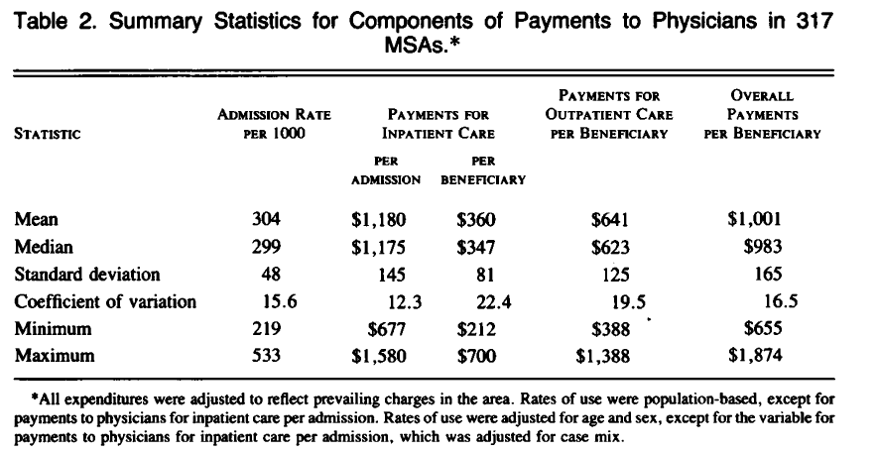
Introduction
Why are ED admissions important?
  Variation in inpatient charges are one of the major drivers of cost variation
  Welch NEJM 1993

Slide 7
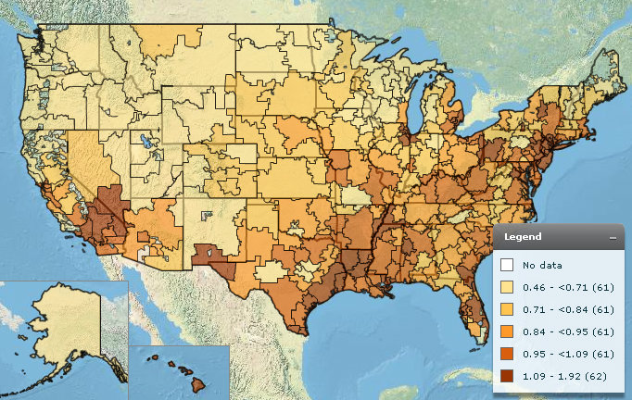
Introduction
Hospital Care Intensity (HCI)
www.dartmouthatlas.org

Slide 8
Introduction
The perspective of the ED
Why admit someone?
  Requires hospital resources
  Critically ill
  Is unable to access a timely resource outside the hospital
  Has a high-risk presentation
  Other reasons

Slide 9
Introduction
Variation in the decision to admit from the ED
  2-3 fold variation in the decision for primary care practices to hospitalize on emergency basis
  Individual ED physician admission rates vary in Canada: 8% - 17%
  Emergency physicians more likely to admit than family physicians or internal medicine physicians.
  Differences in risk tolerance by individual physicians
  Malpractice fear
  Differences in patient & community resources

Slide 10
Introduction
Three categories
  Clear cut admissions
    AMI, stroke, severely-injured trauma
  Clear cut discharges
    Minor conditions
  The remainder
    Shades of gray

Slide 11
Specific Aims
Explore the regional variation in hospital-level ED admission rate across a wide sample of hospitals.
Determine predictors the hospital-level ED admission rate
  Hospital-level factors, ED case-mix, and age-mix, and local economic factors that may drive differences in admission rate
Determine the contribution of local standards of care to explain hospital-level variation in admission rate

Slide 12
Methods
HCUP Data from 2008
All ED encounters from the 2,558 hospital-based EDs in the 28 states
  Had a SID and a SEDD to HCUP in 2008
Calculate an admission rate for each ED
  Transfers included as admissions

Slide 13
Methods
Exclusions
  EDs removed “atypical characteristics”
    639 EDs removed with an annual volume < 8,408, the 25th percentile
    Removed 4 EDs with admit rate > 49%
  HCUP requirements
    Counties < 2 hospitals not appear in a map
  Additional exclusions
    Empirical analysis of the effects of local practice patterns on a facility’s ED admission rate
    Excluded 493 facilities that had the only ED in the county
1,376 EDs: Final sample

Slide 14
Methods
Calculated variables
  County-level ED admission rate
  Age-mix proportions
  Insurance proportions
  Case-mix: 25 most common CCS categories
Other characteristics
  Hospital factors (2008 AHA survey)
  Trauma-level (2008 TIEP survey)
  Community-factors (2007-8 ARF)

Slide 15
Methods
Mapped of ED admission rates at the county level.
Each ED’s admission rate was weighted by its annual volume
Counties that did not have a sufficient number of EDs or which are in states that did not provide a SID and a SEDD are in gray

Slide 16
Methods
Adjusted analysis
  Other factors associated with variations in ED admission rates using multivariate analysis
  Hospital-level ED admission rate (dependent variable).
  Natural log of the dependent variable and the continuous independent variables so that the coefficients on the regressors are elasticities.
  Clustered at the hospital-level

Slide 17
Results
Variable | Mean | Std. Dev.
Patient Characteristics of EDs
% of ED encounters resulting in admission or transfer | 17.5 | 6.5
% of ED encounters paid by Medicare | 21.7 | 7.16
% of ED encounters paid by Medicaid | 20.8 | 11.0
% of ED encounters paid by private insurance | 36.8 | 13.8
% of ED encounters by the uninsured | 15.9 | 9.0
% of ED encounters paid by other source | 4.8 | 4.5
% of ED encounters aged 0 to 17 | 18.8 | 7.5
% of ED encounters aged 18 to 34 | 28.2 | 5.1
% of ED encounters aged 35 to 54 | 25.4 | 3.8
% of ED encounters aged 55 to 64 | 9.1 | 1.7
% of ED encounters aged 65+ | 18.4 | 7.0

Slide 18
Results
Hospital Characteristics of EDs | Mean | Std Dev
Number of inpatient beds | 265.5 | 225.0
ED volume | 40,903.9 | 28,462.8
% of EDs at teaching hospitals | 31.5 | 46.5
% of EDs in an urban location | 87.3 | 33.3
% of EDs at public hospitals | 12.1 | 32.6
%of EDs at for-profit hospitals | 15.5 | 36.3
% of EDs at non-profit hospitals | 72.4 | 44.7
% of EDs at Level 1 trauma centers | 8.9 | 28.5
% of EDs at Level 2 trauma centers | 9.7 | 29.7
% of EDs at Level 3 trauma centers | 7.6 | 26.4
% of EDs at non-trauma centers | 73.8 | 44.0
Socioeconomic and market characteristics of EDs
% of ED encounters resulting in admission, county level with subject ED excluded | 18.0 | 7.1
Per capita income, county level | $39,954.1 | 13,268.7
General practice MDs providing patient care per 100,000, county level | 29.1 | 13.8

Slide 19
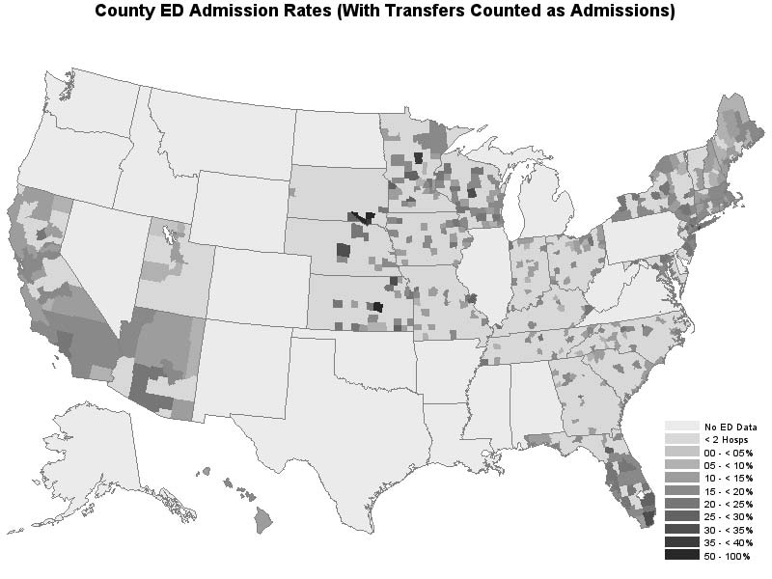

Slide 20
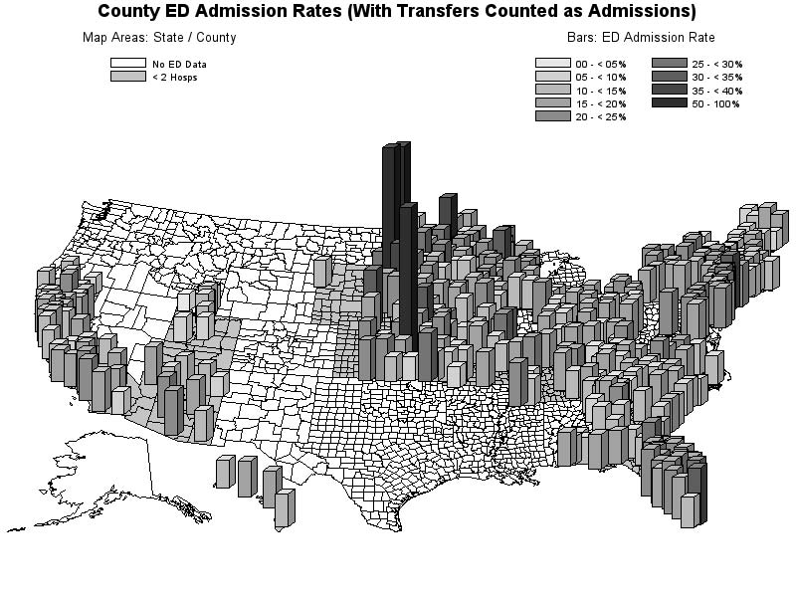

Slide 21
Adjusted analysis
Variable | Coefficient | t-statistic
Intercept | 2.746** | 4.62
Patient Characteristics of EDs
% of ED encounters paid by Medicare | 0.236** | 6.61
% of ED encounters paid by Medicaid | 0.003 | 0.19
% of ED encounters by the uninsured | 0.007 | 1.31
% of ED encounters paid by other source | 0.012 | 1.50
% of ED encounters aged 0 to 17 | 0.001 | 0.04
% of ED encounters aged 18 to 34 | -0.181* | -2.37
% of ED encounters aged 35 to 54 | 0.065 | 0.70
% of ED encounters aged 55 to 64 | 0.015 | 0.20
** p < .01
* p < .05
† p < .10

Slide 22
Adjusted Analysis
Hospital Characteristics of EDs | Coefficient | T-statistic
Number of inpatient beds | 0.168** | 9.04
ED volume | -0.080** | -3.01
Teaching hospital | 0.032† | 1.72
Urban location | 0.004 | 0.13
For-profit hospital | 0.054† | 1.95
Non-profit hospital | -0.012 | -0.56
Level 1 trauma center | 0.118** | 4.66
Level 2 trauma center | 0.014 | 0.64
Level 3 trauma center | 0.006 | 0.27
Socioeconomic and market characteristics of EDs
% of ED encounters resulting in admission, county level with subject ED excluded | 0.145** | 4.78
Per capita income, county level | 0.007 | 0.21
General practice MDs providing patient care per 100,000, county level | -0.073** | -3.68
** p < .01
* p < .05
† p < .10

Slide 23
Discussion
Patient-level characteristics
  % Medicare (higher -> higher)
  % 18-34 (higher -> lower)
Hospital-level characteristics
  Number of inpatient beds (higher -> higher)
  ED volume (higher -> lower)
  Teaching hospital (Yes -> higher)
  Level 1 trauma center (Yes -> higher)

Slide 24
Discussion
Community-level characteristics
  County-level admission rate (higher -> higher)
  Number of primary care doctors (higher -> lower)

Slide 25
Conclusion
There is tremendous variability in ED admission rates across 28 states
  May be the most expensive, regular discretionary decision in U.S. healthcare
Patient & Hospital-level factors predict admission rates
  Medicare & hospitals more likely to receive admissions (trauma, teaching, larger)

Slide 26
Conclusion
Community-factors
  Significant standard of care effect
  Impact of local primary care MDs

Slide 27
Future Directions
Exploring specific diagnoses that may drive this impact
  Pneumonia, DVT, Chest pain, others
Testing solutions to control variation
  Clinical decision rules
  Enhancing care coordination

