Slide 1
Shared Decision Making for
Chronic Conditions and Long-Term Care Planning
July 26, 2016
2:30 p.m. – 4:00 p.m. ET
Sponsored by:
Agency for Healthcare Research and Quality (AHRQ)

Slide 2
SHARE Approach Webinar Series
Webinar 6
Shared Decision Making for
Chronic Conditions and Long-Term Care Planning
Other Webinars available at:
http://www.ahrq.gov/professionals/education/curriculum-tools/shareddecisionmaking/webinars/index.html

Slide 3
Presenters and moderator
Arlene Bierman, M.D., M.S. (Moderator)
  Agency for Healthcare Research and Quality
Cathleen E. Morrow, M.D.
  Dartmouth, Geisel School of Medicine
Sheri Reder, Ph.D., M.S.P.H.
  VA Puget Sound Health Care System

Slide 4
Disclosures
The presenters and moderator have no conflicts of interest to disclose:
  This continuing education activity is managed and accredited by Professional Education Services Group (PESG) in cooperation with AHRQ. PESG, AHRQ, and all accrediting organizations do not support or endorse any product or service mentioned in this activity.
  PESG, AHRQ, and AFYA staff have no financial interest to disclose.
  Commercial support was not received for this activity.

Slide 5
Accreditation
Accredited for:
  Physicians/Physician Assistants, Nurse Practitioners, Nurses, Pharmacists/Pharmacist Technicians, Health Educators, and Non-Physician CME
Instructions for claiming CME/CE – provided at end of Webinar

Slide 6
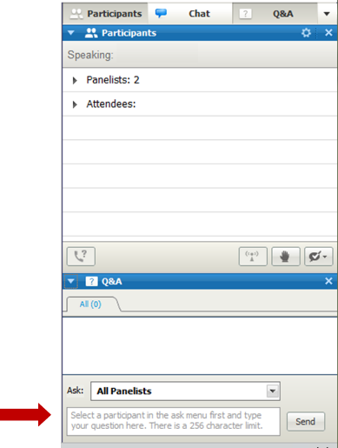
How to submit a question
At any time during the presentation, type your question into the “Q&A” section of your WebEx Q&A panel.
Please address your questions to “All Panelists” in the dropdown menu.
Select “Send” to submit your question to the moderator.
Questions will be read aloud by the moderator.
SHARE@ahrq.hhs.gov

Slide 7
Learning Objectives
At the conclusion of this activity, participants will be able to:
  Describe the rationale and research behind shared decision making and its potential for improved outcomes in chronic disease.
  Explain the differences and complementary qualities of motivational interviewing and skills of shared decision making.
  Outline the clinical applications of shared decision-making principles to chronic disease.
  Distinguish between how shared decision making is used in medical treatment choices and for other preference-sensitive choices frequently faced by aging veterans (e.g., choice of long-term services and supports).
  Explain the short- and long-term outcomes of successful shared decision making for aging veterans.

Slide 8
Shared Decision Making (SDM) and Chronic Disease
Cathleen E. Morrow, M.D.
Department of Community and Family Medicine
Geisel School of Medicine at Dartmouth

Slide 9
Definitions of SDM
A communication skill, focused on patient’s values and preferences as they apply to facilitate high-quality patient care in the context of medical decision making.
An attitude and philosophy; an approach to thinking about effective patient care.
Acknowledges the collaborative nature of good medical care and the dual expertise involved in all decision making–that of patient and doctor.

Slide 10
SDM
Interpersonal and interdependent process.
Recognizes that a decision is required and that providing information is helpful but not sufficient.
Highlights best available evidence about risks and benefits of each option married to the patients values and preferences.
Dynamic interplay between the provider’s guidance and the patient’s values and preferences.

Slide 11
SDM – The Conversation
Is an instrument of care, appropriate to the uncertainties of illness and treatment.
In chronic disease care, is especially important: changes over time; individual patient response varies; patient values and preferences are critical to management and must be frequently re-visited.
Especially called for when best option is not clear: these are common in chronic disease!

Slide 12
Categories of Care
Effective care – evidence-based
Preference-sensitive care
Supply-sensitive care
“Geographic variation” work in the 1970s by Wennberg observed that physician preference dominated the type of care and choices offered to patients.
In the 1990’s Wennberg identified that SDM was central to countering geographic variation and tendency for care to be physician preferenced.

Slide 13
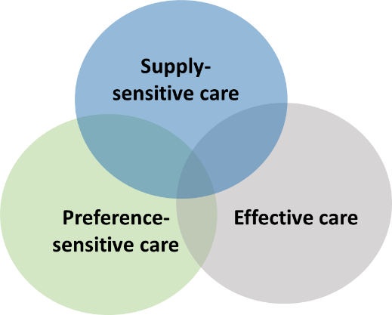
Which Category of Care?
Antibiotics for strep throat
Cardiac catheterization for chest pain
Immunization for Hep B
Breastfeeding
Hip replacement surgery

Slide 14
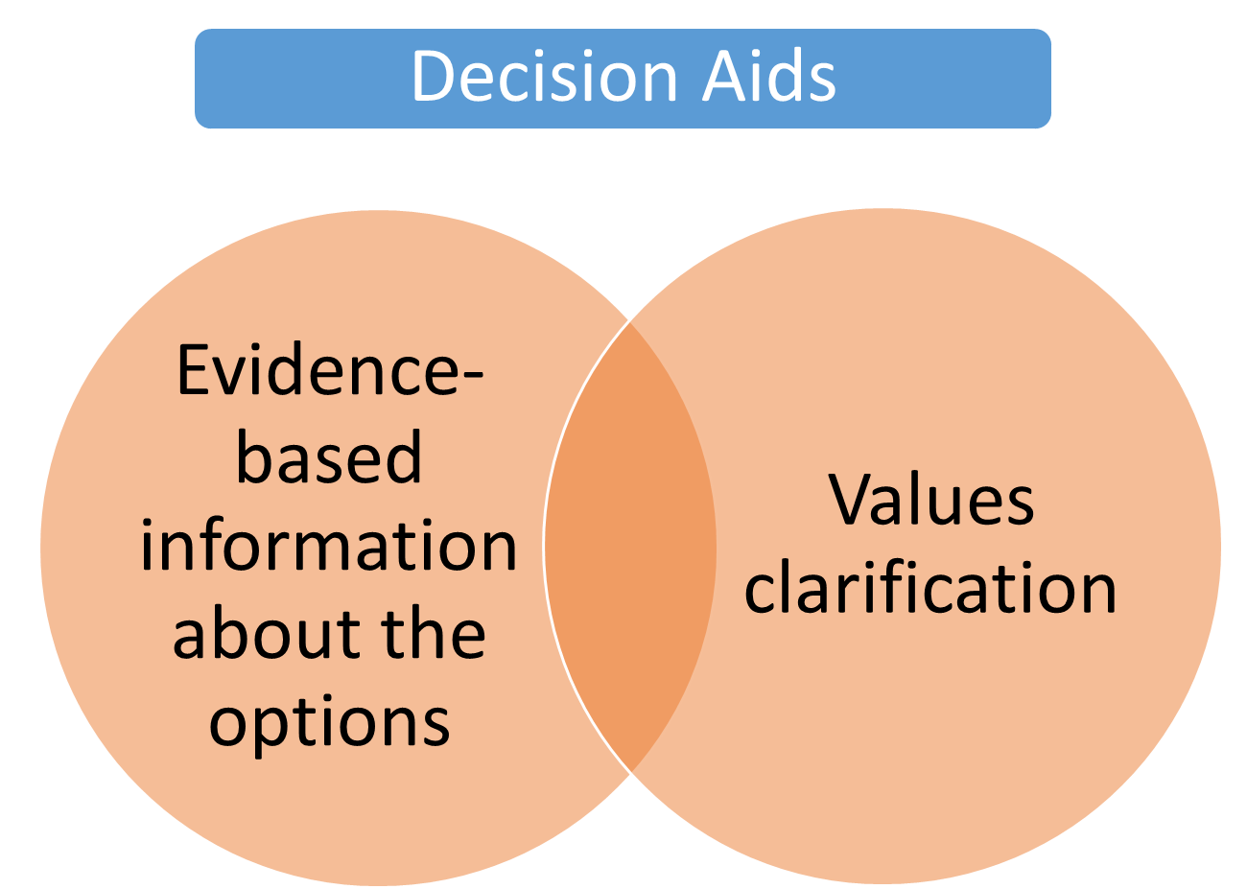
http://decisionaid.ohri.ca/decguide.html

Slide 15

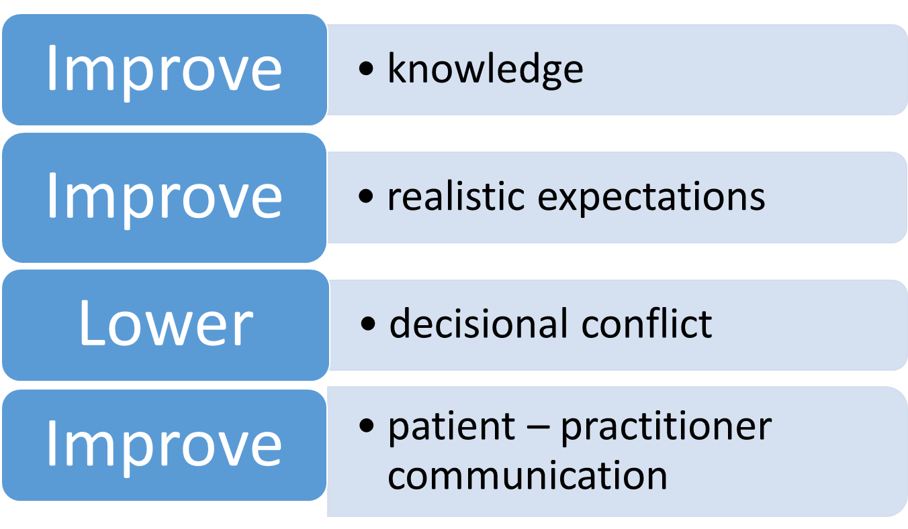
Cochrane Reviews of Decision Aids
Source: Stacey D, et al. Cochrane Database of Systematic Reviews 2014, Issue 1 .

Slide 16
Motivational Interviewing (MI)
A second important communication skill designed to enhance uptake of medical advice and improve outcomes.
Utilized most effectively in evidence-based decision making when evidence is abundant and ‘choice’ is less relevant.
Tobacco cessation provides classic MI content.

Slide 17
Classic Distinguishing
MI: Where are you on a scale of 0 to 10 in your interest in quitting? What would it take to get to next higher number?
SDM: Given that there are a number of options, can you help me understand what is important to you in this matter? What are your values and preferences?

Slide 18
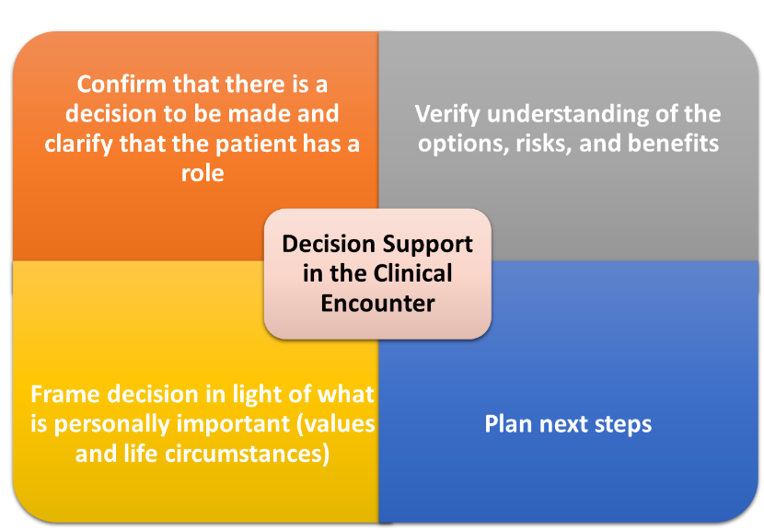
http://decisionaid.ohri.ca/decguide.html

Slide 19
AHRQ SHARE Approach
Step 1: Seek your patient's participation.
Step 2: Help your patient explore and compare treatment options.
Step 3: Assess your patient's values and preferences.
Step 4: Reach a decision with your patient.
Step 5: Evaluate your patient's decision.

Slide 20
Challenges in Chronic Disease Management: Patient View
Many chronic diseases do not have overt symptoms that impact patients’ daily lives.
Many patients deny or minimize the impact of chronic diseases on their lives.
Patients want to be “well,” and they often feel that way.
No one likes to take medicine.
The diagnosis of a “disease” has important and often negative impact on patients’ psychological and emotional health and well-being.

Slide 21
Challenges in Chronic Disease Management: Provider View
We have limited time with patients.
Educating patients about chronic disease is a complex and lengthy process.
Providers vary in their skills and interest to educate, explain, and understand where a given patient is along the trajectory of their acknowledgment and understanding about a diagnosis.
Many providers are fatigued by the effort and feel “it’s not worth it.”
This leads to self-fulfilling prophecy.

Slide 22
Principles in Chronic Disease Management
You can’t get it all done in one visit!
Relationship over time is essential: ongoing conversation.
Message: We can manage this problem effectively together; we are partners in successful outcomes; we will work at this to make you healthier.
Flexibility for management: e-visits, telemedicine, phone management.
Current payment modalities often not helpful!
ACOs and capitated payments will improve this challenge over time.

Slide 23
Evidence Base
Systemic review of 50 studies (2015).
Increased overall patient satisfaction.
Reduced costs: Elective surgery, BPH surgery, PSA screening, end-of-life care.
Studies that looked at behavioral measures (reaching a decision; adherence) showed positive results in 37 percent of the cases.
Studies of self-reported symptoms (e.g., QOL, mental function, etc.) were 42 percent positive.
No negative results were found.
Sources:
Shay LA, Lafata JE. Med Dec Making. 2015;35(1):114-131.
Stiggelbout AM, Pieterse AH, De Haes JC. Patient Educ Couns. 2015 Oct;98(10):1172-9.
Veroff D, Marr A, Wennberg DE. Health Aff (Millwood). 2013 Feb;32(2):285-93.

Slide 24
Evidence Base for SDM
In MD-led decision making, one-third of patients do not feel well-informed.
With SDM, patients:
  Have more accurate understanding of risks and benefits
  Have less decisional conflict
  Increased congruence with their own values.
SDM is a CMS quality metric and requirement for patient-centered medical home recognition.
Sources:
Ferguson M. Transl Behav Med. 2011 June; 1(2):205-206.
Moulton B, King J. Journal of Law, Medicine & Ethics. 2010;38(1):85-97.
Grayson M. 2013. http://www.hhnmag.com
Stacey D, et al. Cochrane Database of Systematic Reviews 2014, Issue 1.

Slide 25
Need: Adherence
Adherence matters! Estimates are that one-third of hospital admissions can be attributed to
non-adherence with medication, leading to $100 billion in costs annually.
Non-adherence is multi-factorial, but engaged patients who have shared in the decision process and feel their values and preferences are understood and part of the consideration for decisions are more likely to remain adherent.
Source: Choudhry NK, Winkelmayer WC. Journal of General Internal Medicine. 2008;23(2):216-218..

Slide 26
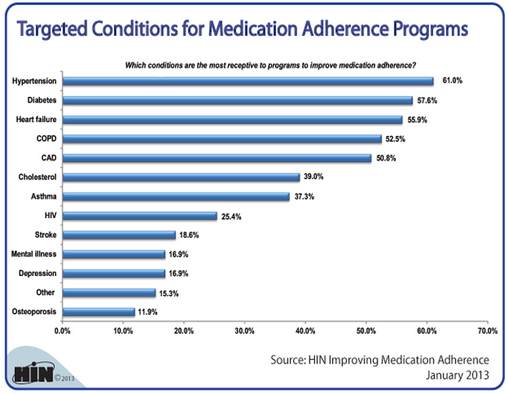

Slide 27
Need for SDM: Adherence
Multiple studies show:
  Post-MI medication adherence to be 40 to 50 percent 1 to 2 years post event.
  Hypertension medication adherence to be 40 to 60 percent.
Statin users have higher BMIs, and they consume more calories than non-users. Over a 10-year period, statin users’ BMIs and caloric intake increased compared to matched controls.
Sources:
Choudhry NK, Winkelmayer WC. 2008;23(2):216-218..
Sugiyama T, Tsugawa Y, Tseng C-H, et al. JAMA Internal Medicine. 2014;174(7):1038-1045.
Schwenk TL. NEJM Journal Watch. 2014 May 8.

Slide 28
Adherence: Diabetes Mellitus (DM)
62 to 64 percent of patients with Type 2 DM on insulin adhered.
One-third of young patients on insulin filled their prescriptions.
36 to 93 percent of Type 2 DM patients took prescribed oral agents for 6 to 24 months.
Source: Cramer JA. Diabetes Care. 2004 May;27(5):1218-24.

Slide 29
SDM Approach to Chronic Disease
Goals: Nurture an activated patient who “owns” his or her disease and is enthusiastic about controlling it.
Respect that patients have their own timeframe, personal and family needs, and need attention to their individual circumstances.
SDM:
  Acknowledges and embraces patient autonomy.
  Appreciates that no decision is a choice.
  Is NEVER about patient abandonment.

Slide 30
Talking to Patients: Diabetes Mellitus
You have Diabetes: Tell me how you understand that? What does it mean to you?
What do you think you need to manage this problem well?
Tell me what is important to you about this diagnosis?
Who else is involved in helping you manage it?
There will be a lot of decisions to make over time to manage your condition. If I understand something about your preferences, I will be better able to help you.

Slide 31
Talking to Patients: Hypertension
You have high blood pressure. Tell me what that means to you?
What is important to you when you think about this medical problem?
Do you have any specific preferences for how we might go about treating this condition?
Who else is going to be involved in helping you get this problem under control?

Slide 32
Talking to Patients: Hyperlipidemia
You have high cholesterol? What do you know about that?
Can you tell me what is important to you about this problem and how to treat it? Preferences? Values?
Who else is part of helping you manage it?
What else should I know that might help me to best understand how to help you?

Slide 33
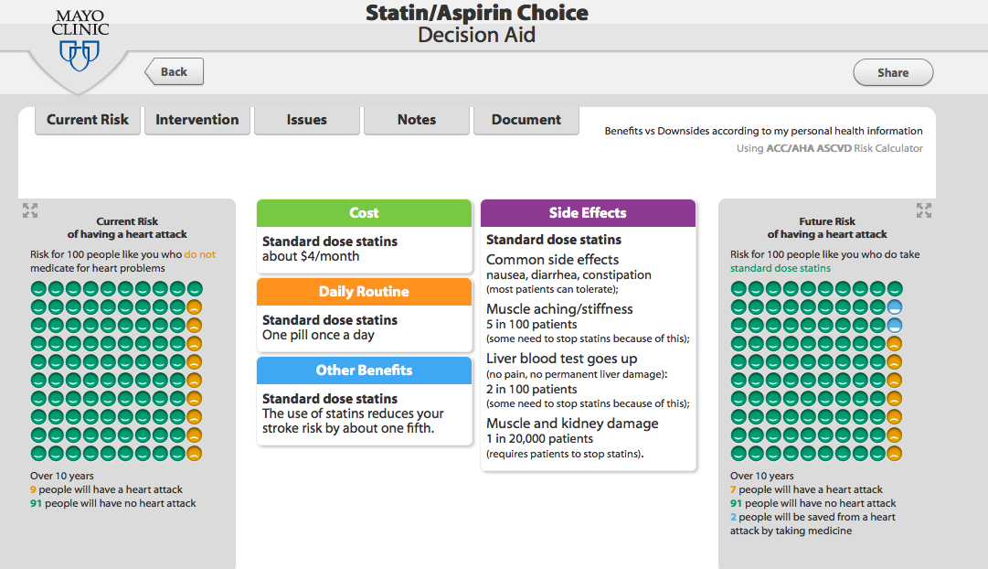
http://statindecisionaid.mayoclinic.org
Notes:
https://statindecisionaid.mayoclinic.org

Slide 34
Lessons Learned
SDM is never about patient abandonment; sometimes patients will ask you to make a decision for them: “Tell me what to do, Doc.”
If you know what is important to your patient, and something about their values and preferences, you will create more realistic plans that patients can live with.
Doing nothing is a choice. Sometimes it helps to identify that.

Slide 35
Other Lessons Learned
Agency and self-efficacy are essential to controlling chronic diseases.
“Management” of a chronic disease includes supporting patients’ sense of self-efficacy. Creating a sense of partnership leads to increased satisfaction for both provider and patient.
In the long-run, SDM saves time during visits and curtails frustration.
Decisions in chronic disease are not ‘done’ – circumstances change over time and require re-visiting the issues frequently.

Slide 36
Contact Information
Cathleen Morrow, M.D.
Dartmouth, Geisel School of Medicine
Cathleen.E.Morrow@dartmouth.edu

Slide 37
Shared Decision Making for Aging Veterans:
Long-Term Care Planning
Sheri Reder, Ph.D., M.S.P.H
VA Puget Sound Health Care System

Slide 38

What is SDM?
We define SDM as a collaborative, patient-directed decision making process that assists veterans in assessing their health-related needs, setting priorities, and making choices that achieve their goals.
SDM aligns with several VA initiatives, and it’s supported by VA leadership.

Slide 39
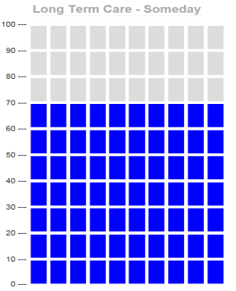
Why Aging Veterans?
Though the rate of growth is slowing, older veterans are the fastest growing cohort we serve.
By 2017, nearly 10 million of our 21.7 million veterans (46%) will be over 65.
About 70 out of 100 people need long-term services and supports (LTSS) during their lifetime.

Slide 40
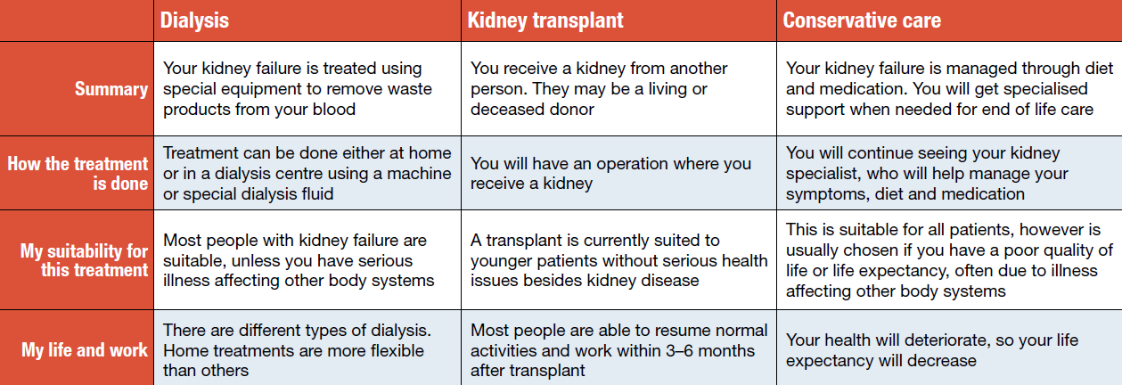
Conventional Use of SDM – Treatment
Traditional decision aids are used to provide health information, help prepare for a conversation with a health care provider, and/or make a decision about a specific treatment or whether to have a screening test.
http://homedialysis.org.au/wp-content/uploads/2013/03/Low-resolution.pdf

Slide 41
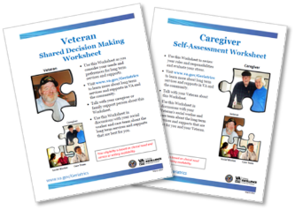
SDM: Other Preference Sensitive Choices
SDM works best for preference-sensitive choices. These decisions do NOT need to be treatment choices. For aging veterans, SDM is a best practice for choices that support aging-in-place.
Provide decision aids (Worksheets) and comprehensive information for veteran and family – www.va.gov/Geriatrics
Facilitate collaborative, asynchronous discussions among the patient, family, social worker, and medical care team.
Support patient-directed decisions, with the goal of decisions accepted by all.

Slide 42
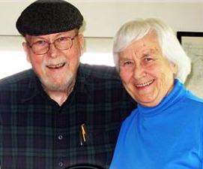
What Veterans Need to Make LTSS Choices
Research studies (including Reder, 2009) indicate veterans and their family caregivers need:
More information about long-term care options, in general.
More information about home and community-based services, so they can remain at home/be independent.
To be asked about their life goals and how LTSS can help support them.
Decision aids (i.e., worksheets) to facilitate making choices about LTSS.

Slide 43
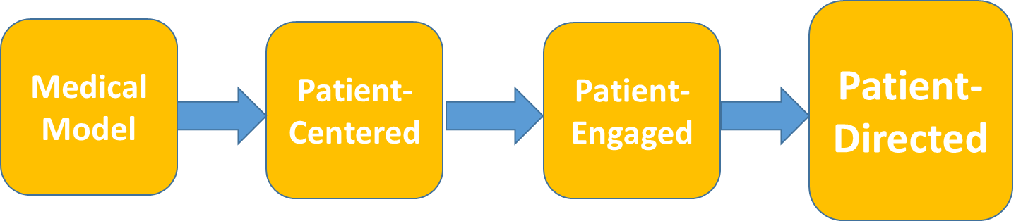
Shifting Veteran’s Role
Our goal is to shift the veteran’s role—and the care team process—from a medical model, focusing on provider expertise, toward a process of patient-directed decisions.

Slide 44

Outcome Measures
Proximal measures – goal of increased:
Access/referrals to home and community-based services.
Veteran-directed choices based on goals and priorities.
Veteran and family caregiver satisfaction with decision process.
Completion rate of advance directives.
Veteran aging-in-place.
Care team acceptance of veteran choice(s).
Distal measures – goal of decreased:
Emergency department and urgent care visits.
Number and length of inpatient hospital stays.

Slide 45

Staff Roles – It’s a Team Effort
The shared goal is veteran-directed decisions facilitated by care team input and quality information.
With SDM, roles filled by team members are interdependent.
This is achieved through collaborative, often asynchronous, discussions with veterans; and supported by team members
communicating with
each other and
respecting veteran’s
choice(s).

Slide 46
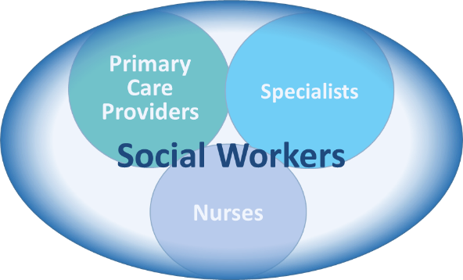
Social Workers – Key Staff Roles
“Social work/care management should take the lead to adopt SDM process and framework to help veterans make LTSS choices.”
— Michael Kilmer

Slide 47
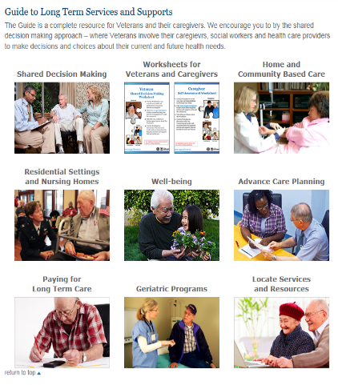
GEC Web Site – Key SDM Info and Tools
SDM overview and Decision Aids – Worksheets for veterans and family/caregivers
Key source of comprehensive range of LTSS and detailed descriptions
Information about geriatric programs and resources for older veterans on well-being, advance care planning, and paying for long-term care
www.va.gov/Geriatrics

Slide 48
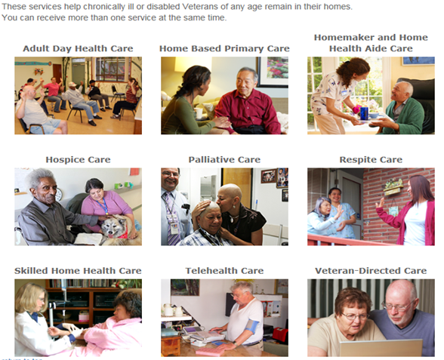
Home and Community-Based Care (HCBC)

Slide 49
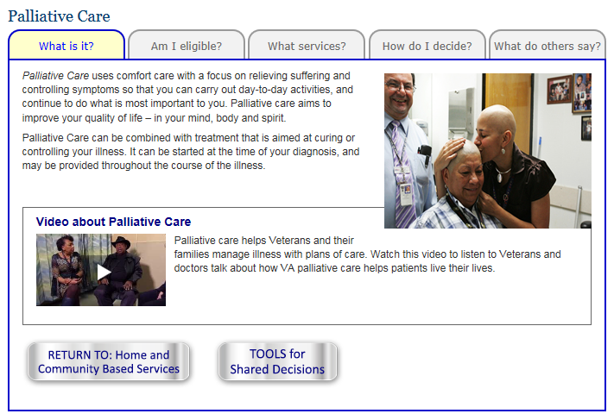

HCBC Service – Palliative Care
Watch video

Slide 50
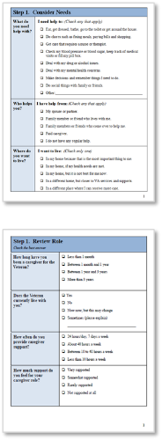
Decision Aid Worksheets
Veteran
Guides veteran through SDM process.
Used to identify goals, priorities, and plans, make decisions, or just start a discussion.
Can be completed or just reviewed; not a professional assessment tool.
Caregiver
Helps family caregivers assess their roles and responsibilities.
Can prompt readiness for participation in shared decisions.

Slide 51
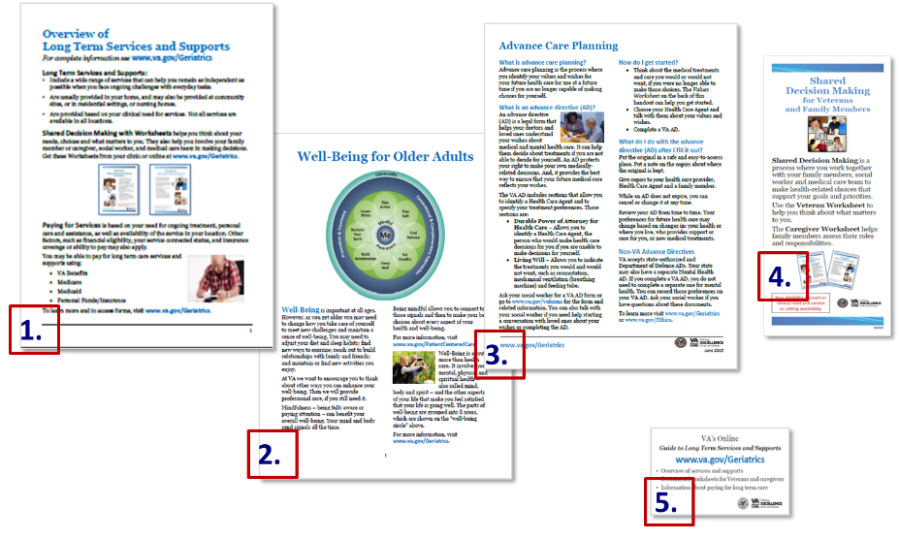
Other SDM Hardcopy Materials

Slide 52

Use SDM for Advance Care Planning (ACP)
SDM is a natural fit for Advance Care Planning.
Any veteran who is considering LTSS also should have an ACP discussion.
The SDM process can help in ACP discussions, such as who would make treatment choices for the veteran if they could no longer do it.
Planning ahead allows veterans to make important end-of-life choices when they can focus on them without pressure.

Slide 53
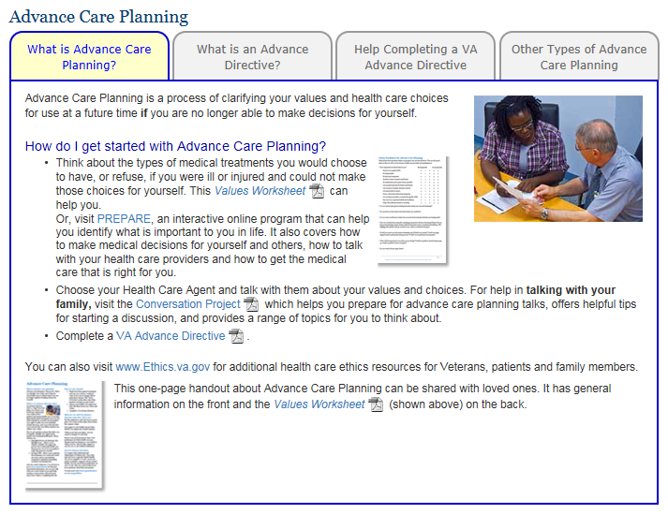
Advance Care Planning (ACP) Homepage
www.va.gov/Geriatrics includes an ACP section.
It provides links to the VA Advance Directive form, and a Values Worksheet.
And, it includes resources that support discussions about end-of-life choices, such as handouts, podcasts, and links to interactive Web sites.

Slide 54
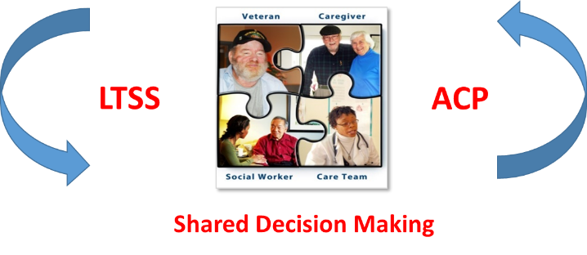
SDM Approach
The SDM approach is flexible—based on the situation, collaborative discussions about long-term services, and supports that can lead to discussions about advance care planning.

Slide 55
SDM Implementation Components
SDM requires change in behaviors. Because good information is rarely sufficient to change behavior, this multi-faceted implementation program includes:
Orientation and Training for all levels of staff from leadership to clinic/service line management and staff to those most closely involved with collaborative SDM discussions.
Policy and Program Changes to address gaps in availability and access to services, including funding (e.g., use of electronic wait lists; involvement of Veteran Community Partnership Organizations).
Tools and Information in hard copy and online that facilitate veteran-directed decisions (e.g., decision aids).

Slide 56

SDM Site Implementation Steps
Leadership Orientation – Provides brief sessions for national and VAMC leadership prior to training to ensure support for SDM.
Training 1 – For all staff and management of any clinic/service line that plans to implement SDM:
  Overview of SDM
  Implementation
  Team roles
  Care team process
Training 2 – Skills practice for social workers and other staff who most frequently discuss LTSS with veterans; uses case scenario teaching model.

Slide 57
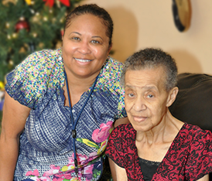
SDM Site Implementation Steps
Implement SDM for aging veterans – Determine your clinic screening criteria, use the GEC Web site and SDM hardcopy materials, and start having SDM discussions.
Interviews – Staff, veterans, and family caregivers will be invited to participate in a quality improvement assessment interview.
Report on progress – Summarize findings of quality improvement interviews.
Note: We are also conducting analyses from databases on outcome measures, such as number of LTSS referrals to home and community-based services and number of advance care directives completed.

Slide 58
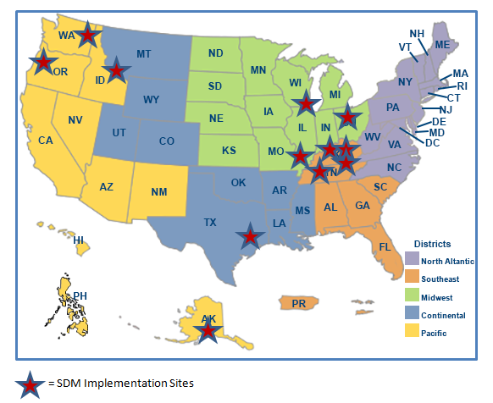
Implementation Sites
Funding for development, implementation, and assessment of Shared Decision Making for Aging Veterans has been provided from multiple sources, including national offices of:
Geriatrics and Extended Care
Rural Health
Patient-Centered Care and Cultural Transformation
Care Management and Social Work Services (key collaborator in this work)

Slide 59
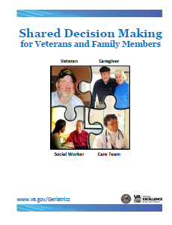
Key SDM Concepts – Review
The SDM approach supports:
Veteran self-identification of goals and priorities, based on their values, preferences, and needs.
Involvement of care teams in collaborative, often asynchronous, discussions with the veteran.
Veteran understanding of medical conditions, the likely effects on health and function, and options for obtaining services and support.
Provision of comprehensive information and use of decision aids to support veteran-directed choices.
Access to home and community-based services to support aging-in-place.

Slide 60
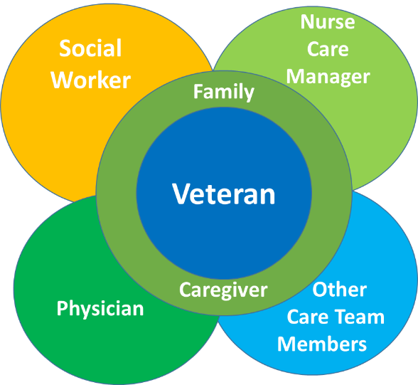
SDM: Collaboration – Veteran at Center

Slide 61
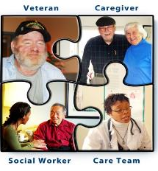
Contact information
We look forward to collaborating with you on implementation of SDM for Aging Veterans.
Sheri Reder, Ph.D., M.S.P.H.
Director, Shared Decision Making for Aging Veterans
Research Investigator, HSR&D
Sheri.reder@va.gov

Slide 62
Obtaining CME/CE credits
If you would like to receive continuing education credit for this activity, please visit:
http://etewebinar.cds.pesgce.com/eindex.php

Slide 63
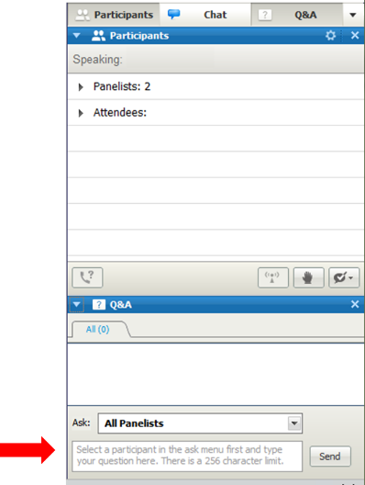
How to submit a question
At any time during the presentation, type your question into the “Q&A” section of your WebEx Q&A panel.
Please address your questions to “All Panelists” in the dropdown menu.
Select “Send” to submit your question to the moderator.
Questions will be read aloud by the moderator.
SHARE@ahrq.hhs.gov

Slide 64
Questions about AHRQ’s
SHARE Approach Resources
Contact:
Alaina Fournier
alaina.fournier@ahrq.hhs.gov OR
SHARE@ahrq.hhs.gov
Agency for Healthcare Research and Quality

Slide 65
Obtaining CME/CE Credits
If you would like to receive continuing education credit for this activity, please visit:
http://etewebinar.cds.pesgce.com/eindex.php

