Slide 1
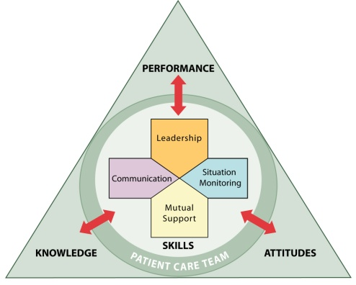

Enhancing Safety for Patients With
Limited English Proficiency
Train-the-Trainer Instructor Guide
TM

Slide 2

Prework
INSTRUCTOR NOTE:
A training of trainers will be most beneficial if participants feel their institution is ready to implement the TeamSTEPPS LEP module. Ask potential participants to complete the readiness questionnaire before you schedule a training. If they feel their institution is ready, based on their responses to the questionnaire, you may include them in the training of trainers.
How many people should you include in your training of trainers? To ensure a team-based experience, we recommend that at least two persons lead the training and a minimum of three hospital teams attend. Each hospital team should include at least two persons to be trained as trainers. Trainings can be scaled up considerably with a larger number of facilitators. You will need at least one facilitator to support every three to four hospital teams trained during breakout sessions.
Who should attend? Ideally, the entire interprofessional care team will be trained together so that doctors, nurses, interpreters, technicians, receptionists, and other members of the care team can work together as a team. In practice, the team may have to be trained in smaller groups, but it is important to have a mix of professionals at each of the small-group trainings. It is also important to engage attending physicians (not just residents) to ensure that culture change takes hold.
Once you have a participant list finalized, prework materials should be sent to training participants at least 2 weeks before the training. Prework materials should include the letter provided in the “prework” folder (edited to best meet your needs and placed on your institution's letterhead) and the site assessment questionnaire, which includes the patient language process map. The site assessment and process map are also shown below.
PREWORK TIME:
30 minutes
MATERIALS:
  Readiness assessment survey
  Letter with prework site assessment for trainers

Slide 3
Prework: Site Assessment for Trainers
Please take a moment to answer the questions below. This will help you to customize the training module to your audience’s needs.
Approximately what percentage of your patients has limited English proficiency (LEP)?
What are the most common languages spoken by your patients?
Answer the following questions on the attached Patient Language Process Map for the units that will receive the training; mark areas of risk or in need of improvement.
In your clinical area…
Who on staff identifies patient language needs? How?
Who contacts an interpreter if needed? How?
Contingency plans: What happens when the interpreter is unavailable, arrives late, or cannot stay for the entire patient encounter?
Who ensures that the interpreter is present for the entire encounter? How?
Who ensures that the interpreter is fully informed and integrated into the team? How?
Please attach a copy of your hospital or organization’s policies for calling an interpreter.
List some examples of real situations from your hospital/clinical area in which LEP patients were at risk due to language barriers or not having an interpreter available (use the reverse side of this sheet if needed).

Slide 4
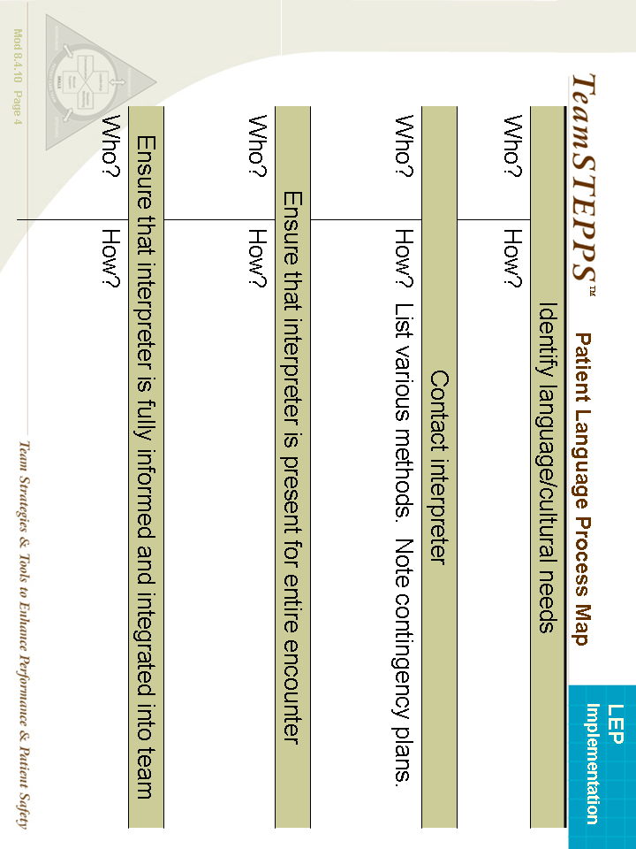

Slide 5
Train-the-Trainer Session Agenda
  Experience pretraining evaluation questionnaires as intended for students (15 minutes)
  Experience the module as intended for students (60 minutes)
  Experience posttraining evaluation questionnaires as intended for students (15 minutes)
  ~ Break – 15 minutes ~
  Debrief on teaching points and areas for customization (15 minutes)
  Implementation planning – phases I and II (55 minutes)
  ~ Lunch – 45 minutes ~
  Implementation planning – phase III (25 minutes)
  Practice teaching parts of the module (40 minutes)
  Wrap-up and Q&A and evaluation (15 minutes)
  LEARNING OBJECTIVES:
  1. Understand the evidence on patient safety risks to LEP patients
  2. Assemble the most appropriate and effective care team for LEP patients
  3. Identify and raise patient communication issues
  4. Use the site readiness assessment to customize training and implementation plans
  5. Develop an implementation plan
  6. Develop the ability to teach Objectives 1–3
No Slide
SESSION TIME:
4 hours, not including breaks
MATERIALS:
  Flash drive or CD with training materials
  Pens
  Train-the-Trainer handouts
  Prework (brought in by participants)

Slide 6

Introduction
SAY:
We begin this Train-the-Trainer session with the module itself, just as you will present it to your participants. Please locate and use your slide handouts for the module “Enhancing Safety for Patients With Limited English Proficiency” and follow along, noting areas where you may wish to customize the material for your own group. The “script” of notes for these slides will be provided to you later in this session.
In recent years, the Agency for Healthcare Research and Quality and the Department of Defense have worked together to enhance patient safety through the TeamSTEPPS system. The TeamSTEPPS system is a powerful set of teachable and trainable skills, behaviors, and tools that has been shown to reduce medical errors. In this module, we show how the TeamSTEPPS system can be used to enhance the safety of patients with limited English proficiency (LEP).
Before we start the module, I’d like you to complete some baseline surveys. The surveys are anonymous and will help us track our progress as a team. Everyone in this session should complete the Learning Outcomes Survey. In addition, everyone in the group except for interpreters should complete the baseline Pretraining Behavior Survey. You will have 10 minutes to complete these surveys.
(Collect baseline surveys and thank participants.)
MODULE TIME:
60 minutes + evaluation time (30 minutes)
PRE- TRAINING EVALUATION TIME:
15 minutes
MATERIALS:
  Flash drive or CD with training materials
  Pens
  Staff training handouts
INSTRUCTOR NOTE:
This module may be customized based on the group’s knowledge and experience with LEP and culturally diverse patients and TeamSTEPPS. For example, if the group is aware of medically significant miscommunication incidents that have occurred with LEP patients in their hospital, it may be useful to replace one of the presentation’s case examples with the example that participants know. Groups familiar with TeamSTEPPS may not need as many slides about TeamSTEPPS, whereas some hospital teams may want to add more slides about TeamSTEPPS as part of a comprehensive implementation effort. Additional TeamSTEPPS resources are available at http://teamstepps.ahrq.gov/.

Slide 7
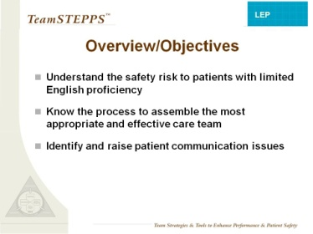
Overview/Objectives
SLIDE TIME:
1 minute
SAY:
This module will help you to:
Understand the safety risk to patients with limited English proficiency.
Know the process to assemble the most appropriate and effective care team for LEP and culturally diverse patients.
Identify and raise patient communication issues.
Notes:
Read objectives
6

Slide 8
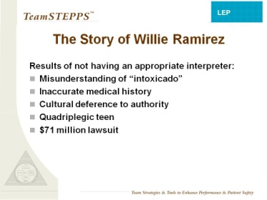
The Story of Willie Ramirez
SAY:
To illustrate why LEP patients are at risk of patient safety events, I would like to share the story of Willie Ramirez. This case is one of the most well-known examples in which limited English proficiency and cultural misunderstandings led to a tragic medical error.
In 1980, 18-year-old athlete Willie Ramirez was taken to the ER by ambulance in a coma, accompanied by his Mom, his sister, his girlfriend, and his girlfriend’s Mom. The ER physician, who did not speak Spanish, assumed Willie had a drug overdose because he had pinpoint pupils and because the girlfriend’s Mom said, in broken English, “He is intoxicado.” In Cuban Spanish, “intoxicado” means “poisoned.” The family thought he had eaten a bad hamburger at a new fast food restaurant that day.
When the ER doctor told the family he would treat Willie for drug overdose, they said to one another, in Spanish, “That’s impossible, he would never take drugs.” Willie was an all-star baseball player and was opposed to drugs and drinking. However, the doctor did not understand what the family was saying. Willie’s brain hemorrhage kept bleeding for more than 2 days before a neurologic consult was scheduled. By then, Willie was quadriplegic. The family sued the hospital, resulting in a $71 million settlement.
Although the ER doctor didn’t understand what was said at the time, in a later interview, the ER doctor said, “If I had a Mom who said, ‘My son would NEVER use drugs,’ I may have thought differently.” However, the family member who was interpreting did not share this information with the doctor, because cultural differences complicated the language issue. In some cultures, people never contradict an authority figure, such as a doctor.
Neither the doctor nor the family asked for a professional medical interpreter because they thought they were communicating well. A professional interpreter could have facilitated mutual understanding by interpreting the doctor’s and family’s words to one another, asking questions to make sure they understood correctly, and speaking up when the family expressed doubts about the doctor’s diagnosis.
SLIDE TIME:
5 minutes
INSTRUCTOR NOTE:
You may read the full story here:
http://healthaffairs.org/blog/2008/11/19/language-culture-and-medical-tragedy-the-case-of-willie-ramirez/
7
Notes:
7

Slide 9
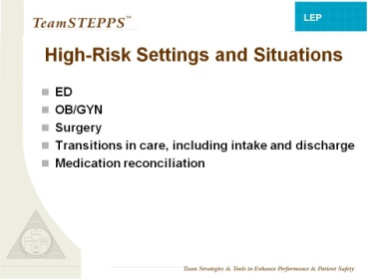
High-Risk Settings and Scenarios
SAY:
Research shows that patient safety events that affect LEP patients tend to be more severe and more frequently due to communication errors compared to English-speaking patients.
LEP patients may be particularly vulnerable in interactions with staff in ED, OB/GYN, or surgical settings. When care is time sensitive and communication with the patient or family is important, such as intake, transitions in care, discharge, and medication reconciliation, LEP patients may need additional support to maintain safety.
SLIDE TIME:
1 minute
INSTRUCTOR NOTE:
The points made above are supported by preliminary research conducted to develop this training module and by these references:
Divi C, Koss RG, Schmaltz SP, et al. Language proficiency and adverse events in U.S. hospitals: a pilot study. Intl J Qual Health Care 2007;19(2):60-67. Epub 2007 Feb 2.
Flores G, Laws MB, Mayo SJ, et al. Errors in medical interpretation and their potential clinical consequences in pediatric encounters. Pediatrics 2003;111(1):6-14.
Notes:
8

Slide 10
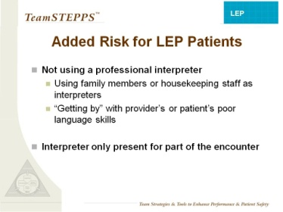
Added Risk for LEP Patients
SAY:
Research also indicates that without a professional interpreter, medical interpretation errors are more common and significantly more likely to have potential clinical consequences. LEP patients also have higher lengths of stay and readmission rates.
When the care team asks family members or housekeeping staff to interpret, or when they rely on their own limited foreign language skills or the patient’s limited English, they place LEP patients at risk for physical harm.
In addition, they place the ad hoc interpreter at risk for psychological harm. Imagine how you would feel if you made an error in interpretation that caused your family member to become quadriplegic.
Another risky situation is when the interpreter arrives after the encounter has already begun or is called away before the encounter ends. Ideally, the interpreter should be present for the whole encounter. If this is not possible, the interpreter should be briefed when he or she arrives and a backup plan should be in place in case the interpreter has to leave.
As of this writing, there is no evidence that in-person interpreters are any safer than phone or video interpreters. The key is to use a professional medical interpreter.
SLIDE TIME:
2 minutes
INSTRUCTOR NOTE:
The points made above are supported by preliminary research conducted to develop this training module, and by the references in the Evidence Summary handout.
MATERIALS:
  Evidence summary sheet

Slide 11
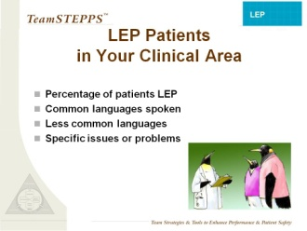
LEP Patients in Your Clinical Area
INSTRUCTOR NOTE:
The bullet points in this slide should be replaced with information about LEP patients in the clinical area where you conduct the training.
About the penguins: Graphic design used throughout TeamSTEPPS, including the cartoon penguins, is inspired by the 2006 book by John Kotter, Our Iceberg Is Melting: Changing and Succeeding Under Adverse Conditions. The book illustrates Kotter’s Eight Stages of Change, a proposed set of steps to initiate and sustain change in an organization, through the story of a penguin colony faced with a melting iceberg.
Reference:
Kotter J, Rathgeber H, Mueller P. Our iceberg is melting: changing and succeeding under adverse conditions. New York, NY: St Martin’s Press; 2006.
SLIDE TIME:
1 minute
CUSTOMIZABLE CONTENT
Notes:
10

Slide 12
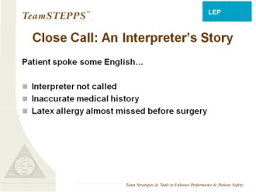
Close Call: An Interpreter’s Story
SAY:
Here is an example of a close call that we experienced here. This story comes from (specify source, such as interpreter services, nursing, or patient safety).
“The patient came to the surgery, and it was assumed that the patient spoke English. After the whole assessment was done, the patient answered inappropriately, and that made the nurse doubt. She called interpreters, and I arrived. And the nurse said, ‘You said you’re not allergic to medicine….drug or latex.’ And when I interpreted, [the patient] said, ‘I am allergic to latex’. …And the nurse kept saying, ‘Are you sure?’ and she said, ‘Yeah…’ ‘And what happens to you?’ ‘Well, they put the latex band…it was itchy, it was red, and it was swollen.’ So she had to stop, run, call the OR, put on the latex sensitivity. They had to move everything from the OR.”
SLIDE TIME:
2 minutes
INSTRUCTOR NOTE:
Replace this story with a local story from one of your clinical settings, in which an LEP patient was at risk or was harmed due to problems with cultural differences or missed communication. You will likely discover stories of close calls or risky situations if you speak to frontline staff members or leaders in nursing, interpreter services, or patient safety.
If you do not have a local story to share, you may use the example above and say:
“As part of the preliminary research that was done for this training module, 18 people were interviewed in 3 hospitals among frontline staff and leaders in interpreter services, nursing, and patient safety. All 18 reported situations where an interpreter was needed but was not present. In several cases, this led to ‘close calls’ like the one described on this slide.”
11
Notes:
11

Slide 13
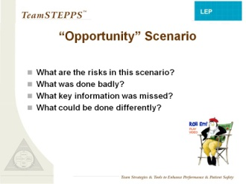

Scenario
SAY:
This video gives us an example situation in which a patient with limited English proficiency is at risk.
DO: Show the “Opportunity” video.
Play the video by clicking the penguin director icon on the slide.
You must be in slide show mode for the video to play.
SLIDE TIME:
7 minutes
Ask participants: What are the risks in this situation? What was handled well? What was handled poorly? What important information was missed? What could be done differently? Allow them the opportunity to discuss and respond. If they do not respond, prompt them with suggestions:
What might the triage nurse have known about words that sound familiar in foreign languages?
  Words that sound the same can mean different things.
At what point should a professional interpreter have been called ?
  The triage nurse, Rachel Lansky, could have identified the need and called the interpreter sooner.
At what other points were there missed opportunities to call an interpreter?
  At the front desk (before the triage nurse), and earlier in the conversation with Dr. Desai .
What else could the care team have done to better communicate with the patient and his wife?
  We’ll review some of the things the care team could have done in the rest of the training.
VIDEO TIME:
4:34 minutes
Notes:
12

Slide 14
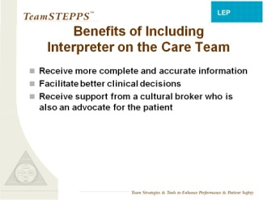
Benefits of Including Interpreter on the Care Team
SAY:
Including a professional interpreter as a member of the care team has significant benefits to the patient.
The presence of a professional interpreter also has significant benefits to the care team, ensuring that both the patient and the care team have more accurate and complete information, which facilitates decisionmaking.
The interpreter achieves this primarily by interpreting the spoken words or written documents.
In addition, the interpreter can serve as an advocate, speaking up when he or she thinks the patient or provider may have missed important information.
Finally, the interpreter can serve as a cultural broker, helping health care providers understand the cultural perceptions and expectations of the patient as well as helping the patient understand the expectations and culture of health care.
SLIDE TIME:
3 minutes
INSTRUCTOR NOTE:
It can also be beneficial to use bilingual staff who are certified to provide care in non-English languages or volunteers who are trained and certified to act as interpreters.
Some health care settings advocate a “Black Box” model, where interpreters limit themselves to interpreting and translating words. However, patient safety can be enhanced when the interpreter is also allowed to share important cultural information and raise patient safety concerns.
In many other health care settings, medical interpreters are trained to serve as cultural brokers and patient advocates, but clinical staff do not always welcome their intervention in this role. It may be useful to assess the culture of interpretation at your own hospital to help you set your goals.
13
Notes:
13

Slide 15
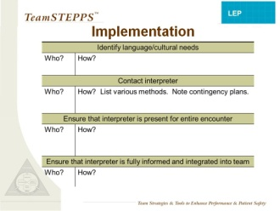

Implementation
SAY:
  What is the process for obtaining an interpreter in your clinical area?
  The basic steps include (1) identifying the need for language or cultural support, (2) contacting the interpreter, (3) ensuring that the interpreter remains present during the entire patient encounter, and (4) ensuring that the interpreter is fully informed and integrated into the patient care team.
  There are often barriers that make it difficult for people to fully implement the process. For example, an interpreter is not always available right away, or the interpreter may arrive late or need to leave early. Since these problems put LEP patients at risk, it is important that you or your team leader raise these issues with your patient safety and interpreter services leaders. This module has an accompanying guide to help hospital leaders address the challenges.
  In the meantime, your process should include a way of implementing contingency plans, such as calling a phone interpreter if no face-to-face interpreter is available, briefing interpreters when they arrive, and switching to a new interpreter or telephone interpretation if the face-to-face interpreter needs to leave before the encounter is complete.
  EXERCISE:
  Instruct participants to take out their blank copy of the patient language process map and to take 5 minutes to complete it, adding any steps necessary at their site and noting who, when, and how. If there is a team from one unit or area, they can work together to complete the worksheet, or they may use a flipchart for easy viewing by the whole group. Once they have completed the sheet, ask the groups to share their detailed maps with the full group, closely monitoring time (5 minutes).
  Participants may find it useful to flag problems that hinder them from following the outlined process and to develop a contingency plan and a plan to raise these issues with their organization’s leaders.
SLIDE TIME:
7 minutes
MATERIALS:
  Patient Language Process Map
  Optional: Flipcharts and markers
Notes:
14

Slide 16
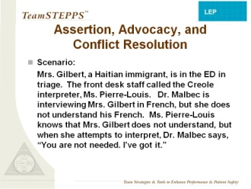
Assertion, Advocacy, and Conflict Resolution
DO:
Read the scenario.
DISCUSSION:
What are the risks to the patient in this scenario?
What could go wrong?
What needs to happen to avoid problems? If you were Ms. Pierre-Louis, what could you do?
(Allow time for group to answer questions and discuss. If no one speaks up, call on a few people by name to encourage responses to these questions.)
SAY:
Specific skills needed in this scenario include assertion, advocacy, and conflict resolution. We will learn some structured methods of assertion that might help in situations like this.
SLIDE TIME:
3 minutes
INSTRUCTOR NOTE:
Two main languages are spoken in Haiti, Haitian Creole (sometimes referred to as just “Creole”) and French. Speaking French signals a higher social status. Thus, some patients may be reluctant to admit they don’t understand it well.
Most countries have more than one language and several dialects. It is safest and only takes a few seconds to ask patients what language they speak best or in what language they would like to receive care.
15
Notes:
15

Slide 17
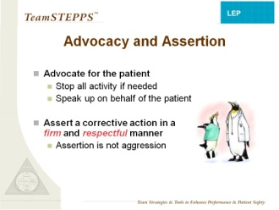
Advocacy and Assertion
SAY:
Advocacy and assertion are useful for any team member who does not agree with a decisionmaker or who notices a patient safety problem. In advocating for the patient and asserting a corrective action, the team member has an opportunity to correct or avoid errors. Failure to use advocacy and assertion has been frequently identified as a primary contributor to the clinical errors found in malpractice cases and sentinel events.
DISCUSSION:
When might you use advocacy and assertion for LEP patients?
To make sure that patient language needs are assessed.
To make sure that an interpreter is called when needed.
To raise communication issues.
SAY:
When advocating, assert your viewpoint in a firm and respectful manner. You should also be persistent and persuasive, providing evidence or data for your concerns. Appropriate assertion is a way to advocate for the patient. In the interest of safety, you may need to speak up to stop all patient care activity until a risk can be resolved or until the patient understands what is happening. In this session, we will show you structured language and gestures that can make it easier to be appropriately assertive.
It’s helpful to note that assertion is not aggression. Assertive statements respect and support authority.
SLIDE TIME:
3 minutes
DISCUSSION:
Why might it be difficult to speak up on behalf of the patient? (Allow the group to respond.) Some possible reasons include the traditional hierarchy of health care, strong personalities of some health care providers, and previous negative experiences with speaking up. If you have tried it once and been “shot down,” you tend to be very hesitant to speak up again even in a different setting with different people. Cultural differences are also a factor in the difficulty with assertion, because deference to authority is an important value in many cultures.
Notes:
16

Slide 18
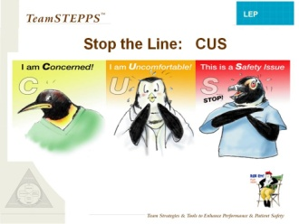
Stop the Line: CUS
SAY:
Structured language can make it easier to speak up and be assertive when it’s needed. Using a “script” of set phrases that the team has agreed upon in advance can make interactions more predictable and less “personal.”
In TeamSTEPPS, when we need to “stop the line” to ensure safety, we “CUS.” The team understands that when any member of the team says, “I’m concerned…I’m uncomfortable…This is a safety issue…” it means that we need to pause and make sure no safety risks are happening and that the entire team understands the situation.
The phrases function as a signal, similar to calling a code. Hand signals or gestures are also useful as “code” language for interpreters (or others) to indicate a need to stop and listen. Raising the hands in front of yourself, palms out, can be an agreed-upon gesture to “stop the line” for interpreters. Here’s an example.
SLIDE TIME:
5 minutes
DO: Show “CUS” video clip.
VIDEO TIME:
:47 seconds
Play the video by clicking the penguin director icon on the slide.
DISCUSSION:
Was the use of CUS effective? Why?
SAY:
You can also use these signal phrases to escalate a concern. First state that you are concerned; then, if there is no response, you can go on to say you are uncomfortable or that this is a safety problem. It’s important to give as much information as you can regarding why you are concerned and what you are seeing or hearing that is making you uncomfortable.
17
Notes:
17

Slide 19
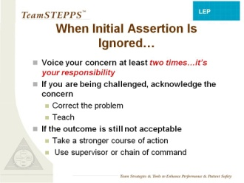
When Initial Assertion Is Ignored…
SAY:
It is important to voice your concern by advocating and asserting your statement at least twice if the initial assertion is ignored (sometimes it is called the “Two-Challenge rule”). These two attempts may come from the same person or two different team members.
The first challenge should be in the form of a question or initial concern. The second challenge should provide some support for your concern. Remember, assertion is about advocating for the patient.
This “two-challenge" tactic ensures that an expressed concern has been heard, understood, and acknowledged. If, after two attempts to clearly assert your concern, there is no resolution of the problem, you may then seek assistance from an additional resource, such as a charge nurse or other physician.
SLIDE TIME:
1 minute
Notes:
18

Slide 20
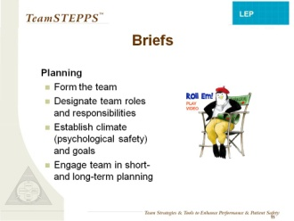
Briefs
SAY:
Once the full team is present and engaged, it’s necessary to ensure that all are informed. This includes the interpreter. Briefs are a communication and team tool for planning purposes.
The team leader is responsible for organizing a short briefing to discuss essential team information and to establish an environment in which the team, including the interpreter and the patient, are comfortable speaking up and participating. The following information should be discussed in a brief:
  Team membership and roles—who is on the team (including the interpreter) and who is the designated team leader.
  Encouragement to speak up and share any relevant information or concerns, including relevant information about the patient’s culture that might affect care.
  Team goals, plans, and risks—what is to be accomplished, who will do it, and what the potential risks are.
SLIDE TIME:
3 minutes
DO: Show “Optional Briefs” video.
Play the video by clicking the director icon on the slide.
VIDEO TIME:
:36 seconds
  DISCUSSION:
  Who is the team leader?
  How did the leader establish psychological safety for the team?
  Did the team have a plan for the patient?
  Did everyone understand the plan?
19
Notes:
19

Slide 21
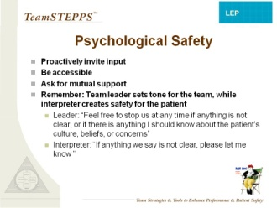
Psychological Safety
SAY:
The team leader establishes psychological safety for the group; the INTERPRETER establishes this for the patient. This is the way we create an environment in which it is safe to speak up.
Traditional hierarchy, status differences, and cultural differences can create real barriers to effective team communication. It is up to the leaders of a team to overcome these barriers through these strategies.
Leaders invite comments by calling on team members by name and by role: “Gerardo, as the interpreter, do you see anything here that we’ve missed or that Mr. Ruiz may not understand?” or “Jane, as Mrs. Ruiz’s nurse, do you have anything to add?”
Leaders also are perceived as more accessible and approachable if they validate the comments of the team. “Mr. Ruiz, it sounds like you are concerned about this.” Leaders also recognize that all humans can make mistakes and they ask for mutual support to avoid error. You can do this in your own words; for example: “If you see anything that seems risky or that you don’t understand, please let me know,” or “Feel free to stop us at any time if anything is not clear, or if there is anything I should know about the patient's culture, beliefs, or concerns.”
SLIDE TIME:
3 minutes
VIDEO TIME:
:40 seconds
DO: Show the “Psychological Safety” video.
Play the video by clicking the penguin director icon on the slide.
Notes:
20

Slide 22
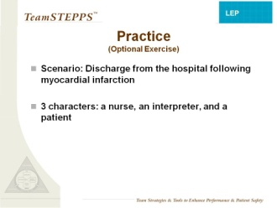
Optional Practice Exercise
INSTRUCTOR NOTE:
This exercise is optional. It may be useful if you have more than an hour to teach the module, or if you are teaching the module in segments over several days’ time.
SAY:
We’re going to practice briefing, including creating psychological safety, by having you read through a scenario where a patient is being discharged from the hospital after a myocardial infarction. I need someone to play the nurse, someone to play the interpreter, and someone to play the patient.
DO: Hand out the briefing exercise. Ask for volunteers to be the nurse, interpreter, and patient. Have them read the scenario. It is o.k. for them to deviate from the script and do more of a role play.
OPTIONAL EXERCISE TIME:
5 minutes
MATERIALS:
  Briefing exercise handout
21
Notes:
21

Slide 23
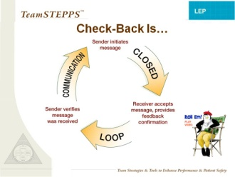
Check-Back Is…
SAY:
A check-back is a closed-loop communication strategy used to verify and validate information exchanged. The strategy involves the sender initiating a message, the receiver accepting the message and confirming what was communicated, and the sender verifying that the message was received.
A simple example of this is in the coffee shop when you order a tall nonfat soy latte, and the cashier says aloud, “Tall nonfat soy latte” and the person behind the counter repeats back, “Tall nonfat soy latte,” and you verify, “That’s correct.”
A clinical example would be an information call-out such as, “BP is falling, 80/48 down from 90/60.” The sender expects the information to be verified (repeated aloud) and validated and to receive a follow-on order that must be acknowledged with a check-back.
In the video, you will see a provider using check-back to confirm her understanding of what the patient was saying.
  DO: Play the “Check-Back” video clip.
  Play the video by clicking the penguin director icon on the slide.
SLIDE TIME:
3 minutes
VIDEO TIME:
:57 seconds
Notes:
22

Slide 24
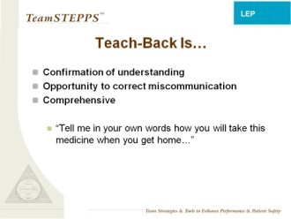
Teach-Back Is…
SAY:
While check-back simply verifies accuracy of a simple communication, teach-back is a method to confirm understanding of larger concepts or processes. In a teach-back, you ask people to tell you in their own words what they have learned or understood.
This technique can be most useful for interpreters, who can use the teach-back to correct any misinformation or missed communication.
Examples include asking patients to tell how they will take their medication when they get home or how they will explain their illness to their family.
SLIDE TIME:
1 minute
23

Slide 25
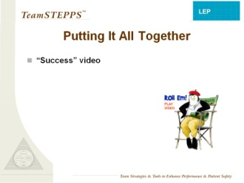
Putting It All Together
  DO: Play the “Success” video.
  Play the video by clicking the penguin director icon on the slide.
DISCUSSION:
What tools were used in this version that were not used in the first version of this scenario?
How did the use of those tools change the outcome?
What challenges might you have using these tools in your work?
How might you overcome these challenges?
Tell us about a time when these tools would have come in handy.
SLIDE TIME:
8 minutes
VIDEO TIME:
6:08 minutes
24
Notes:
24

Slide 26
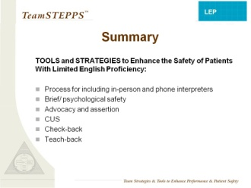
Summary
SAY:
In summary, here are tools and strategies that can enhance the safety of your patients with LEP:
Process for including in-person and /or phone interpreters
Brief/psychological safety
Advocacy and assertion
CUS
Check-back
Teach-back
SLIDE TIME:
1 minute
25

Slide 27
Training Evaluation
SAY:
Thank you very much for your participation today. Please take a few minutes to complete the training evaluations that are in your training packets. Then we will discuss this module. Everyone should complete two forms: the Training Participant Satisfaction Survey and the Learning Outcomes Survey. We anticipate this will take you no more than 15 minutes.
As a reminder, you do not have to put your names on any of the survey questionnaires. We are just using this information to get some feedback on how we did as trainers and to improve future trainings.
No Slide
POST-TRAINING EVALUATIONTIME:
15 minutes
MATERIALS:
  Training Participant Satisfaction Survey
  Learning Outcomes Survey
  Pens

Slide 28
Review the Teaching Points
DISCUSSION:
Having experienced the module, what questions do you have about the content?
What parts will be easiest for you to teach?
Which parts will be harder to teach? Why?
Where will you want to customize the module for your group? (Note: Slides 6 and 7 require customization).
What concerns were raised for you as you experienced the module?
DISCUSSION TIME:
10 minutes
27

Slide 29
Review the Instructor Guides
DO:
Hand out the module Instructor Guides to participants, or direct them to that segment of their packet.
SAY:
This guide provides you with a possible script to accompany the slides and indicates areas where you can customize the material. Additional resources and references are also provided. As we go through the guide, please note the places where you would want to customize the content.
DO:
Go through the guide briefly, answering questions and clarifying symbols.
No Slide
5 minutes
MATERIALS:
  LEP Staff Training Instructor Guides

Slide 30
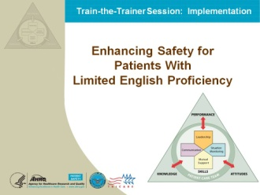
Implementation
INSTRUCTOR NOTE:
The TeamSTEPPS LEP implementation slides are used in the following segment, which will take about 50 minutes to complete.
SAY:
For this portion of the training, you need to be in groups with the others from your organization so that you can work together on the activities and worksheets.
29

Slide 31
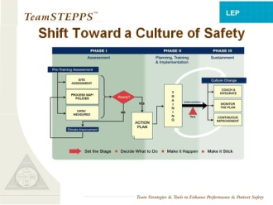
Implementation: Shift Toward a Culture of Safety
SAY:
This diagram provides an overview of the implementation of any culture change and of any TeamSTEPPS intervention. If you have done other TeamSTEPPS work in your organization, you are probably familiar with this process. We’ll review it very briefly. Any successful implementation has three phases: Assessment, Planning/Training/Action, and Sustainment. You can think of it in simple terms by following the bottom of the diagram: Set the Stage, Decide What To Do, Make It Happen, Make It Stick.
In Phase I, assessment, you use what information you have to determine readiness and to inform your planning phase. For this intervention to improve the safety of LEP patients, you’ll use the site assessment you completed prior to training. This will include the process map you completed, information you gathered about your hospital or organization’s policies for calling an interpreter, and data you have about LEP patients at your organization. You can include any useful survey data you might have, such as patient satisfaction survey information if it can be segmented by language or cultural needs. If the results of your assessment indicate readiness, then you move into action planning—and we will do that today in this module. You’ll leave this session with an action plan for your implementation.
Only after assessment, review of the information, and action planning are you ready to plan your training. Training alone is not enough to implement a change in safety culture. Your staff probably won’t be motivated to change their behavior in terms of accessing language services and integrating interpreters on the care team with just training. You have to build in a change in the way things are done…that’s the intervention. Then you test your intervention, on a small scale, to see if it needs any adjustment prior to implementing. If you are changing the way you call for an interpreter, for example, do that in just one unit or on just a few days to see if the process you’ve decided on really works well. Then, once it’s been tested and improved, you can actually implement the change. Build your training to prepare people for the change in behavior and the change in practice.
Monitoring the measures you choose during assessment is a way of building in sustainment and making your changes stick. So is the use of coaches. We will provide you with some information about coaching later today….but this is the basic process you’ll be using now to plan your changes and your training.
SLIDE TIME:
5 minutes

Slide 32
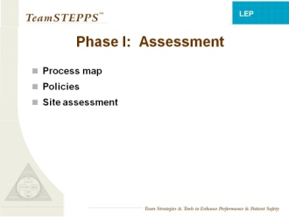
Implementation Phase I - Assessment
SAY:
We will now work through the first phase, assessment, using your prework materials.
MATERIALS:
  Completed site assessments
31

Slide 33
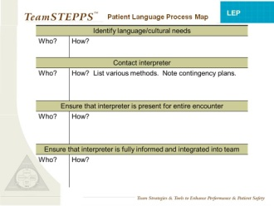
Implementation: Patient Language Process Map
SAY:
Let’s start with your Patient Language Process Map. Take out the one from your prework assessment, as well as the one completed today when you experienced the LEP module. It may be helpful to label these “Current Process Map 1” and “Current Process Map 2.” These should represent how your process currently works.
You have in your packet a blank process map. Work with your group to reach consensus on the ideal, safest process you’d like your clinical area to follow and complete the worksheet accordingly. It may be helpful to label this worksheet “ideal process map.” You have 5 minutes to complete this exercise.
DISCUSSION:
What are the gaps that you identified in the current process?
How will you address them so that you can implement the ideal process map?
SAY:
During the field test for this training module, several hospital teams found that they needed to make system changes so that their ideal process could become a reality. For example:
One hospital revised its interpreter standards to recognize the interpreter’s advocate role; and
Another hospital restructured its interpreter services to accommodate higher demand in Labor and Delivery.
TIME:
10 minutes
MATERIALS:
  Previously completed Patient Language Process Maps
  One blank copy of the Patient Language Process Map

Slide 34
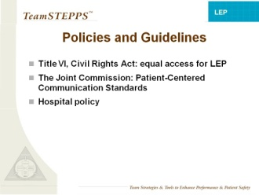
Implementation: Policies and Guidelines
SAY:
Now we will consider policies that govern use of language services for your patients.
Title VI of the Civil Rights Act requires recipients of Federal assistance (such as Medicare and Medicaid funds and grants) to take reasonable steps to provide meaningful access to LEP persons. http://www.hhs.gov/ocr/civilrights/resources/specialtopics/lep/policyguidancedocument.html. In case any of your trainees feel they should not have to accommodate LEP patients, it can be helpful to mention this legal requirement.
Effective July 1, 2012, Joint Commission standards require hospitals to identify, record, and address patient communication needs, including preferred language for discussing health care. Hospitals are required to provide qualified interpreter services when needed. The Joint Commission’s Patient-Centered Communication standards are available in Appendix C of the guide titled Advancing Effective Communication, Cultural Competence, and Patient- and Family-Centered Care: A Roadmap for Hospitals, available at: http://www.jointcommission.org/assets/1/6/ARoadmapforHospitalsfinalversion727.pdf
Consider these requirements along with your hospital policies that you have included in your Prework Site Assessment. Take 5 minutes to review the policies with your group and note any changes in policy that will be needed to implement your ideal process for meeting patient language and cultural needs. Also note any relevant current policies that are not being followed in your current process.
10 minutes
DISCUSSION:
Did you find any discrepancies between policies that you thought your hospital had (or didn’t have) in place versus those that are actually outlined by the hospital? Did you identify any relevant policies that are not being followed right now? What are some examples of policy changes that would be needed if your ideal process were implemented?
33

Slide 35
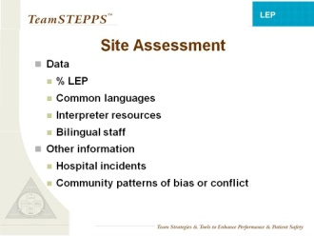
Site Assessment
SAY:
In your planning you will need to consider your data—for example, the percentage of your patients with LEP or the most common languages spoken by your patients. You’ll also want to consider additional information about your hospital, your unit, and your patients with LEP, information that may not show up in the data. These may be stories or examples of specific incidents involving LEP patients, particular patterns of cultural bias or conflict in your area, and general attitudes about diversity and inclusion.
ASK:
What other information needs to be included in planning changes for your process of meeting the language and cultural needs of your patients? Take 5 minutes to discuss with your group any other information from your prework that needs to be considered as you plan. Also note any additional information that you may need to collect.
DISCUSSION:
What other information will you need to consider?
SLIDE TIME:
6 minutes

Slide 36
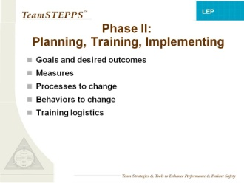
Phase II: Planning, Training, Implementing
SAY:
Now we move into planning the changes and the training.
You will define your goals and identify measures that will indicate progress toward those goals. You will target specifically what processes and behaviors need to change and strategies for making those changes. And you’ll plan the logistics and customization of your training.
Bear in mind that there are many ways to plan the logistics of your training and to focus your TeamSTEPPS intervention. For example:
One military hospital implemented the basic TeamSTEPPS training by coaching just one behavior (briefs) for 60 days. Once everyone was used to doing briefs, they added another behavior and coached that for 60 days. They kept going in that way until all the behaviors had become part of the culture.
One hospital had a large number of staff to train on the LEP module. To accommodate everyone’s schedule, they provided back-to-back TeamSTEPPS LEP trainings for 2 days, with staff dropping in at the time that was most convenient for them. Other hospitals addressed the scheduling challenge by offering the TeamSTEPPS LEP training during regular staff meetings.
During the field test of this module, hospitals focused their interventions on various aspects of LEP patient safety. One focused on the use of a qualified medical interpreter; another focused on the use of telephone interpretation services to fill in when interpreters were not immediately available; and a third focused on the use of briefs to better integrate interpreters into the care team.
When planning logistics, ensure that training groups are cross-disciplinary if possible. Include doctors, nurses, technicians, interpreters, registration staff, and any other important members of the care team. Cross-disciplinary training fosters a collaborative learning environment and helps staff come to a shared understanding of everyone’s role in ensuring LEP patient safety.
SLIDE TIME:
2 minutes
35

Slide 37
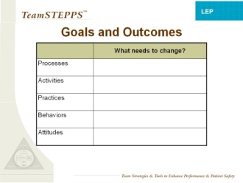
Goals and Outcomes
SAY:
Return to your Patient Language Process Maps of the current process and the ideal process. With your group, take 5 minutes to identify specific changes that are needed, and write them on the Goals and Outcomes worksheet.
5 minutes
MATERIALS:
  Goals and Outcomes worksheet (see next page)
  Patient Language Process Maps completed earlier

Slide 38
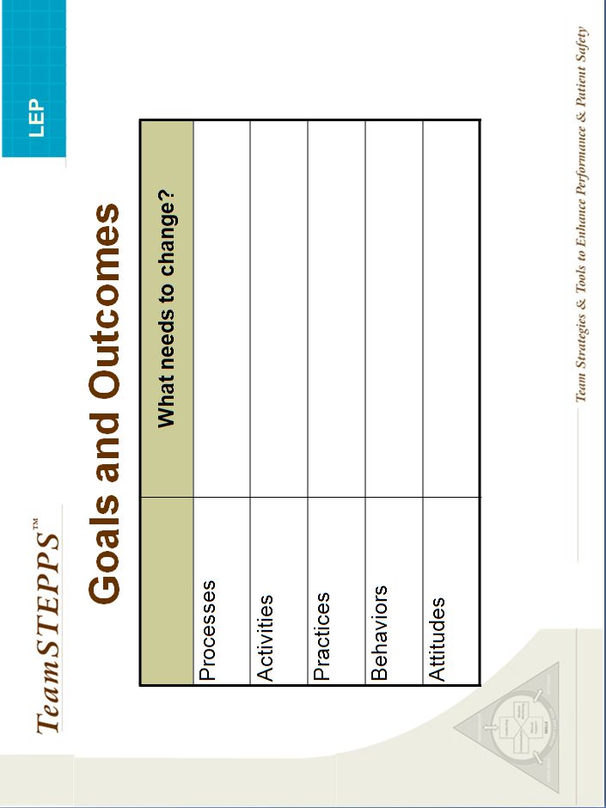

Slide 39
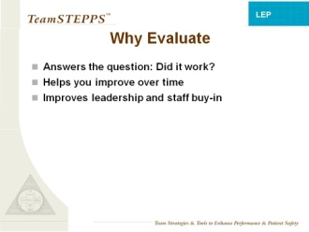
Evaluation
SAY:
Evaluating your TeamSTEPPS module can help you to figure out if the training worked and how to improve your results over time. By documenting your efforts and results, you can help increase buy-in from the leadership and staff members in your hospital, which can help you to sustain change in your hospital.
As part of this training, we are sharing with you an evaluation guide to help you in your evaluation task. The guide discusses the purposes of evaluation, provides evaluation metrics and survey instruments, and gives you a basic evaluation checklist.
SLIDE TIME:
2 minutes
MATERIALS:
  Evaluation guide

Slide 40
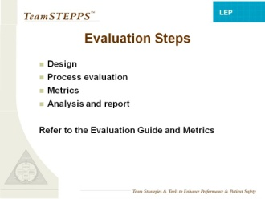
Evaluation
SAY:
The evaluation guide outlines a simple evaluation design. It also provides metrics and survey instruments to collect them, as well as some basic tips to analyze the data and create a report Feel free to adapt the tools provided in this evaluation guide to best meet your data needs.
If you plan to implement your TeamSTEPPS intervention in a large number of units, you may want to consult with an evaluation researcher to see if a more rigorous evaluation design (such as a randomized controlled trial) is feasible.
In any case, it’s a good idea to delegate the evaluation work to someone else, since you’re going to be busy with the trainings. It’s also a good idea to monitor your process during the intervention. This can help you explain why you got the results you got, whether any midcourse corrections are needed, and what you can do to improve the intervention next time. The evaluation guide includes a basic template to monitor your process.
SLIDE TIME:
1 minute
39

Slide 41
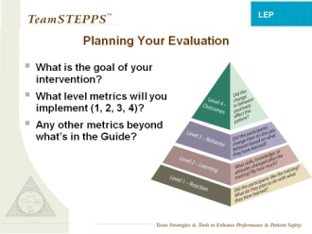
Evaluation
The evaluation guide provides basic evaluation metrics, but you should feel free to customize the metrics to best meet your information needs. Ideally, your metrics should help you measure whether you are meeting the goals you have set for your intervention.
In training programs you can evaluate metrics on four levels: reactions, learning, behaviors, and patient outcomes. At level 1, you measure trainees’ reactions to the training – whether they liked it and found it to be useful. At level 2, you measure how much they learned from the training. Level 3 measures how behaviors change because of the training. Finally, at level 4, you measure patient outcomes resulting from the training.
When you experienced the module as intended for staff, you filled out the questionnaires for levels 1, 2, and pretraining level 3. Take a moment now to review the other surveys in the evaluation guide. These include the Posttraining Behavior Survey at level 3 and LEP Patient Outcome Survey at level 4.
DISCUSSION:
The higher up you go in the levels, the more convincing your evaluation will be. How high will you go in your evaluation?
What other metrics might you like to use, beyond what’s provided in the evaluation guide?
SLIDE TIME:
7 minutes
MATERIALS:
  Evaluation guide

Slide 42
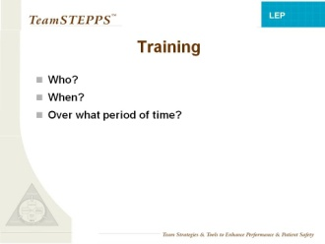
Training
SLIDE TIME:
7 minutes
SAY:
Now that you know what changes you want to implement and how to measure the success of those changes, you are ready to plan your training. Take a few minutes with your group to discuss the logistics of your training. Who will be trained? Can you bring interdisciplinary teams together for the training? How will you get everyone together for the 60-minute session? How long will it take to cycle everyone through training? How will you handle staff who work during the night shift?

Slide 43
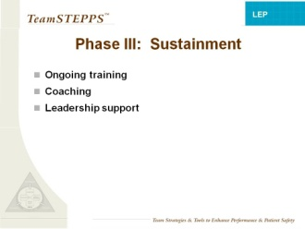
Phase III: Sustainment
SLIDE TIME:
5 minutes
MATERIALS:
  Coaching manual
SAY:
Now consider how you will “make it stick.” How will new staff be trained? How will these changes become “institutionalized” and permanent?
Remember that it took time for providers to develop their habits and practices regarding the use of interpreters. It can take time and more than one training session to undo habits that were developed over time, especially if those habits were developed in response to the limited availability of interpretation services. Take a moment to think about objections people may raise during trainings about the changes you’re trying to make. How will you answer these objections? The hospital guide that comes with this module offers a “Frequently Asked Questions” section that answers several commonly heard objections. Planning ongoing training and refresher courses also helps it “stick,” as do consistent feedback and encouragement from leadership.
One element that can support long-term behavior change is the use of coaches: people within the unit representing the different professions and disciplines, including interpreters, who agree to help their peers use the new tools and processes. Internal coaches receive extra training and support and provide effective, respectful feedback in the midst of the work that can help keep the team on track. For example, a coach in a clinical area who works at the front desk as unit clerk might remind the nurse, “We agreed to call language services first when a patient comes in and we are unclear about their language needs, remember? Let’s do that now….” Or a coach who is an interpreter might debrief with another interpreter, encouraging him or her to use assertion skills in future. There is a coaching module on your CD and in your packet, and we encourage you to use it to help you prepare for sustaining your changes and improvements.
Another key element to help with sustainment is mobilizing leadership support. Ideally you would do this before your first training. The hospital guide that comes with this module provides tools and information to engage hospital leaders.

Slide 44
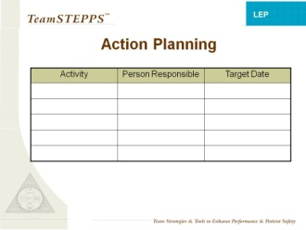
Action Planning
SAY:
Take 20 minutes in your group to complete your action plan for implementation, using all the information you have gathered and discussed so far. Include all the steps of the plan, note who will be responsible for each step, and set a target timeframe for each step. Use the action planning worksheet provided. We will be available to help your groups as you complete the action planning.
DO:
Ask the groups to share their action plans with each other.
20 minutes
MATERIALS:
  Action planning worksheets

Slide 45


Slide 46
Practice Teaching
40 minutes
SAY:
For our practice teaching segment, you will be assigned one slide from the LEP module. You will have a few minutes to review the instructor guide for that slide and prepare to present that one slide to the group (or to a small group segment if there are more than 10 participants in the Train-the-Trainer session).
DO:
Assign each participant one slide from the set.
Allow them 10 minutes to work individually with their instructor guides preparing the material to present.
Then have them present their slides in order, with 1 minute per slide. Provide encouragement and suggestions, and give them assistance with navigating the CD and the slides.
Debrief with the group, praising good presentations with specific feedback.

Slide 47
Evaluation of the Train-the-Trainer Session
SAY:
This concludes our training of trainers for the LEP Patient Safety module. Thank you all for your participation. We would be very interested in your honest feedback, which will help us continue to improve this session.
DISCUSSION:
What questions do you have about the training?
What worked in this training of trainers?
What could be improved?
15 minutes
46

