Slide 1
AHRQ Safety Program for Ambulatory Surgery
Coaching Clinical Teams Module

Slide 2
Objectives
Understand current team training in the health care setting
Describe coaching in the clinical environment
Outline benefits of coaching
Identify the characteristics of a good coach
Demonstrate coaching steps when giving feedback to a team
Describe how an observation tool can improve performance

Slide 3
Overview
Coaching Defined
Providing Constructive Feedback to Teams
Putting Coaching Into Action
Observation Tools as Coaching Resources

Slide 4
Coaching Defined
This section covers—
Teaching in the health care setting
Using coaching as an alternative approach to teaching in the health care setting
Overview of coaching
Benefits of coaching
Characteristics of a good coach

Slide 5
Standard Approach to Training in the Health Care Setting
Manual or procedure guide
Lecture with PowerPoint presentation
Individuals are expected to change
Little followup or change

Slide 6
Applying Health Care Training to Driving Instruction
A driver’s manual
A PowerPoint presentation
The car keys and the freeway

Slide 7
How We Really Teach Someone To Drive
A driver’s manual
A PowerPoint presentation
An introduction to the car
Lots of practice and driving with a “coach”
Driving alone
Notes:
No edits

Slide 8
An Alternative Approach to Teaching in Health Care – Coaching
Teach Me/ Show Me
Watch Me
Give Me Feedback

Slide 9
Overview Of Coaching
Coaching is—
Listening and watching
Asking questions
Getting the team to—
reflect on their behavior and actions
understand how to improve their performance^{1,2}
¹TeamSTEPPS Fundamentals Course: Module 9. Coaching Workshop: Instructor's Materials. November 2008. Agency for Healthcare Research and Quality, Rockville, MD. http://www.ahrq.gov/professionals/education/curriculum-tools/teamstepps/instructor/fundamentals/module9/igcoaching.html.
²Knight J. Coaching: The key to translating research into practice lies in continuous, job-embedded learning with ongoing support. Journal of Staff Development. 2009 Dec 1;30(1):18-22.

Slide 10
Overview Of Coaching (continued)
Coaching is not—
Telling²
Criticizing
Instructing/teaching
²Knight J. Coaching: The key to translating research into practice lies in continuous, job-embedded learning with ongoing support. Journal of Staff Development. 2009 Dec 1;30(1):18-22.

Slide 11
Benefits of Coaching Teams
Better patient care³
Better morale
Better functioning team
Motivates individuals and teams to make changes^{3,1}
Identifies safe practices and areas where you may want to focus future quality improvement efforts⁴
¹TeamSTEPPS Fundamentals Course: Module 9. Coaching Workshop: Instructor's Materials. November 2008. Agency for Healthcare Research and Quality, Rockville, MD. http://www.ahrq.gov/professionals/education/curriculum-tools/teamstepps/instructor/fundamentals/module9/igcoaching.html.
³Rudolph JW, Simon R, Rivard P, et al. Debriefing with good judgment: combining rigorous feedback with genuine inquiry. Anesthesiol Clin. 2007 Jun;25(2):361-376. PMID: 17574196.
⁴Marilyn, PC, Moore Joseph. Learning in the thick of it. Harv Bus Rev. 2005 Jul-Aug;83(7):84-92, 192. PMID: 16028819.

Slide 12
Traits of a Coach
A coach should be someone who is—
Coachable
Trusted and respected by their peers¹
An excellent communicator and listens respectfully
Knowledgeable of the clinical environment
Trained at giving feedback²
¹TeamSTEPPS Fundamentals Course: Module 9. Coaching Workshop: Instructor's Materials. November 2008. Agency for Healthcare Research and Quality, Rockville, MD. http://www.ahrq.gov/professionals/education/curriculum-tools/teamstepps/instructor/fundamentals/module9/igcoaching.html.
²Knight J. Coaching: The key to translating research into practice lies in continuous, job-embedded learning with ongoing support. Journal of Staff Development. 2009 Dec 1;30(1):18-22.

Slide 13
Giving Constructive Feedback to Teams
This section covers—
How feedback is usually given in the health care environment
The basics of giving constructive feedback
The power of asking questions
Examples of using the three-part question to coach teams

Slide 14
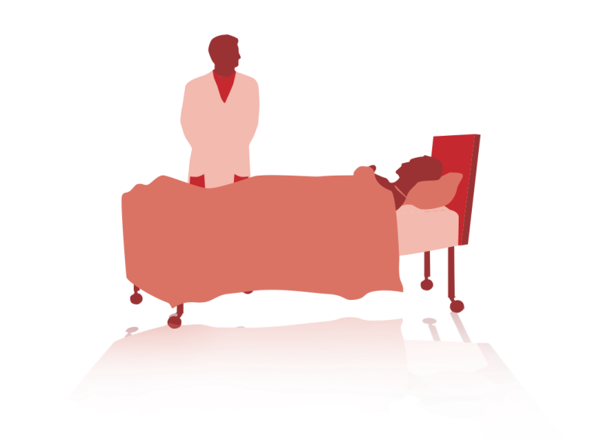
How Feedback Is Often Given in the Health Care Setting
Criticizing
Telling
Yelling
One-sided
Assuming incompetence

Slide 15
Key Components of Feedback
Simple
Focused
Respectful
Kind

Slide 16
Coach by Asking Questions
Your audience consists of knowledgeable adults
Team members benefit from—
reflecting on what has happened
identifying their own solutions
The role of a coach is to guide, not to tell

Slide 17
Components of the Three-Part Question
Your observation:
“I saw…”
Your opinion:
“I think that it is important to…”
Your question:
“I wonder…”

Slide 18
Part I: Your Observation
Explain your observations
Be specific and clear
Remain as objective as possible
Examples
“I saw”
“I observed”
“I watched”
“The team did”
“The team didn’t”
“I noticed”

Slide 19
Part II: Your Opinion
Share why you are focusing on a specific behavior or action and explain its importance
Examples
“I think…”
“I believe…”
“It is really important to…”
“I am pleased because…”
“I am concerned because…”

Slide 20
Part III: Your Question
Allows the team to reflect
Displays genuine curiosity and interest in what happened
Examples
“Can you help me understand?”
“I am curious, what do you think happened?”
“How did that make you feel?”
“What is your point of view?”
“How did you experience that?”
“I wonder what you think happened?”
“Where do you think your team was coming from?”

Slide 21
The Three Parts Together
“I noticed that the team did not debrief at the end of the case.”
“I think that debriefing is really important.”
“Can you help me understand why that didn’t happen?

Slide 22
Avoid Making Generalizations
Example of generalization
“I noticed that communication wasn’t very good. I think that having good communication is important. Can you help me understand what happened?”
Instead, give the team specific examples of what you saw
“I noticed that your team didn’t use the checklist on the wall to prompt your discussions. I believe reading off of the checklist helps so that all items on the checklist are discussed. I’m curious why you didn’t read the items on the poster.”

Slide 23
Avoid Assuming You Understand People’s Actions
Example of assuming you understand people’s actions
“I noticed that you skipped the introductions because you were in a hurry.”
Instead say this
“I noticed that your team skipped the introductions. I think they’re an important part of the checklist because it gives everyone a chance to say something before the start of the case. Can you tell me why you skipped them?”

Slide 24
Avoid Making the Team Guess What You Are Thinking
Example of making the team guess what you are thinking
“Can you tell me what you did wrong?” [When you already know exactly what you are after]
Instead say this
“I saw that your team didn’t confirm that the antibiotics were completely infused before the start of the case. I believe it is important that the team confirms the antibiotics are infused so that the patient doesn’t get an infection. Can you help me understand why you did this?”

Slide 25
Avoid Asking Questions That Already Contain the Answer
Example of asking a question that already contains the answer
“Don’t you think it would have been better if you would have done…”
Instead say this
“I noticed that the whole team didn’t stop all activity when performing the timeout. I think it is important for patient safety that everyone in the operating room stop activity so they can fully participate in the timeout. Can you help me understand what happened?”
Notes:
No edits

Slide 26
Avoid Disguising a Statement as a Question
Example of disguising a statement as a question
“You didn’t really want to do that, did you?”
Instead say this
“I saw that your team didn’t review the specimen labeling before the patient left the room. I believe it is important to read back the specimen labeling, including the patient’s name, so that there is no confusion over what the specimen is. I am curious, what do you think happened?”
Notes:
No edits

Slide 27
Avoid Singling Out Individuals When Coaching the Team
Example of singling out individuals when coaching the team
“Dr. Brown, I noticed that you didn’t participate in the briefing section. I think the briefing section is important. Can you tell me why?”
Instead say this
“I noticed that during the timeout when you verified the surgical procedure that the team did not verify that it matched the consent form. I think it is safe practice to have the surgeon read the consent form in the operating room so it can be checked by multiple team members. What is your point of view?”
Notes:
No edits

Slide 28
Putting Coaching Into Action
This section covers—
Planning your coaching day
Giving feedback at the appropriate time
Steps you should take when giving feedback to teams
Step I: Set the stage
Step II: Start with an open-ended question
Step III: Share your observations with the team using the three part question
Step IV: Motivate the team by focusing on what they could do better
Step V: End the coaching session
Notes:
No edits

Slide 29
Planning Your Coaching Day
Pick the appropriate cases to coach
Coach on days when the team will have time to talk
Prepare the team for your coaching session

Slide 30
When To Coach in the Clinical Setting
Avoid interfering with direct patient care
Speak up if you see something that may be harmful to the patient
Notes:
No edits

Slide 31
Questions Coaches Need To Ask Themselves Before Coaching The Team’s Performance
What is the team doing?
Do I need to coach the team or an individual?
Will coaching be effective for this team?
What happened during the case?
Notes:
No edits

Slide 32
Giving Feedback to the Team: Step 1 – Setting the Stage
Thank the team for letting you observe
Frame the coaching session by telling the team the purpose is to improve patient care by enhancing their performance as a team
Select to play video: https://youtu.be/hk-3S5sQVmQ

Slide 33
Giving Feedback to the Team: Step 2 – Start With an Open-Ended Question
Ask “How did the last case go?”
This allows team members to say what is on their minds so you can direct the conversation where you would like it to go
Select to play video: https://youtu.be/9C1cvna5NAg

Slide 34
Giving Feedback to the Team: Step 3 – Share Observations Using the Three-Part Question
Your observation:
“I saw…”
Your opinion:
“I think that it is important to…”
Your question:
“I wonder…”

Slide 35
Coaching Using Three-Part Question
Select to play video: https://youtu.be/mQJA9-_fxUE

Slide 36
Giving Feedback to the Team: Step 4 – Motivate the Team by Focusing on What It Could Do Better
Gives teams the chance to look at what went well and what can be improved upon
Use a two-part technique for helping the team focus³
First, the team discusses what the team did well
Second, the team identifies opportunities for improvement and discusses how to implement them in the future
³Rudolph JW, Simon R, Rivard P, et al. Debriefing with good judgment: combining rigorous feedback with genuine inquiry. Anesthesiol Clin. 2007 Jun;25(2):361-376. PMID: 17574196.

Slide 37
Motivating the Team
Select to play video: https://youtu.be/8H1gorfVbEk

Slide 38
Giving Feedback to the Team: Step 5 – Ending the Coaching Session
Ask team members if they would like to talk about anything else
Thank the team

Slide 39
Ending the Coaching Session
Select to play video: https://youtu.be/88t46tAXUVE

Slide 40
Observation Tools as Coaching Resources
This section covers—
Benefits of using an observation tool
How to use an observation tool when coaching a team
Coaching resources

Slide 41
Benefits of Using an Observation Tool
Keeps you focused on what you want to look for
Helps you watch each team in a standardized way
Keeps you organized

Slide 42
How To Use an Observation Tool
Tell the team about the observation tool and explain its purpose beforehand
An observation tool can be filled out during the case or immediately after
Avoid writing down personal identifiers

Slide 43
Summary
Coaching can improve patient care
Pick the appropriate people to be coaches
Train coaches on how to give feedback
Plan the coaching day ahead of time
Observation tools can help a coach give feedback

Slide 44
Tools
Ambulatory Surgery Center (ASC) Observation Tool
Checklist for Creating Coaching Observation Tools
Learn From Defects Tool: Modified for use in ASCs
Comprehensive Unit-based Safety Program Learn From Defects Tool⁵

Slide 45
References
TeamSTEPPS Fundamentals Course: Module 9. Coaching Workshop: Instructor's Materials. November 2008. Agency for Healthcare Research and Quality, Rockville, MD. http://www.ahrq.gov/professionals/education/curriculum-tools/teamstepps/instructor/fundamentals/module9/igcoaching.html.
Knight J. Coaching: The key to translating research into practice lies in continuous, job-embedded learning with ongoing support. Journal of Staff Development. 2009 Dec 1;30(1):18-22.
Rudolph JW, Simon R, Rivard P, et al. Debriefing with good judgment: combining rigorous feedback with genuine inquiry. Anesthesiol Clin. 2007 Jun;25(2):361-376. PMID: 17574196.
Marilyn, PC, Moore Joseph. Learning in the thick of it. Harv Bus Rev. 2005 Jul-Aug;83(7):84-92, 192. PMID: 16028819.
Learn From Defects Tool. CUSP Toolkit. December 2012. Agency for Healthcare Research and Quality, Rockville, MD. http://www.ahrq.gov/professionals/education/curriculum-tools/cusptoolkit/toolkit/learndefects.html.

