Slide 1
AHRQ Safety Program for Ambulatory Surgery
Management Practices for Sustainability
Module 1: Overview
AHRQ Pub. No. 16(17)-0019-4-EF
May 2017

Slide 2
Ensuring Safety in Ambulatory Surgery
Surgery volume in ambulatory surgery centers (ASCs) has increased rapidly¹
The complexity of procedures continues to increase²
ASCs have an excellent safety record³
Surgical safety checklists can reduce accidents and infections, and are now mandated for ASCs⁴
However, “checklist fatigue” can blunt their
effectiveness⁵
Cullen KA, Hall MJ, Golosinskiy A. Ambulatory Surgery in the United States, 2006. Centers for Disease Control and Prevention, National Center for Health Statistics. http://www.cdc.gov/nchs/data/nhsr/nhsr011.pdf. Accessed July 7, 2016.
Wallace CL, Quattrone MS. Risk management for ambulatory surgery centers. J Ambul Care Manage. 2007 Apr; 30(2) 114-15. PMID: 17495678.
Kent C, Metzner J, Bollag L. An analysis of risk factors and adverse events in ambulatory surgery. Ambulatory Anesthesia. 2014;2014(1):3-10. DOI: https://dx.doi.org/10.2147/AA.S53280.
Aston G. Awareness of patient safety grows with increased outpatient surgeries. Hospitals & Health Networks. 9 Sep 2014. http://www.hhnmag.com/articles/3989-awareness-of-patient-safety-grows-with-increased-outpatient-surgeries. Accessed July 7, 2016.
Federico F. Avoiding checklist fatigue: Interview with Dr. Thomas Varghese. Institute for Healthcare Improvement blog. http://www.ihi.org/communities/blogs. Accessed July 7, 2016.

Slide 3
AHRQ Safety Program for Ambulatory Surgery
Funded by Agency for Healthcare Research and Quality (AHRQ) as part of the National Action Plan to Prevent Healthcare-Associated Infections (HAI)
665 registered ASCs from 47 States and DC participated in 8 program cohorts
Program Goals
  Reduce surgical infection and complication rates
  Improve safety culture through improved teamwork and communication
How can ASCs maintain effectiveness of safety practices over time?

Slide 4
Sustaining Change Is Not Easy!
Many (if not most) change implementations fail to sustain⁶
Few studies provide practical guidance or specific methods for sustaining changes
Lean health care organizations offer insights and guidance for specific management practices to monitor and sustain process changes⁷
The Institute for Healthcare Improvement (IHI) team studied 10 leading health care organizations that are addressing this problem head-on⁷
6.Snee RD. The hard part: Holding improvement gains. Quality Progress. Sep 2006. http://asq.org/quality-progress/2006/09/3.4-per-million/the-hard-part--holding-improvement-gains.html. Accessed July 8, 2016.
7.Scoville R, Little K, Rakover J. Sustaining Improvement. Institute for Healthcare Improvement. http://www.ihi.org/resources/Pages/IHIWhitePapers/Sustaining-Improvement.aspx. Accessed July 8, 2016.

Slide 5
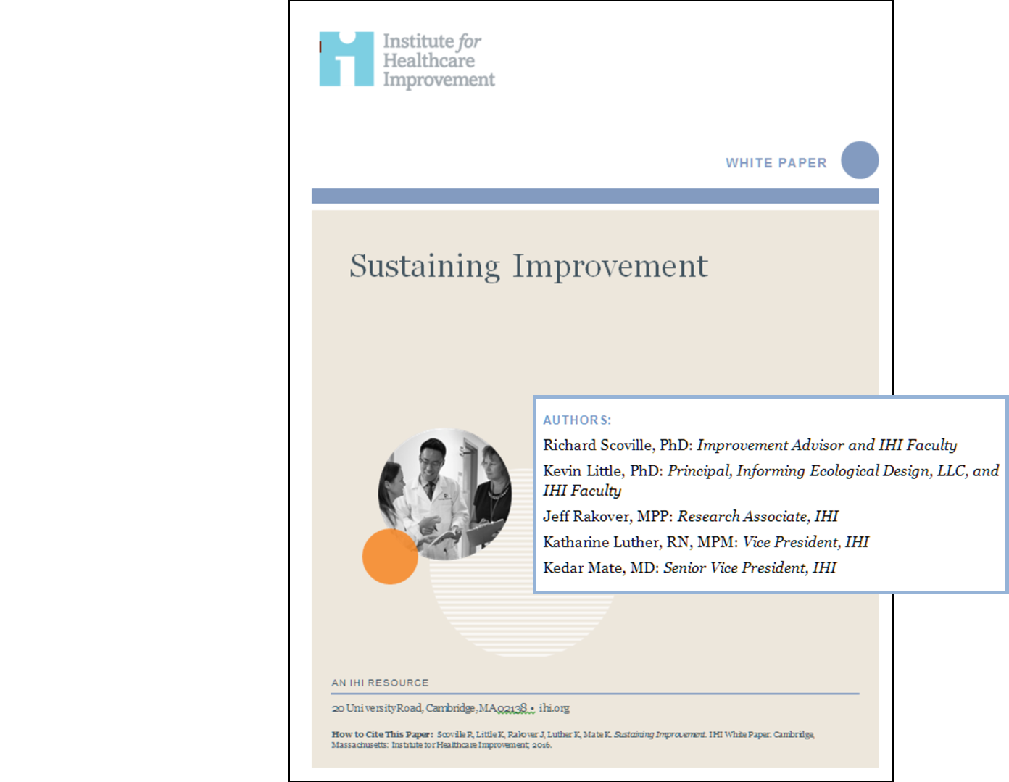
What Does it Take To Sustain Improvement?
IHI developed a model for sustainability focused on daily work for frontline managers and staff
Key elements
  Daily huddles
  Use of visual boards at the front line
  Problem-solving and escalation protocols
  Integration of aims and priorities

Slide 6
A Model for Sustainability in ASCs
Visual board tracks safety practices and outcomes; tracks current problems with status
Daily 5-minute standup huddle with unit lead and staff, standard agenda, and visual board as backdrop
Problems are categorized and escalated to higher management, if needed
Problem-solving skills applied at appropriate level
Integration with leaders ensures alignment across levels of organization with safety goals and “cascading” standard work

Slide 7
Testing the Model
The IHI team carried out a pilot test of the model with two volunteer ambulatory surgical centers:
  One large center with an established quality improvement (QI) department
  One small center with less QI experience
  After prework calls and activities, IHI team spent 2 intensive days at each center helping adapt the model to their systems
Uptake by unit managers and staff was enthusiastic
  Huddles persisted after the team left
  Larger center extended huddle to all departments, including business office
  One center noted a 10 percentage-point increase in patient safety culture survey, attributed to the use of management practices

Slide 8
Key Findings from IHI’s Pilot Testing
Huddle agenda can be accomplished in 5 minutes: short and to the point
Teams were able to surface and track problems such as missing items in kits and problems with reaching patients for followup
Visual Management can focus on the “precious few” key metrics such as days since last near miss and surgical timeout compliance
Senior managers have a key role in monitoring and sustaining the huddles
Model success relies on skills of unit managers leading huddles; skill building is critical
Notes:
[Read the slide]

Slide 9
References
Cullen KA, Hall MJ, Golosinskiy A. Ambulatory Surgery in the United States, 2006. Centers for Disease Control and Prevention, National Center for Health Statistics. http://www.cdc.gov/nchs/data/nhsr/nhsr011.pdf. Accessed July 7, 2016.
Wallace CL, Quattrone MS. Risk management for ambulatory surgery centers. J Ambul Care Manage. 2007 Apr; 30(2) 114-15. PMID: 17495678.
Kent C, Metzner J, Bollag L. An analysis of risk factors and adverse events in ambulatory surgery. Ambulatory Anesthesia. 2014;2014(1):3-10. DOI: https://dx.doi.org/10.2147/AA.S53280.
Aston G. Awareness of patient safety grows with increased outpatient surgeries. Hospitals & Health Networks. 9 Sep 2014. http://www.hhnmag.com/articles/3989-awareness-of-patient-safety-grows-with-increased-outpatient-surgeries. Accessed July 7, 2016.
Federico F. Avoiding checklist fatigue: Interview with Dr. Thomas Varghese. Institute for Healthcare Improvement blog. http://www.ihi.org/communities/blogs. Accessed July 7, 2016.
Snee RD. The hard part: Holding improvement gains. Quality Progress. Sep 2006. http://asq.org/quality-progress/2006/09/3.4-per-million/the-hard-part--holding-improvement-gains.html. Accessed July 8, 2016.
Scoville R, Little K, Rakover J. Sustaining Improvement. Institute for Healthcare Improvement. http://www.ihi.org/resources/Pages/IHIWhitePapers/Sustaining-Improvement.aspx. Accessed July 8, 2016.

