Slide 1
Using Checklists and Audit Tools To Improve Care in Hemodialysis Facilities

Slide 2
Objectives
Describe the importance of using data in the Quality Assurance and Performance Improvement (QAPI) process
Describe methods for using the National Opportunity to Improve Care in End Stage Renal Disease (NOTICE) tools as part of the facility QAPI program
Explain how implementing checklists and audit tools aligns with the principles of safe design
List four questions used in the process of learning from defects or system errors
Notes:
SAY:
The objectives of this presentation are:
Describe the importance of using data in the Quality Assurance and Performance Improvement, or QAPI, process
Describe methods for using the National Opportunity to Improve Care in End Stage Renal Disease (NOTICE) tools as part of the facility QAPI program
Explain how implementing checklists and audit tools align with the principles of safe design
List four questions that are used in the process of learning from defects which are defined here as any error or process that keep you from meeting your quality improvement goals.

Slide 3
Overview
Using NOTICE in dialysis facilities
Importance of QAPI in vascular access infection (VAI)
Notes:
SAY:
This Using Checklists and Audit Tools to Improve Care in Hemodialysis Facilities module aims to provide you with a comprehensive overview of using NOTICE in your dialysis facility. The module will also discuss the importance of QAPI in vascular access infection (VAI).

Slide 4
Using NOTICE in Dialysis Facilities
QAPI
Understanding data
Developing a culture of safety
Notes:
SAY:
The purpose of this presentation is to help you understand how the NOTICE tools can be used in your dialysis facility in the QAPI process, to understand data, and to develop a culture of safety.

Slide 5
Why Worry About Infections?
Hemodialysis patients are high-risk patients
Require long-term vascular access, and some require ongoing use of central venous catheters (CVC)
Are often immunocompromised
Are at higher risk for potential infection through exposure from—
Patient-to-patient contact
Contact with contaminated sources, such as environmental surfaces, equipment or supplies
Direct exposure from health care providers¹
Notes:
SAY:
Hemodialysis patients are at high risk for infections for numerous reasons. Just the nature of end-stage renal disease makes them immunocompromised, increasing risk. The need for blood access for the hemodialysis procedure means patients may have a central venous catheter for some period of time. Many patients require chronic CVCs. In addition, contact with potentially contaminated surfaces, close contact with other patients, and frequent contact with health care providers can all further increase the risk of infection.

Slide 6
QAPI for VAI
Hemodialysis facility structure and processes affect outcomes of care
When the actual outcome doesn't match with the preferred outcome, it is the facility’s duty to assess why and make necessary improvements
NOTICE findings suggest there are six main interventions that may improve and reduce VAI rates
Remember these interventions using the acronym CHARGE!
Notes:
SAY:
The Conditions for Coverage require that all dialysis facilities develop and maintain a QAPI program that includes tracking, analyzing, and improving infection control. This requires processes that monitor adherence to infection control policies and procedures. When actual outcomes do not meet the expected outcomes, the QAPI team should identify barriers and find strategies to improve outcomes. The NOTICE project identified six intervention areas for improving VAI infection rates. The acronym CHARGE can help us remember those interventions.

Slide 7
The CHARGE! model’s six interventions
CHARGE!
Culture of Safety
Hand Hygiene
Access Site (Preparation/Cleansing)
Reduce and Remove Catheters
Great Connection/Disconnection Technique
Evaluation of Team Infection Control Practices
Notes:
SAY:
The six interventions that make up the CHARGE acronym are:
Creating a culture of safety
Safety culture is local and best sustained when it is accepted and maintained at the facility level. A safe culture is mutually supportive, creating an environment that engages all staff members in performance excellence and quality improvement.
Hand hygiene
Hand hygiene is an essential component of preventing harm in hemodialysis patients. In this presentation, you will see tools and checklists that will help you monitor and track this important skill.
Access site (preparation/ cleansing)
Care of the access site is another important skill that should be monitored and tracked. Consistent adherence to Centers for Disease Control and Prevention, or CDC, guidelines has been shown to improve vascular access infection rates.
Reduce and remove catheters
Catheters contribute to patient harm. By systematically addressing catheter use and promptly removing them whenever possible, facilities can reduce infection rates and instances of patient harm.
Great connection/disconnection technique
Having a great connection/disconnection technique of the access hub will pose less risk of infection to patients. Additionally, standardizing the techniques used in care delivery will contribute to the reliability of the organization and patient care outcomes.
Evaluation of team infection control practices
Regular review and evaluation of infection control practices will ensure that system processes are functioning properly to prevent patient harm. Errors are the result of system level breakdowns. For dialysis patients and facilities, this means that infections occur when infection control practices are not being adhered to consistently. Reviewing and evaluating these practices will ensure that members of the care team are supported by an effective infection control system when delivering patient centered care.
ASK:
Which of the following areas do you want to focus on in your facility?

Slide 8
Importance of Using Data
If you don’t know where you are, you won’t know where you need to go
Simply measuring things will not make them better
For data to be useful, data must be collected, interpreted, and then leveraged.
Collect
Interpret
Leverage
Notes:
SAY:
A QAPI program is most effective when it is data-driven. Data let you know where you are in relation to where you need to be. However, simply measuring things will not make them better. For data to be useful, data must be collected, interpreted, and then leveraged. All teams should determine what data to collect at the beginning of an intervention. Data should be directly linked to the outcomes you want to occur. Reports available through the National Healthcare Safety Network (NHSN) provide feedback to assist you in interpreting your data. Now, let’s discuss leveraging data and how to use what you’ve learned to your advantage.

Slide 9
Why Use Data?
Adds credibility to your actions
Aids in motivating change and aligning others with your cause
Provides reason and backing for focus on quality improvement project
Ensures correct focus
Collect
Interpret
Leverage
Notes:
SAY:
Using data in your QAPI process is important for several reasons. Data not only add credibility to the need for change, but also motivates others to get on board with the need for change. Above all, data help to focus your efforts on what needs to change, instead of wasting time developing strategies that address areas that do not need change.
ASK:
Are there other reasons you find data valuable?

Slide 10
Keys to Using Data
Decide what
matters
Make data
accessible
Focus your
efforts
Be prepared
to operate
differently
Visible Change
Notes:
SAY:
There are many ways to leverage data, but we’d like to focus on four keys points to help leverage data. First, decide what matters. Second, make data accessible. You’re all working hard to make changes in your facilities, but in order to really use the data and highlight your efforts, you need to share and make the information accessible to all. Third, focus your efforts. Through focusing on actionable steps, you will be able to accomplish more. Fourth, be prepared to operate differently if the data show that changes need to be made.

Slide 11
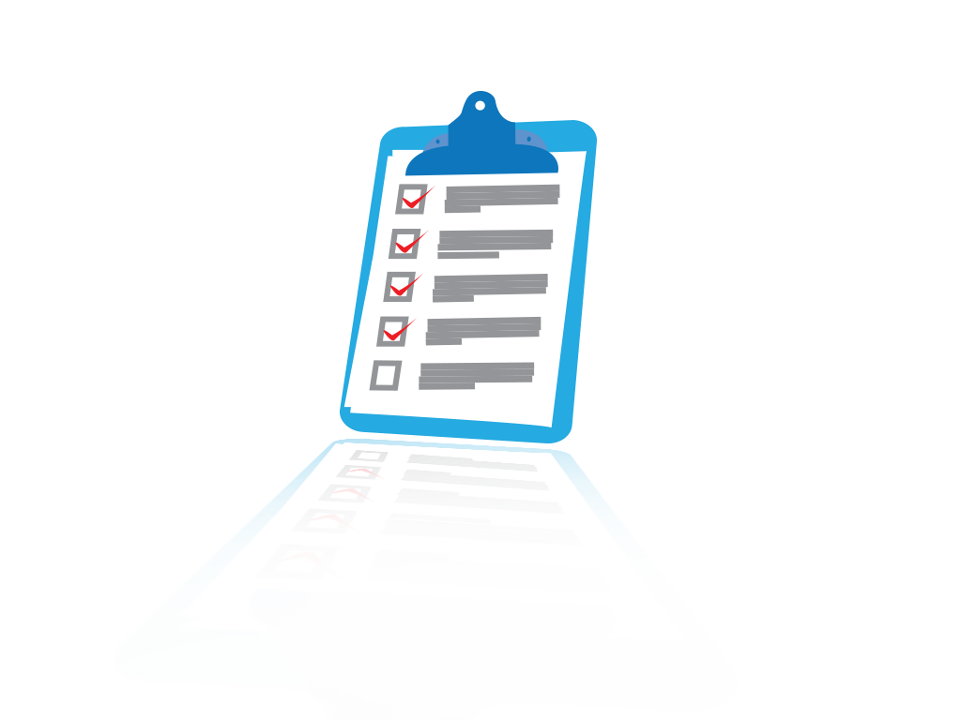
Decide What Matters
NOTICE focus – using a checklist:
Reduce VAIs through—
Improved culture of safety
Improved hand hygiene
Access site preparation
Catheter reduction and removal
Connection and disconnection technique
Evaluation efforts
Improve Culture of Safety – Audit tools
Measure data
Notes:
SAY:
The NOTICE tools focus on reducing VAIs through improved hand hygiene, correct access site preparation, catheter reduction, good connection and disconnection technique, and evaluation efforts as well as improving the overall culture of safety in your facility. You may find that specific areas of concern arise in your facility. Your audits may show that catheter reduction and removal protocols are already used but that hand hygiene steps are consistently missed. If that is the case, you may decide that improving hand hygiene is most important to your team.
DO: Ask everyone to select two priority areas (culture of safety and evaluation efforts should be incorporated into all technical interventions).

Slide 12
Making Data Accessible
Communicates that your organization cares about infection risks
Educates staff and patients about specific risks that are the most important, and changes being made to impact these risk factors
Motivates others to care about your cause
Notes:
SAY:
Making data accessible to all staff is so important. Trending data over time and posting the data for all to see lets staff identify the results of missed steps and celebrate positive trends. When new procedures are instituted, staff can identify when improvements occur and understand the relationship between the intervention and improvement.
Making data visible also communicates to staff and patients the importance placed on patient safety. Posting data can have an impact on the culture of safety.
People tend to think they are doing procedures correctly because they have been doing them over a long period of time. But subtle changes in practice can add up to major omissions, leaving the opportunity for infections. Accessible data creates transparency that allows for improvement and praise for staff.

Slide 13
Make Data Accessible to Everyone
Staff
Leadership
Patients and families
Report in staff meetings
Embed within leadership reports
Post results in staff and patient areas
Announce successes and opportunities for improvement in facility newsletters
Be creative!
13
Notes:
SAY:
Share goals of measurement with staff, leadership, patients, and families. Explain what you are measuring and why those measures were chosen. Involve staff and patients in measurement activities. Some potential ways to make data accessible include:
Report out in staff meetings
Embed within leadership reports
Post results in staff and patient areas
Announce successes and opportunities for improvement in facility newsletters
ASK:
Which of these approaches would you like to try? Which ones are you already doing?
DO: Make an action plan for at least one method to implement with your intervention.

Slide 14
Focus Your Efforts
Opportunities for Improvement
First, address “low-hanging fruit,” then other areas of high importance to your facility.
Two or three issues that can be easily addressed
Notes:
SAY:
You may find yourself with lots of opportunities for improvement. This is normal for facilities that are conducting Learning from Defects exercises and reviewing data regularly. Start by focusing on areas that will be easy to address, the proverbial “low-hanging fruit.” After success in these areas, it will be easier to find backing to take on the more challenging areas that may be of high importance to your facility. The key is to not do it all at once. You all work long and hard taking care of patients. Quality improvement projects should complement this work, not interfere with it. Unfocused projects can be a distraction and actually discourage staff.
DO: Use the Learning from Defects form to determine potential opportunities for improvement and identify areas to be addressed.

Slide 15
Be Prepared To Operate Differently
Leveraging data for change means you may have to change, or you may not, but you need to be prepared to make changes.
Notes:
SAY:
Leveraging data for change means that you may have to change, or you may not, but you need to be prepared to make changes.

Slide 16
Remember…
Not all change is improvement,
but all improvement requires change!
Notes:
SAY:
Not all change is improvement, but all improvement requires change!

Slide 17
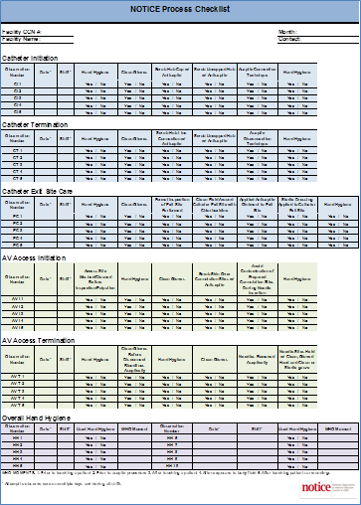
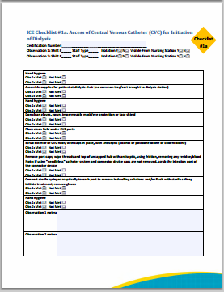
Using the NOTICE Tools: Promoting The Science of Safety
17
Notes:
SAY:
Audits and checklists are both tools that can be used to monitor infection prevention activities in the facility. NOTICE created an audit tool and multiple checklists. Other similar checklists and tools are also available from CDC.
ASK:
Have you used audit tools or checklists before? If so, what did they help you monitor?

Slide 18
Keys to the Science of Safety
As seen in CUSP®
Every system is designed to achieve its anticipated results
The principles of safe design are—
Standardize when you can
Create independent checks
Learn from defects
The principles of safe design apply to technical/clinical work and teamwork
Teams make wise decisions when there is diverse and independent input²
Notes:
SAY:
The results you get are a result of your system, so if you are not achieving the results you want, redesign your system. The principles of safe design are:
Standardize when you can
Create independent checks
Learn from defects
The principles of safe design apply to both technical/clinical work and teamwork. Teams make wise decisions when there is diverse and independent input. To achieve this, include a variety of team members and encourage input from all team members.

Slide 19
Use the NOTICE Tools To Standardize
Standardize
Create independent checks
Learn from defects
Notes:
SAY:
Using the NOTICE tools can assist unit teams in scrutinizing their environment and their processes to deliver safe patient care. Standardize processes, create independent checks, and learn from defects.
Well-functioning teams evaluate their processes and learn from defects and, when possible, share what they learn with other similar care settings.
When learning from defects, teams identify:
What happened?
Why did it happen?
What will we do to reduce the recurrence?
How will we know it worked?
Standardizing processes is the first step. In a dialysis clinic, it is easy for staff to begin to deviate from the standard procedure. As time goes on, this deviation becomes the norm. Standardizing the process, and having a tool to assure adherence to the correct process, prevents the deviation. Standardization of processes can be assured through the development of and consistent use of checklists.

Slide 20
Standardize: NOTICE Checklists
“Good checklists…are precise. They are efficient, to the point, and easy to use even in the most difficult situations. They do not try to spell out everything--a checklist cannot fly a plane. Instead, they provide reminders of only the most critical and important steps, the ones that even the highly skilled professional using them could miss. Good checklists are, above all, practical.”³
Atul Gawande, The Checklist Manifesto: How to Get Things Right
Notes:
DO:
Read quote on slide.
SAY:
Checklists should contain only the important steps in a given process. Airline pilots do not rely on their memories to act in given situations, and similarly we should not expect our staff to remember every important step. Checklists are invaluable to assist staff in maintaining strict adherence to processes and prevent deviation. They should not distract from quality care but rather support the process to ensure standardized quality care.

Slide 21
NOTICE Checklists
Developed in collaboration with the NOTICE team, the Centers for Disease Control and Prevention (CDC), and state surveyors
Seven checklists that cover all steps of vascular access care for hemodialysis patients
Vetted for usefulness in NOTICE phase I
Piloted in 34 facilities in 4 ESRD networks
Observations done in these facilities by infection control experts – results:
91% of facilities stated that awareness increased
85% of facilities stated it was a positive experience⁴
Notes:
SAY:
The NOTICE checklists were developed by a team that included the Agency for Healthcare Research and Quality, Health Research & Educational Trust, the University of Michigan Kidney Epidemiology and Cost Center, Renal Network 11, the Centers for Disease Control and Prevention, the Centers for Medicare and Medicaid Services, and the state survey agencies. The seven checklists cover all aspects of infection control associated with vascular access for hemodialysis.
The checklists were piloted in more than 30 dialysis facilities in four ESRD networks across the country. After implementation, Infection Control Experts visited the facilities and audited the procedures. When asked if the checklists were helpful, 91 percent of facilities reported that the checklists and associated education helped to increase staff awareness of the importance of infection control. Eighty-five percent of the facilities reported that the project was a positive experience.

Slide 22
CVC Procedural Checklist
NOTICE checklists are available on AHRQ’s Web site at http://www.ahrq.gov/professionals/quality-patient-safety/patient-safety-resources/resources/esrd/index.html.
Notes:
SAY:
This is an example of one of the available checklists. All of the checklists are available on AHRQ’s Web site at http://www.ahrq.gov/professionals/quality-patient-safety/patient-safety-resources/resources/esrd/esrd_checklists.pdf.

Slide 23
NOTICE Procedural Checklists
Initiation of dialysis – CVC
Exit site care – CVC
Initiation of dialysis – arteriovenous fistula (AV fistula)/arteriovenous graft (AV graft)
Medication administration
Termination of dialysis – CVC
Termination of dialysis – AV fistula/AV graft
Cleaning/disinfection of the dialysis station
Notes:
SAY:
Procedural checklists are available for:
Initiation of dialysis – CVC
Exit site care – CVC
Initiation of dialysis – arteriovenous fistula (AV Fistula)/Arteriovenous graft (AV Graft)
Medication administration
Termination of dialysis – CVC
Termination of dialysis – AV Fistula/AV Graft
Cleaning/disinfection of the dialysis station

Slide 24
Using the Procedural Checklists
Staff education
Patient education
Posted reminders
Root cause analysis
Patient engagement
Discussions with patient and family
Notes:
SAY:
There are several ways to use these checklists, including:
Staff education
Patient education
Posted reminders
Root cause analysis
Patient engagement
Discussions with patient and family
Staff education can be provided by using the checklists or by focusing on areas that are often missed on the checklists. Checklists are helpful in conjunction with your QAPI committee to identify barriers and root causes. The facility culture of safety extends beyond the staff and should also involve the patients; patients and their families should be included in the educational process. Staff can review checklists with patients or give them copies to follow. By sharing checklists and information about routine processes with patients, you can further develop patient-provider relationships and involve them in the quality improvement process. You can also post checklists near the patient station so they are available for easy referral.

Slide 25
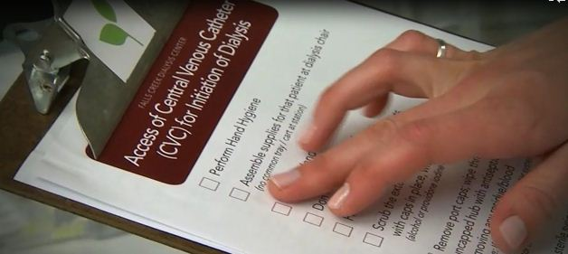
Checklists Work Well In Tandem With Other Tools
Offer educational sessions on creating clean and aseptic fields and how to maintain them
Watch supplemental videos with staff
Teach proper techniques to cleanse access sites
“Scrub the Hub” technique for CVCs
Cleansing of skin over AV fistulas and grafts
These materials are available on AHRQ’s Web site at http://www.ahrq.gov/professionals/quality-patient-safety/patient-safety-resources/resources/esrd/index.html.
Notes:
SAY:
Here are other ways to use the checklists and other educational tools from NOTICE. Offer educational sessions on creating and maintaining clean and aseptic fields, watch supplemental videos with staff, and teach staff proper techniques to cleanse access sites. These materials are available on AHRQ’s Web site at http://www.ahrq.gov/professionals/quality-patient-safety/patient-safety-resources/resources/esrd/index.html.

Slide 26
Checklist Education: 5 Moments For Hand Hygiene
According to the World Health Organization (WHO), there are “5 Moments for Hand Hygiene” in health Care. These are—
Before touching a patient
Before clean/aseptic procedure
After body fluid exposure
After touching a patient
After touching patient surroundings⁵
Notes:
SAY:
According to the World Health Organization, there are “5 Moments for Hand Hygiene” in health care:
Before touching a patient – Clean your hands before touching a patient when approaching him or her to protect the patient against harmful germs carried on your hands.
Before clean/aseptic procedure – Clean your hands immediately before any aseptic task to protect the patient against harmful germs, including the patient’s own germs, entering his or her body.
After body fluid exposure – Clean your hands immediately after an exposure risk to body fluids (and after glove removal) to protect yourself and the health-care environment from harmful patient germs.
After touching a patient – Clean your hands after touching a patient and his or her immediate surroundings when leaving to protect yourself and the health-care environment from harmful patient germs.
After touching a patient’s surroundings – Clean your hands after touching any object or furniture in the patient’s immediate surroundings, when leaving – even without touching the patient, to protect yourself and the health-care environment from harmful patient germs.

Slide 27
Using the NOTICE Tools To Create Independent Checks
Standardize
Create independent checks
Learn from defects
Notes:
SAY:
When any QAPI process is implemented, independent checks should be incorporated to ensure success. Creating independent checks is the best way to make sure that the checklists and other tools are being used consistently and effectively as well as to confirm they are good tools for your facility.
ASK: What independent checks already exist in your facility?

Slide 28
Independent Checks: Process Audits
Validate the usefulness of the checklists and procedures
Identify deviation from procedure
Provide data to identify areas for improvement
Checklist and audit tools are available on AHRQ’s Web site at http://www.ahrq.gov/professionals/quality-patient-safety/patient-safety-resources/resources/esrd/esrd_checklists.pdf.
Notes:
SAY:
NOTICE has developed process audits to serve as independent checks needed for assessing infection control processes. These audits can be used to determine any deviation from the correct process. The results of these process audits provide the data needed by the QAPI program to determine opportunities for improvement and to help focus interventions. For instance, if staff members perform hand hygiene correctly according to the audit, the data collected can be used to highlight their great work. However, if hand hygiene is often skipped, the data can be leveraged to show additional staff training is necessary. Checklist and audit tools are available on AHRQ’s Web site at http://www.ahrq.gov/professionals/quality-patient-safety/patient-safety-resources/resources/esrd/esrd_checklists.pdf.
ASK:
Why would you use process audits in your facility?

Slide 29
NOTICE Process Audits
Notes:
SAY:
This is an example of the NOTICE process audits available on AHRQ’s Web site. Other audit tools, such as the audits created by CDC, are also available.
ASK: Are you currently using audit tools in your facility?

Slide 30
Conducting Process Audits
Audits should be done at least monthly
Limit the number of staff doing the audits to one or two to provide consistency
Capture multiple days and shifts
Capture as many different staff members as possible
Audits should be unannounced if possible
Notes:
SAY:
When conducting audits, it is important to follow a few rules:
Audits should be done at least monthly
Limit the number of staff doing the audits to one or two to provide consistency
Capture multiple days and shifts
Capture as many different staff members as possible
Audits should be unannounced if possible
All of these steps help to create an independent check system that delivers an accurate, holistic picture of patient safety in your facility.

Slide 31
Using Process Audit Results
Establish baseline and identify areas for improvement
Prioritize QAPI efforts
Simplify procedures when necessary
Measure improvement
Celebrate successes
Notes:
SAY:
The data obtained from the process audits can be used in a variety of ways. These data can be used to identify areas for improvement, establish a baseline and prioritize effort. In addition, the data can be used to identify areas where procedures can be simplified. The data can also be very motivational as they show improvement and offer the opportunity to celebrate successes.

Slide 32
A Success Story: Facility A
Checklists and monthly process audits were instituted
Problem identified:
Breaks in process occurred during turnover between patients
Staff identified the main barrier as too little time between patients
Strategy developed by the dialysis staff
Add 15 minutes at the start of the day and 30 minutes at the end of the day
Time between patients was slightly extended
Breaks in process were decreased
Bloodstream infection rates decreased
Notes:
SAY:
Facility A is a medium-sized facility selected as part of the NOTICE project. The facility had reported several bloodstream infections to the NHSN system in a relatively short period of time. In the first half of 2013, the facility reported 3 bloodstream infections for an infection rate of 1.23 infections per 100 patient months. In the first half of 2014, they only had 1 bloodstream infection for a rate of 0.41 infections per 100 patient months.
As part of the NOTICE project, the facility instituted the procedural checklists and conducted monthly audits. The monthly audits showed a deviation from process, particularly during patient turnover. Dialysis staff discussed the concern during a weekly huddle and identified the barrier to following the process correctly: rushed time between patients during turnover. Following further discussion, the staff agreed to start patient shifts 15 minutes earlier and end the day 30 minutes later. Without adding overtime, the staff was able to extend turnover time enough to follow procedures more carefully. Subsequent audits showed a decrease in the number of deviations from the process and an eventual decrease in bloodstream infections. Success!

Slide 33
Summarizing the Data
Use comparisons
By personnel (registered nurses, patient care technicians)
Over time (we were there, now we are here)
By access type (CVCs, AV fistulas, AV grafts)
Keep charts and graphs as simple as possible
Highlight the important points
Clearly identify where improvement is needed
Notes:
SAY:
One of the best ways to summarize data and make them useful to understand is to arrange comparative data in a chart. Use of these types of charts makes it easy to identify the biggest opportunity for improvement. Be careful, however, not to use too many different comparisons on one chart, which can be confusing. Here are several examples of comparative data you might find helpful. Use comparisons by personnel type such as nurses or patient care technicians, by time period to see where you were versus where you are, or by access type (CVCs, AV Fistulas, AV Grafts). Highlight the important points, and clearly identify where improvement is needed. When presenting the information in a meeting, make sure to walk staff through the charts, highlighting the key takeaway points. When summarizing data, keep your objective in mind. Do you want the team to see where improvement is needed? Do you want to show gains over the past three months? Do you want to show how different staff types rank compared with one another?

Slide 34
Sharing Data
Post data charts and graphs
Share at QAPI
Share at staff meetings
Use to develop quality improvement plans
Monitor success and celebrate!
Notes:
SAY:
The data you collect will not do any good if they are closed away in a binder on a shelf. Unlike infections, data are meant to be shared with the entire care team—this includes the patients. Getting patients engaged in this process is very important. Be creative in how you share your data. Not all methods work for every site. Here are some ideas:
Post data charts and graphs
Share at QAPI
Share at staff meetings
Use to develop quality improvement plans
Monitor successes and celebrate!

Slide 35
Using the NOTICE Tools To Learn From Defects
Standardize
Create independent checks
Learn from defects
Notes:
SAY:
Learning from defects is the final piece to this process. When you review your data from process audit and checklist implementation, you’ll start to find areas you want to improve. In determining the defect that occurred, teams reconstruct the timeline of the event by placing themselves in the midst of the incident as it unfolded. Analyzing what happened and why it happened helps the team understand the contributing factors and processes. Through proposing, prioritizing, and implementing solutions, unit teams seek to minimize the chances the defect will reoccur.
Unit wide assessment of the effectiveness of the interventions allows the team to ensure effective solutions are sustained and ineffective solutions are revised, and frontline staff members are aware their input is critical to continual quality improvement as embodied by the Learning from Defects exercise. Tools to assist with Learning from Defects can be found in the CUSP Toolkit on AHRQ’s Web page.

Slide 36
What is a Defect?
As seen in CUSP®
A defect is any error or process that keeps you from meeting your quality improvement goals.²
In this case, it is anything in your facility that increases patient risk for VAIs such as inappropriate hand hygiene or unwillingness of staff members to assist others.
Notes:
SAY:
A defect is any error or process that keeps you from meeting your quality improvement goals.
In this case, it is anything in your facility that increases patient risk for VAIs, such as inappropriate hand hygiene or unwillingness of staff members to assist others.
It is important to remember that a defect is anything that increases risk in your dialysis facility – in this case any break in technique that might lead to an infection. Examples would be failure to do hand hygiene or scrub the hub, or, failure to confront a co-worker who fails to do so.
DO:
Watch the NOTICE video “Undermining a Culture of Safety.” What defects to you see in this video that might lead to infection?

Slide 37
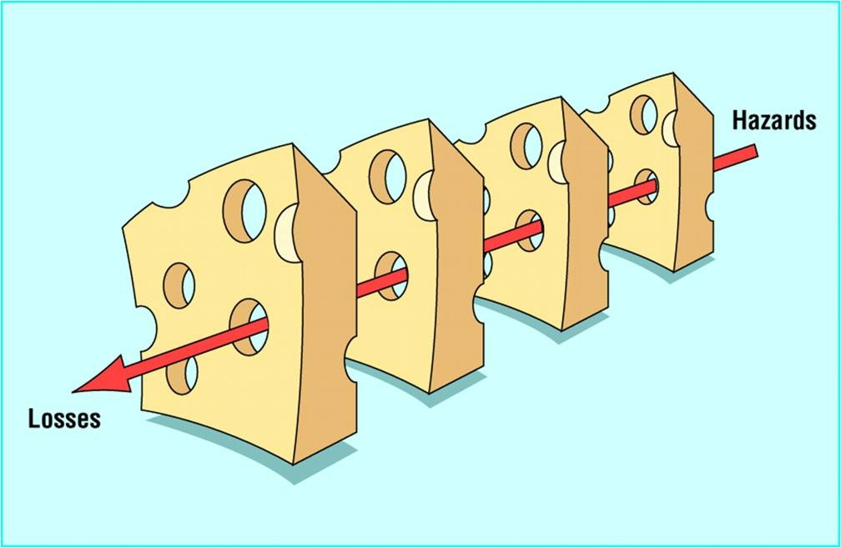
How Defects Impact Patient Harm⁶
As seen in CUSP®
Excerpted from the “Swiss Cheese” Model – James Reason, 1990. Reason J. Human Error. Cambridge: University Press; 1990.
Notes:
SAY:
When combating defects in the facility, it is important for the staff to understand where and how breakdowns in safety occur. The Swiss cheese model portrays how defects permeate the unit-level systems and contribute to patient harm. The cheese itself represents the unit-level systems, and the holes symbolize the opportunities for defects to permeate established systems and cause patient harm. Bearing this in mind, staff members are responsible for being aware of their patients and the environment to prevent defects from permeating their systems and contributing to patient harm.

Slide 38
Tools To Identify and Learn From Defects
As seen in CUSP®
Learning from Defects Form
Staff Safety Assessment
Safety Issues Worksheet for Senior Executive Partnership
Root Cause Analysis
Other Tools Used in Your Facility²
Notes:
SAY:
Many tools are available to identify and learn from defects. Some of these are available in the CUSP Toolkit on AHRQ’S Web site at http://www.ahrq.gov/professionals/education/curriculum-tools/cusptoolkit/toolkit/learndefects.html.
ASK:
Do you use any of these tools currently?

Slide 39
Learn From Defects: 4 Questions²
As seen in CUSP®
1. What happened?
2. Why did it happen?
3. What will you do to reduce the risk of recurrence?
4. How will you know the risk is reduced?
Notes:
SAY:
When learning from defects, the following questions should be used to guide the assessment and understanding of the event.
What happened?
Step 1. Reconstruct the timeline to understand what happened.
Step 2. Put yourself in the place of those involved and in the middle of the event as it was unfolding.
Step 3. Try to understand the thinking and reasoning behind their actions and decisions.
Step 4. Try to view the world as they did when the event occurred.
Why did it happen?
Step 1. Visualize the factors that led to the event.
Step 2. Identify the contributing factors.
Step 3. Prioritize the contributing factors.
What will you do to reduce the risk of recurrence?
Step 1. Develop interventions for two to five of the most important factors.
Step 2. Rate the interventions.
Step 3. Select the highest rated interventions.
Step 4. Develop an action plan for implementation.
How will you know the risk is reduced?
Question 1. Did you create a policy or procedure (rate strong or weak)?
Question 2. Do staff members know about the policy or procedure?
Question 3. Are staff members using the procedure as intended?
Question 4. Do staff members believe risks were reduced?
DO:
Select one of the defects from the “Undermining a Culture of Safety” video. Using this defect, walk through the process above with your team.

Slide 40
Examples of Defects in Dialysis Facilities
Defect | Intervention
Patient Care Technician (PCT) is unable to find cannulation site with his gloves on. PCT removes his gloves and palpates the site and then proceeds to insert the needle without hand hygiene or re-gloving. | Staff should be instructed to never remove gloves when cannulating. If the staff member is unable to identify a site for cannulation, request assistance from an expert cannulator.
Catheters used routinely by facility due to staff preference. | Train staff on benefits of fistula use and proper fistula cannulation techniques.
Alcohol-based hand rub (AHBR) is not being used after glove removal. | Place AHBR dispensers near trashcans and gloves to make it readily available.
Notes:
SAY: Anything that places the patient at risk of an avoidable harm is considered a defect in the system. For instance, alcohol-based hand rub not being used after glove removal is a defect. Some harms are unavoidable. Many others are avoidable. Near misses should be examined as closely as actual harms. Ask yourselves, how did we get this close to a harm, not, how did we manage to avoid it? It’s easier to talk about near misses because they often occur more frequently, are less sensitive and more proactive, and do not lead to immediately visible harms. Learning from these defects can result in interventions that improve patient safety in your facility. For instance, this slides lists through examples of defects along with interventions determined by using a Learning from Defects process.

Slide 41
Using the NOTICE Tools To—
Standardize
Create independent checks
Learn from defects
Notes:
SAY:
Decreasing bloodstream infections in the dialysis unit is a challenge. Because our patients deserve the best care possible, it is a challenge that needs to be addressed. NOTICE tools can help you.
ASK:
Which of these tools would you like to use in your facility?
DO:
Select a tool to use in your facility in the next month. Set a date and place to introduce the tool to staff.

Slide 42
References
U.S. Department of Health and Human Services, U.S. Department of Defense, U.S. Department of Veterans Affairs. End-Stage Renal Disease Facilities. In: National Action Plan To Prevent Healthcare-Associated Infections: Roadmap to Elimination. Washington, D.C.:U.S. Department of Health and Human Services; 2013. http://www.health.gov/hai/pdfs/hai-action-plan-esrd.pdf. Accessed September 3, 2014.
Agency for Healthcare Research and Quality. Understand the Science of Safety module, CUSP Toolkit. http://www.ahrq.gov/professionals/education/curriculum-tools/cusptoolkit/modules/understand/scisafetyslides.html. Accessed September 3, 2014.
Gawande A. The Checklist Manifesto: How to Get Things Right. New York: Metropolitan Books; 2010.
Health Research and Educational Trust, Renal Network of the Upper Midwest, Inc., University of Michigan Kidney Epidemiology and Cost Center. National Opportunity to Improve Infection Control in ESRD Final Report. Chicago: Health Research and Educational Trust; 2012.
World Health Organization Guidelines on Hand Hygiene in Health Care: First Global Patient Safety Challenge , Clean Care is Safer Care. Geneva, Switzerland: World Health Organization; 2009. http://whqlibdoc.who.int/publications/2009/9789241597906_eng.pdf. Accessed September 3, 2014.
Pronovost PJ, Wu AW, Sexton JB. Acute Decompensation after Removing a Central Line: Practical Approaches to Increasing Safety in the Intensive Care Unit. Annals of Internal Medicine. 2004 June;140(12): 1025-1033. PMID: 15197020.

