Slide 1
Antibiotic Stewardship
AHRQ Pub. No. 16(17)-0003-22-EF
March 2017
Notes:
Welcome to today’s educational session on antibiotic stewardship. This module is part of the Agency for Healthcare Research and Quality (or AHRQ) Safety Program for Long-Term Care that addresses Healthcare-Associated Infections (or HAIs) and Catheter-Associated Urinary Tract Infections (or CAUTI).
This education session was designed with all long-term care facility staff in mind, because every team member is important in helping make your long-term care facility a safe place to live and work!

Slide 2
Objectives
Upon completion of this webinar, participants will be able to—
  Describe how antibiotic stewardship is linked to infection prevention;
  Explain how overtreating urinary tract infections (UTI) and catheter-associated urinary tract infections (CAUTI) can contribute to microbial resistance burden; and
  List the core elements of executing an antibiotic stewardship program.
Notes:
Upon completion of this webinar, participants will be able to:
Describe how antibiotic stewardship is linked to infection prevention;
Explain how over-treating urinary tract infections (UTI) and catheter-associated urinary tract infections (CAUTI) can contribute to microbial resistance burden; and
List the core elements of executing an antibiotic stewardship program.

Slide 3

Antimicrobial Resistance is a Growing Problem¹
Every year 2 million people get sick with antibiotic-resistant infections
Every year 23,000 die from antibiotic-resistant infections
Costs as much as $20 billion in direct health care expenses per year
Source: Centers for Disease Control and Prevention. Antibiotic Resistance Threats in the United States, 2013.
Notes:
Antibiotic resistance is a growing problem. Every year 2 million people get sick with antibiotic-resistant infections and about 23,000 of these people will die from their resistant infections.
Antibiotic resistance costs as much as $20 billion in direct health care expenses per year.

Slide 4
Antimicrobial Resistance in Long-Term Care (LTC)^{2,3}
A 2013 MMWR report found that carbapenem-resistant Enterobacteriaceae prevalence was higher in long-term acute-care hospitals than in acute-care hospitals (17.8% vs. 4.6%)
Healthcare-associated Clostridium difficile often originates in long-term care
Notes:
The reason we care so much about preventing antibiotic resistance in long-term care is that long-term care facilities seem to be the source for many of the highly resistant strains we are now seeing in acute care. And we care about antibiotic stewardship in long-term care because our residents are suffering ill effects of excessive antibiotic use—roughly a third of healthcare-associated C. diff originates in long-term care.

Slide 5
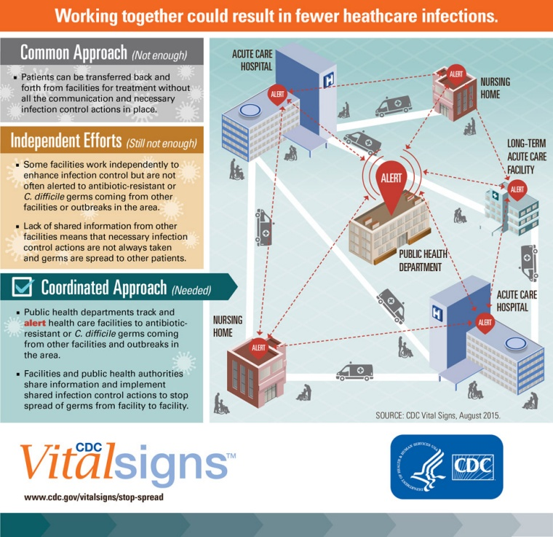
Long-Term Care Is Critical in the Fight⁴
Source: Centers for Disease Control and Prevention. “Making Health Care Safer: Stop Spread of Antibiotic Resistance.” CDC Vital Signs. August 2015.
Notes:
Long-term care is critical in the fight to stop the rise of resistant bacteria.
Here’s why we need a coordinated approach. The resistant bacteria are being transferred back and forth between health care facilities along with the patients. Simply doing screening on patients in acute care facilities is not enough—long-term care facilities need to be able to alert acute care facilities when sending a resident who has a very resistant organism, and at the same time, long-term care facilities need to know when they are going to bring in a resident who has acquired some bacteria in the hospital that can endanger other residents. That’s why we need a unified alerting system, and long-term care needs to be at the table to develop this innovation.

Slide 6
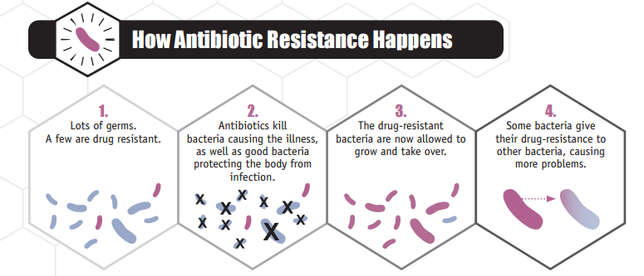
Problem Statement⁵
Source: Centers for Disease Control and Prevention. Antibiotic Resistance Threats in the United States, 2013.
Up to 70% of residents in a nursing home receive one or more courses of antibiotics every year
Between 40 and 70% of antibiotic use in nursing homes is inappropriate
Inappropriate and unnecessary antibiotic use can lead to the selection of resistant pathogens
Notes:
Here’s how antibiotic resistance develops. In field 1, we can see a bunch of bacteria, much like what is in the normal human gut. If you give the resident antibiotics, only a few bacteria survive—and these tend to be resistant to that antibiotic. These resistant bacteria multiply and take over. Even worse, in panel 4, the resistant bacteria share their resistance traits with other bacteria, now making them resistant too. This can also happen in the human intestine. Every course of antibiotics carries these risks—and nursing home residents get a lot of antibiotics each year. Many of these rounds of antibiotics are unnecessary. And that is why we are talking about antibiotic stewardship today. We are learning when to give antibiotics and when to withhold antibiotics.

Slide 7

Antibiotic Use in LTC Facilities⁶⁻⁹
Antibiotics are frequently used in long-term care
  They comprise about 40% of all prescriptions
Antibiotics can cause harm to residents
  High risk of side effects and adverse events
  Major risk factor for Clostridium difficile infection
  Driver of antibiotic resistance
Prescribers often not on site and rely on assessments made by other staff
  67% of antibiotics were ordered over the phone
Limited documentation of the assessments and rationale for antibiotic use
  43% of LTC-initiated antibiotic courses have no documentation of infection
Notes:
We tend to think of antibiotics as good or helpful. But we tend to forget the side effects of antibiotics that can be harmful: allergic reactions, rashes, diarrhea, C. diff diarrhea, and the onset of resistant bacteria. The common practice of requesting antibiotic orders over the phone can lead to inappropriate use. Also, documentation about why antibiotics are used in long-term care is spotty. Improving documentation for the rationale for antibiotic use is an important step toward more effective use of antibiotics.

Slide 8
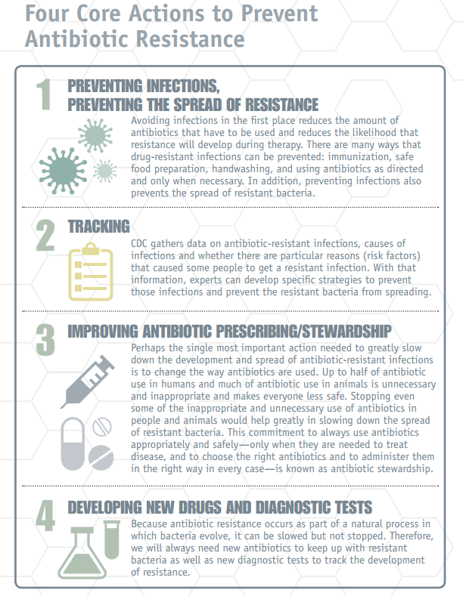
Fighting Back Against Antibiotic Resistance¹
Infection prevention IS antibiotic stewardship!
Tracking infection prevention data has double value
  HAI prevention
  Informs antibiotic stewardship programs
Improving antibiotic prescribing
Bacteria are constantly evolving, requiring the need for new antibiotics
Source: Centers for Disease Control and Prevention. Antibiotic Resistance Threats in the United States, 2013.
Notes:
How can we fight back against antibiotic resistance? The Centers for Disease Control and Prevention, or CDC, devised four key strategies to combat resistance.
[CLICK]
First, preventing infections prevents the spread of resistance. By participating in this program, you are taking the key step to prevent antimicrobial resistance. Fewer CAUTIs mean fewer courses of antibiotics, and that in turn means fewer chances for bacteria to become resistant to antibiotics.
[CLICK]
Second—tracking. The CDC gathers data on antibiotic-resistant infections and works with experts to develop specific strategies to prevent those infections and prevent resistant bacteria from spreading. Through this program, you should be tracking and reporting CAUTI, catheter use and urine cultures. These data are also important to antimicrobial stewardship. So your surveillance work has double value—preventing CAUT, and informing antimicrobial stewardship programs.
[CLICK]
Third—improving antibiotic prescribing and stewardship. Changing the way we use antibiotics is probably the most important step to fight resistance. Through this program you may have learned about not ordering and collecting a urine culture unless a resident has signs or symptoms of a CAUTI or UTI. Avoiding unnecessary testing, such as urine cultures, is part of antibiotic stewardship.
[CLICK]
Fourth—developing new drugs and tests. Bacteria are constantly evolving; we can only slow their evolution, we can’t stop it. Therefore, we need new antibiotics to keep up with the changing bacteria. While developing new drugs is beyond the scope of our project, it is still important to understand this need.
We will spend the rest of this module discussing strategies to promote antibiotic stewardship in long-term care.

Slide 9
Goals of Antibiotic Stewardship⁵
What is antibiotic stewardship?
Antibiotic stewardship refers to a set of commitments and activities designed to “optimize the treatment of infections while reducing the adverse events associated with antibiotic use.”
    The goal is…
      to have the RIGHT DRUG
      for the RIGHT PERSON
      over the RIGHT TIME FRAME
Notes:
So what is antibiotic stewardship?
[CLICK]
Antibiotic stewardship is a set of commitments and activities designed to optimize the treatment of infections while reducing the harmful events that can be associated with antibiotic use.
[CLICK]
Basically, it is having the right drug, for the right person, over the right time frame.

Slide 10
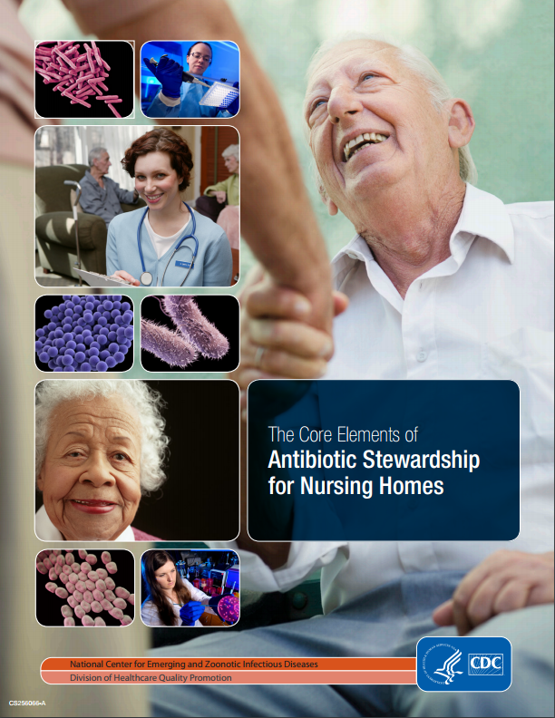
CDC’s Core Elements of Antibiotic Stewardship for Nursing Homes⁵
Leadership Commitment: Dedicate resources
Accountability: Appoint a leader responsible for implementation
Drug Expertise: Appoint a pharmacist leader
Actions To Improve Use: Implement at least one recommended action
Tracking: Monitor antibiotic prescribing and resistance patterns
Reporting: Regular report on antibiotic use and resistance
Education: Train staff, residents, and families about resistance and optimal prescribing
Source: Centers for Disease Control and Prevention. The Core Elements of Antibiotic Stewardship for Nursing Homes. 2015.
Notes:
The CDC developed seven core elements to help nursing homes and long-term care facilities implement successful antibiotic stewardship programs.
These elements are
Leadership Commitment,
Accountability,
Drug Expertise,
Actions to Improve Use,
Tracking,
Reporting and
Education.
Your facility may have already begun implementing these core elements to improve your antibiotic stewardship program.

Slide 11
CDC Core Elements: Education¹⁰
Engage and educate residents and families on antibiotic stewardship efforts
  Interactive, face-to-face education has the strongest evidence for improving antibiotic stewardship knowledge
Effective communication is
  Complete
  Clear
  Brief
  Timely
Notes:
As members of the frontline care team you play a crucial role in the element of education. Sometimes residents and families can be the ones driving inappropriate antibiotic use. Engaging and educating residents and families is a crucial part of a successful stewardship program. Interactive, face-to face education has the strongest evidence for improving perceptions.
Remember, effective communication should be complete, clear, brief, and timely.

Slide 12

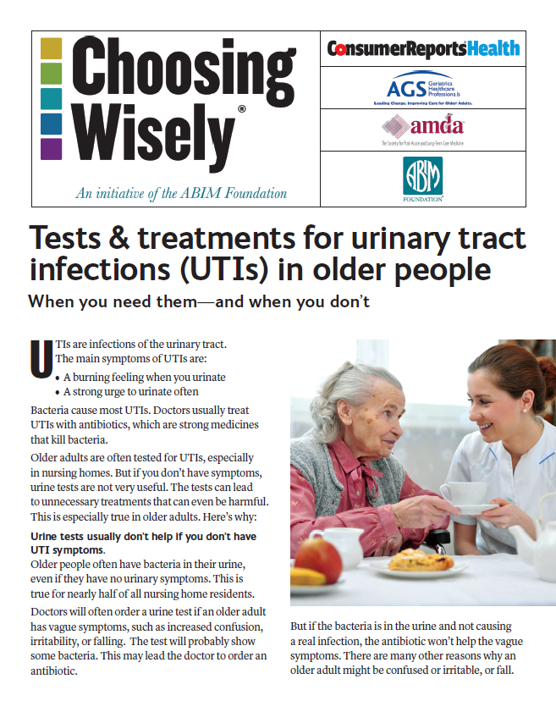
Communication to Enhance Antibiotic Stewardship¹⁰⁻¹²
Consider using TeamSTEPPS communication strategies to standardize communication about antibiotic use
  S – Situation
  B – Background
  A – Assessment
  R – Recommendation
Source: Consumer Voice
Source: Choosing Wisely
Notes:
Consider using TeamSTEPPS communication strategies to standardize communication about antibiotic use. Using SBAR will help ensure that all of the necessary information is being communicated in a way that is easy and straightforward for the resident and his or her family to follow.
During your communication consider having a brochure ready to provide more information about the potential harm of prescribing antibiotics if they are not medically necessary.

Slide 13
Stay Updated with Useful Resources
TeamSTEPPS® for Long-term Care
CDC’s Antibiotic Resistance Threats in the United States, 2013
CDC’s The Core Elements of Antibiotic Stewardship for Nursing Homes
Consumer Voice’s CAUTI Informational Brochure
AHRQ SAFETY PROGRAM FOR LONG-TERM CARE: HAIs/CAUTI
Notes:
As we wrap up today’s discussion, I’d like to thank you for your time and attention to this program and for working to make your long-term care facility a safer place for residents, family members and staff.
The following resources are available to you as participants in this program. We hope that these resources will be useful as you help your facility improve its antibiotic stewardship and prevention of HAI/CAUTIs.
Thank you again for participating in this training. Have a great rest of your day.

Slide 14
References
Antibiotic Resistance Threats in the United States, 2013. Centers for Disease Control and Prevention (CDC). U.S. Department of Health and Human Services. Accessible at: http://www.cdc.gov/drugresistance/pdf/ar-threats-2013-508.pdf
CDC. Vital Signs: Carbapenem-Resistant Enterobacteriaceae. MMWR Morb Mortal Wkly Rep. 2013; 62 (9): 165-70.
Lessa FC, Mu Y, Bamberg WM, et al. Burden of Clostridium difficile Infection in the United States. N Engl J Med 2015; 372: 825-834. DOI: 10.1056/NEJMoa1408913
Stop Spread of Antibiotic Resistance. August 2015. Making Health Care Safer –CDC Vital Signs. Centers for Disease Control and Prevention. http://www.cdc.gov/vitalsigns/pdf/2015-08-vitalsigns.pdf
CDC. The Core Elements of Antibiotic Stewardship for Nursing Homes. Atlanta, GA: US Department of Health and Human Services, CDC; 2015. Available at: http://www.cdc.gov/longtermcare/index.html
Benoit SR, Nsa W, Richards CL, et al. Factors Associate with Antimicrobial Use in Nursing Homes: A Multilevel Model. JAGS 2008; 56: 2039-44. DOI: 10.1111/j.1532-5415.2008.01967.x.
Daneman N, Grunir A, Bronskill SE, et al. Prolonged Antibiotic Treatment in Long-term Care. Role of the Prescriber. JAMA Intern. Med. 2013; 173: 673-82.
Nicolle LE, Bentley DW, Garibaldi R, et al. Antimicrobial Use in Long-Term –Care Facilities. Infect Control Hosp Epidwmiol 2000; 21 (8): 537-545.
Richards CL, Darrandji M, Weinberg DM, et al. Antimicrobial Use in Post-Acute Care: A Retrospective Descriptive Analysis in Seven Long-Term Care Facilities in Georgia. J Am Med Dir Assoc. 2005; 6 (2): 109-12.
TeamSTEPPS® Long-Term Care Version. Content last reviewed September 2015. Agency for Healthcare Research and Quality, Rockville, MD. http://www.ahrq.gov/professionals/education/curriculum-tools/teamstepps/longtermcare/index.html. Accessed on August 22, 2016.
Choosing Wisely. Tests & treatments for urinary tract infections (UTIs) in older people. 2014 Consumer Reports. Developed in cooperation with the AMDA: The Society for Post-Acute and Long-Term Care Medicine and The American Geriatrics Society. https://www.choosingwisely.org/wp-content/uploads/2018/02/Tests-And-Treatments-For-Urinary-Tract-Infections-In-Older-People-AGSAMDA.pdf
Consumer Voice. CAUTI Informational Brochure. 2016. National Consumer Voice for Quality Long-Term Care. http://theconsumervoice.org/issues/other-issues-and-resources/infection-prevention.

