Slide 1
Designing & Delivering Whole-Person Transitional Care The Hospital Guide to Reducing Medicaid Readmissions
Webinar 4: Implement Whole-Person Transitional Care for All

Slide 2
Agenda
Describe the guidance and proposed changes to the CMS Discharge Planning Conditions of Participation
Identify the ways in which the guidance and proposed changes to CMS Discharge Planning expectations promote “whole-person” transitional care and are relevant to Medicaid patients
Share tools from the Guide to support improving “whole-person” transitional care

Slide 3
Objectives
Understand that hospitals should improve transitional care processes in ways that apply to all patients, regardless of risk
Understand that all hospitalized patients should be assessed for readmission risks and transitional care needs
Identify ways to implement improved care processes for all

Slide 4
Table of Contents
Introduction
Why focus on Medicaid Readmissions?
How to Use This Guide
Analyze Your Data
Survey Your Current Readmission Reduction Efforts
Plan a Multi-Faceted Data-Informed Portfolio of Strategies
Implement Whole-Person Transitional Care for All
Reach Out to Collaborate With Cross-Continuum Providers
Enhance Services for High-Risk Patients

Slide 5
List of Tools
The guide comes with 13 customizable tools to be used in hospital teams’ day-to-day operations.
Data Analysis
Readmission Review
Hospital Inventory
Community Inventory
Portfolio Design
Operational Dashboard
Portfolio Presentation
Conditions of Participation Handout
Whole-Person Transitional Care Planning
Discharge Process Checklist
Community Resource Guide
Cross Continuum Collaboration
ED Care Plan Examples

Slide 6
The ASPIRE Framework

Slide 7
Understand evolving guidance and requirements
Use these as your blueprint to improve standard care

Slide 8
Improving Standard Processes for All Patients
Identify all patients at high-risk of readmission
Assess all patients for clinical, behavioral and social needs
Communicate with patients simply and effectively
Link patients to follow-up and post-hospital services
Provide real-time information to receiving providers
Ensure timely post-discharge contact
AND
Have a process
Track, trend and review readmissions
Continuously improve the process to better meet needs

Slide 9
Excerpts from Recent CMS Guidance and Proposal
Have a written discharge process approved by governing body
Analyze and track readmissions
Review readmissions and look for patterns
Regularly review and improve the discharge processes
Every patient in inpatient or observation needs a discharge plan
Actively solicit the preferences of the patient and family/friends/support person
The plan must be able to be realistically implemented
Address behavioral health follow up as part of the discharge plan
Provide customized education
Provider verbalized instructions, using the teach-back technique
Know capabilities community based providers – including Medicaid home and community based services
Know options for Medicaid long term services and supports or have a contact at Medicaid who can help
Provide patients with data to inform their choice of post-acute providers
Transmit discharge summaries within 48 hours of discharge
Follow up with patients at high risk of readmission

Slide 10
New York Medicaid Transition of Care Process Excerpts from the New York Medicaid “DSRIP Toolkit”
Have a transition of care process in place
Partner with MCOs, community and social service agencies
Notify patient and partners of discharge early
Allow transitional care providers to visit patient while in the hospital
Ensure timely communication with providers
Establish and track patients during a 30-day transition of care period
DSRIP = Delivery System Reform Incentive Program

Slide 11
Understand and Align Rules & Requirements
CMS Medicare & Medicaid Requirements | NY Delivery System Reform Incentive Program (DSRIP) Medicaid Requirements
Have a specified process | Have a specified process
All patients need discharge plan
Address behavioral health needs
Work with partners | Work with partners, including MCOs
Engage patients & caregivers | Notify patients & partners early
Use data to refer to post acute care
Effectively link to post hospital care | Allow partners to visit in-hospital
Communicate with PCP <48h | Communicate with PCP
Follow up with patient after d/c | Track patients for 30 day period
Review & improve process

Slide 12
Reflect on Current Practice: Still Rare to Do it All
Regional survey of hospitals found:
Variation across hospitals in practices targeting readmission reduction
Most hospitals use some method to identify readmission risk
Most hospitals working on patient education and medication
Few hospitals working on efforts to ensure follow-up
Few hospitals have processes to coordinate with community providers
Few hospitals working on efforts requiring shared accountability
Few hospitals track services delivered and outcomes after discharge

Slide 13
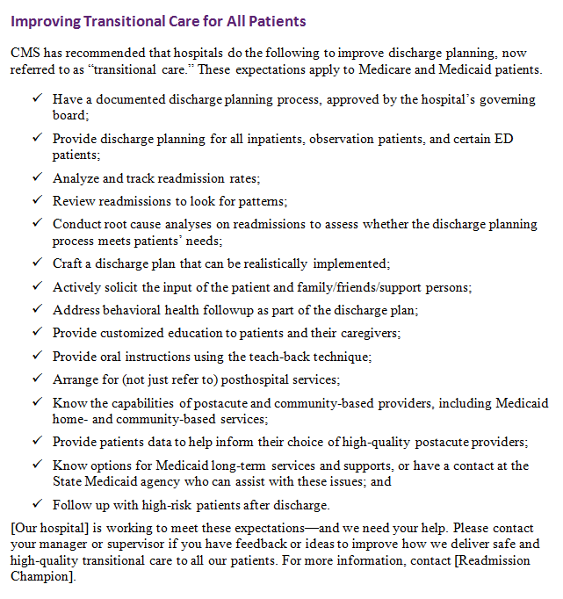

Slide 14
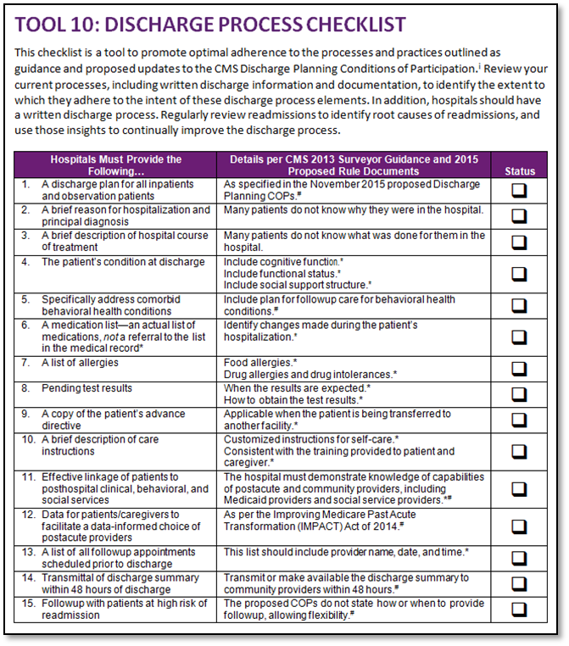

Slide 15
Screen for and address transitional care needs Identify and address needs for all; identify high-risk patients

Slide 16
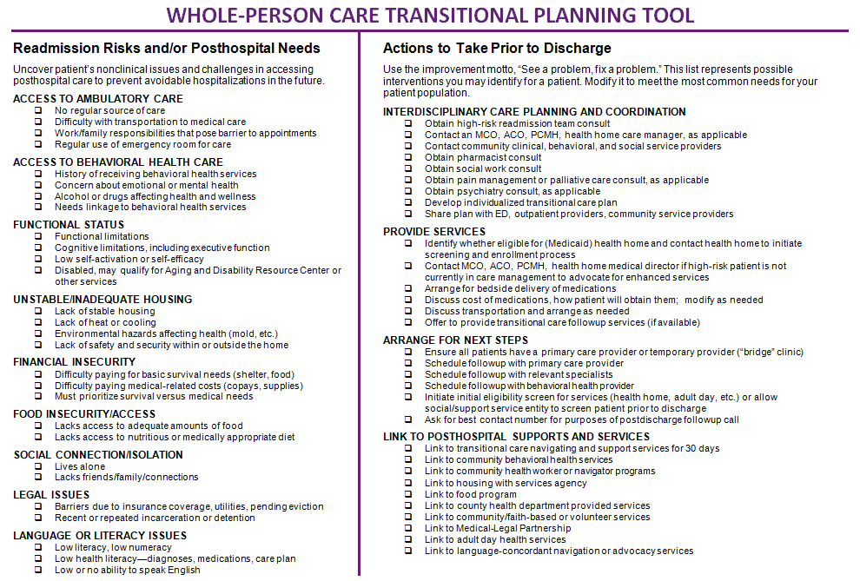
Whole-Person Transitional Care Planning

Slide 17
Implementation Tips: Standard Care
Use Whole-Person Transitional Care Planning Tool to review the assessments your staff already conduct
It is likely a significant percentage of these questions are asked by various hospital providers at some point; ensure information is in one place
Update your standard nursing, case management, discharge planning, and/or social work assessment to more consistently assess “whole-person needs” and Medicaid-relevant risks
Leverage electronic workflow prompts to promote efficiency (check boxes, clicks, review & confirm from prior events) and consistency

Slide 18
Remember to Ask “Why”

Slide 19
Implementation Tips: High-Risk
Use flags to identify patients with high-risk features on admission, based on your data analysis and root cause analysis
Personal history of repeated hospitalizations (based on a specific definition)
Personal history of a behavioral health diagnosis
Adult Medicaid patient (not admitted to an obstetrics unit)
Current admission diagnosis known to be high-risk (heart failure, sickle cell, etc.)
Leverage “high risk flags” to send alerts to staff
Push alerts to case managers, hospitalists, readmission team
Develop enhanced steps to follow for high risk patients (pharmacist med review, bedside delivery of medications, 48 hour follow-up contact, etc.)
Use alerts to identify “high risk” discharges per month for tracking and quality efforts
Analyze alerts: how many per day? Per month?
Analyze response to alerts: were the enhanced steps followed? How often?

Slide 20
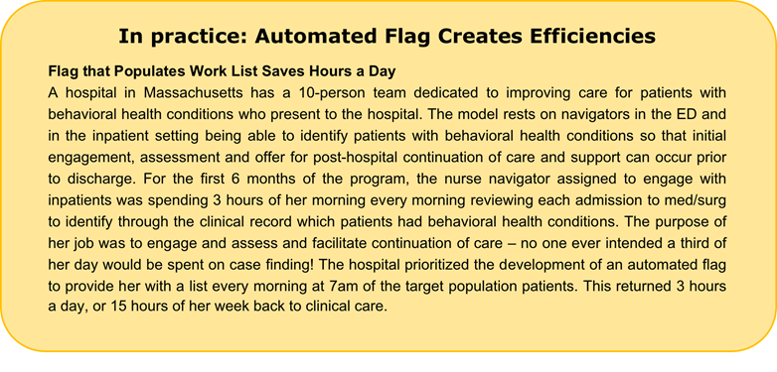

Slide 22
Reliably Implement Processes
The work of improving transitional care and reducing readmissions is the work of delivery system transformation: working to make standard, day-to-day processes more effective, efficient, high-quality and person-centered.
Tools that can help include:
Enabling tools and technologies
Written standard operating procedures
Updated work flow, roles, and responsibilities
Communication and training materials
Implementation measurement and feedback

Slide 23
Summary
Improve hospital based transitional care processes for all patients, including but not limited to patients identified as “high risk” of readmission
We emphasize the guidance and proposals from CMS because they represent Medicaid-relevant and whole-person enhancements to transitional care and apply to all
Reference tools and content in this guide to help your teams apply the CMS guidance in practice

Slide 24
Thank you for your commitment to reducing readmissions
Amy E. Boutwell, MD, MPP
Collaborative Healthcare Strategies
amy@collaborativehealthcarestrategies.com
Angel Bourgoin, PhD & Jim Maxwell, PhD
John Snow, Inc.
Angel_Burgoin@jsi.com; Jim_Maxwell@jsi.com

